Slide 1
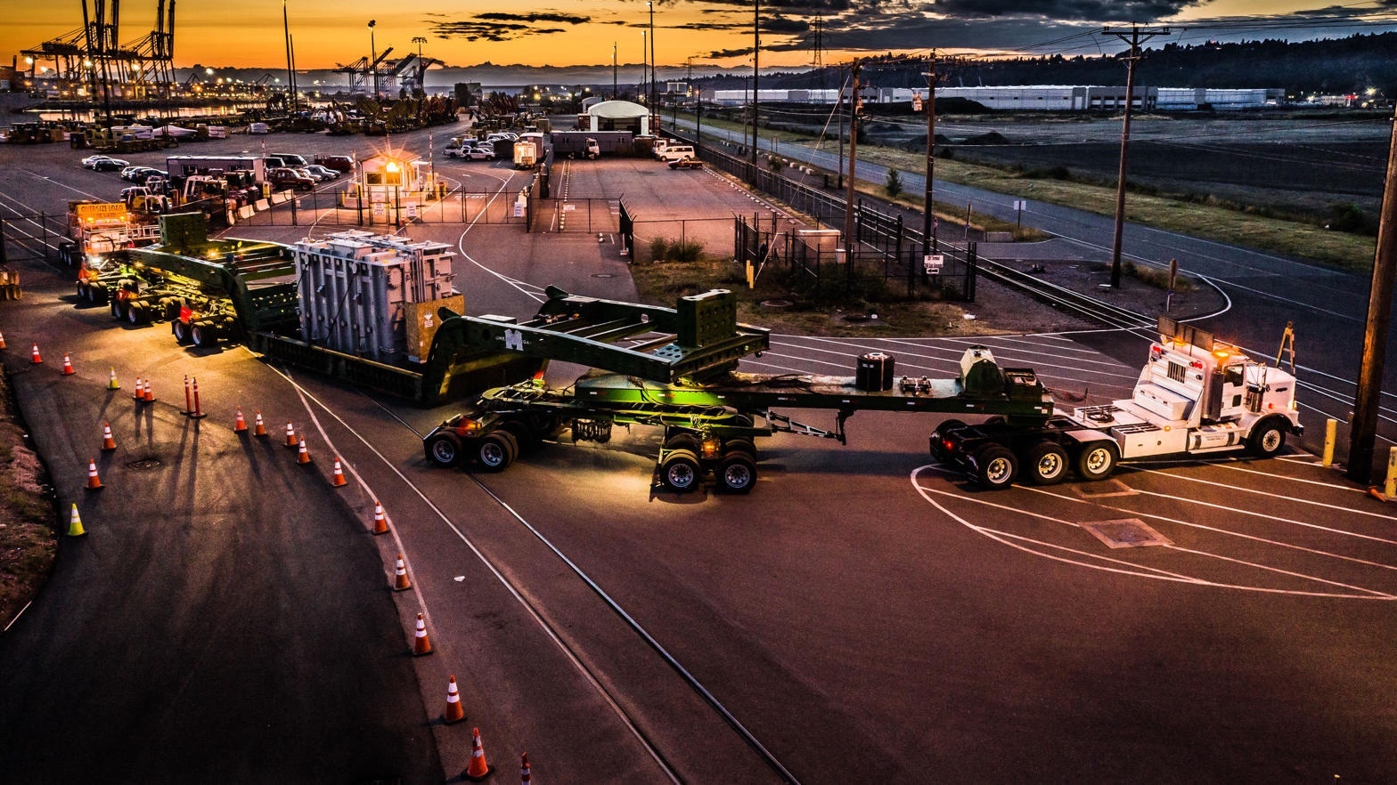

ROAD FREIGHT

Slide 2

ROAD FREIGHT

Slide 3
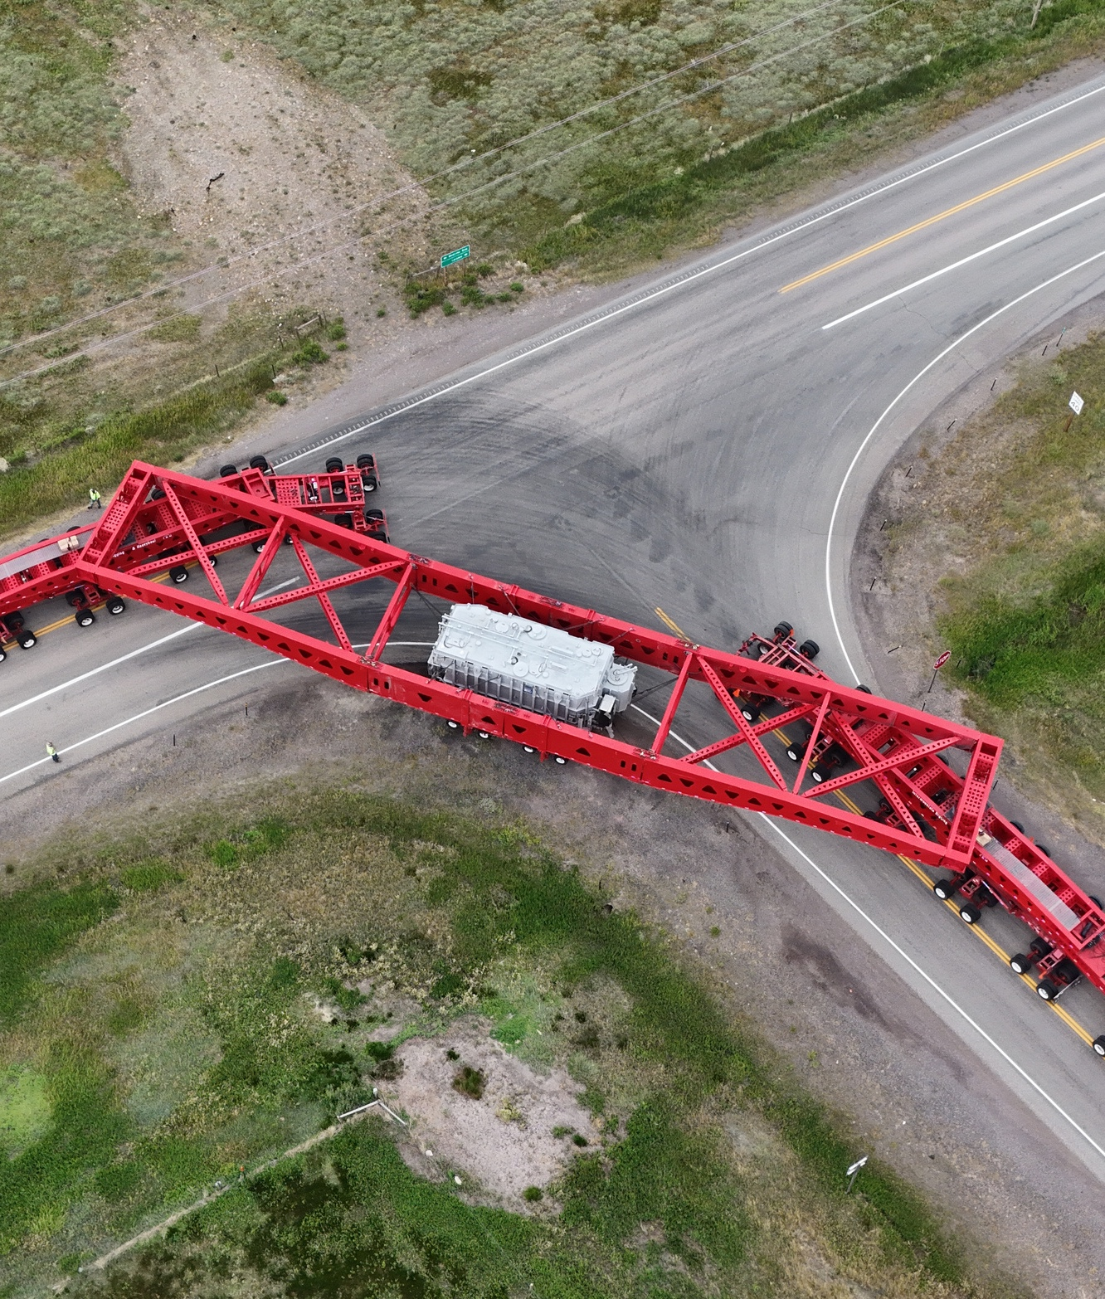


THE DRIVING FORCE BEHIND YOUR SUCCESS
Whether your destination is local, regional, national, cross-border, or international, Fracht knows the way!
Fracht ensures the safe and timely delivery of your goods, by road, thanks to a complete range of road freight solutions that allow us to meet the needs of your supply chain:
  National groupage (LTL) and full truckload (FTL) transport.
  Specialized transport (rolling stock, tankers, etc...).
  Cross-border transport.
  Intermodal transport.
  Oversized goods transport.
  Hotshot transport.
  Hazardous materials transport.
ROAD FREIGHT
120

Slide 4
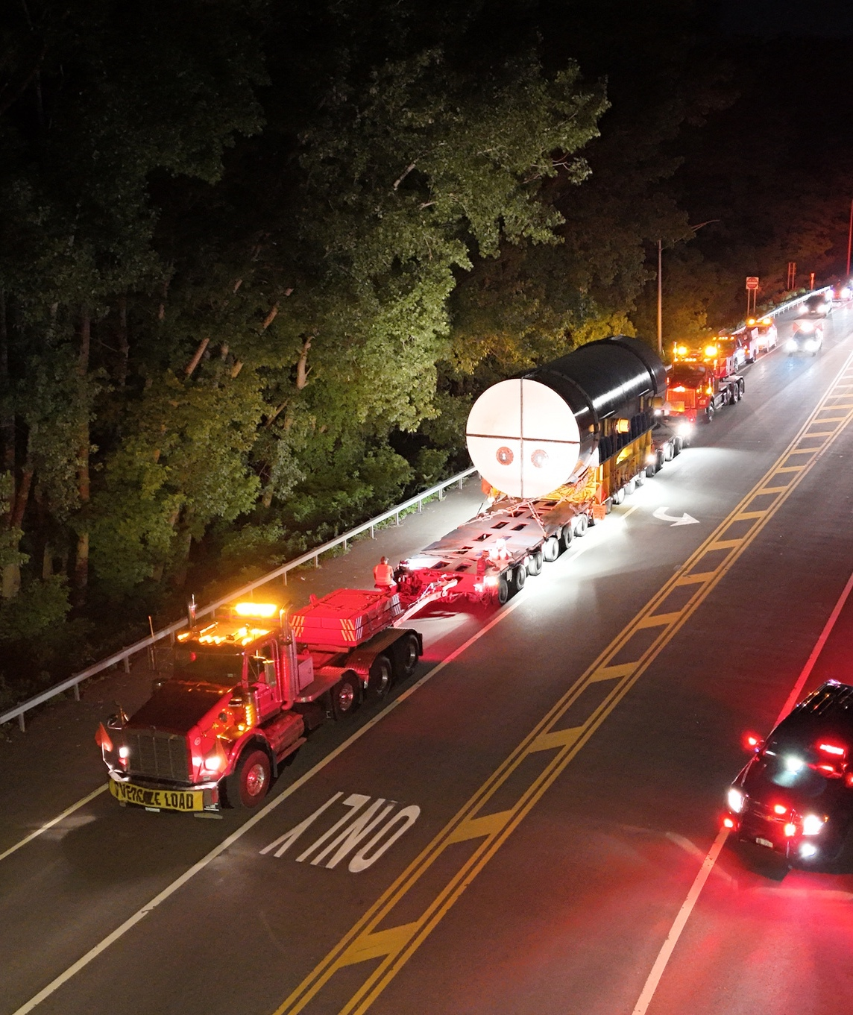
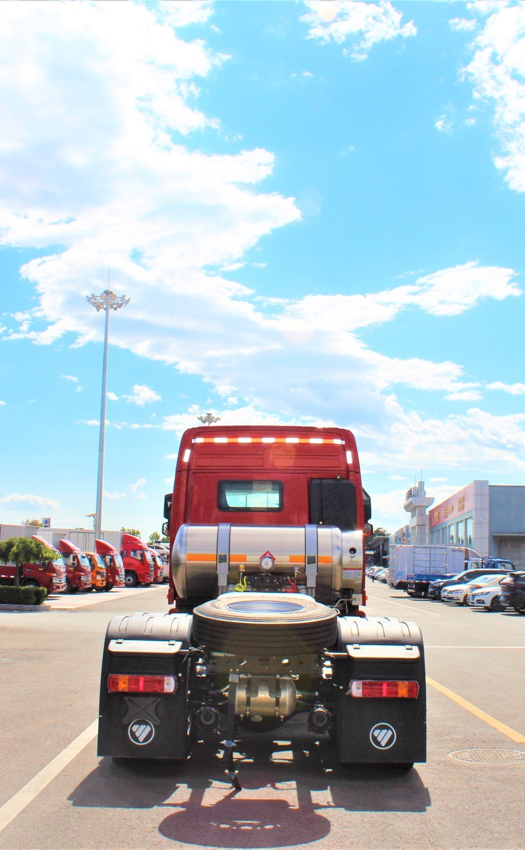

OPTIMIZE YOUR FREIGHT
Fracht’s over the road solutions not only allow you to transport your goods efficiently and accurately to the destination of your choice, but also optimize your supply chain by balancing speed and cost.
With freight cost optimization, professional carrier assessment, comprehensive tracking capabilities, and seamless communication with a single point of contact at Fracht, you can be sure your shipments are in good hands.
ROAD FREIGHT
121

Slide 5
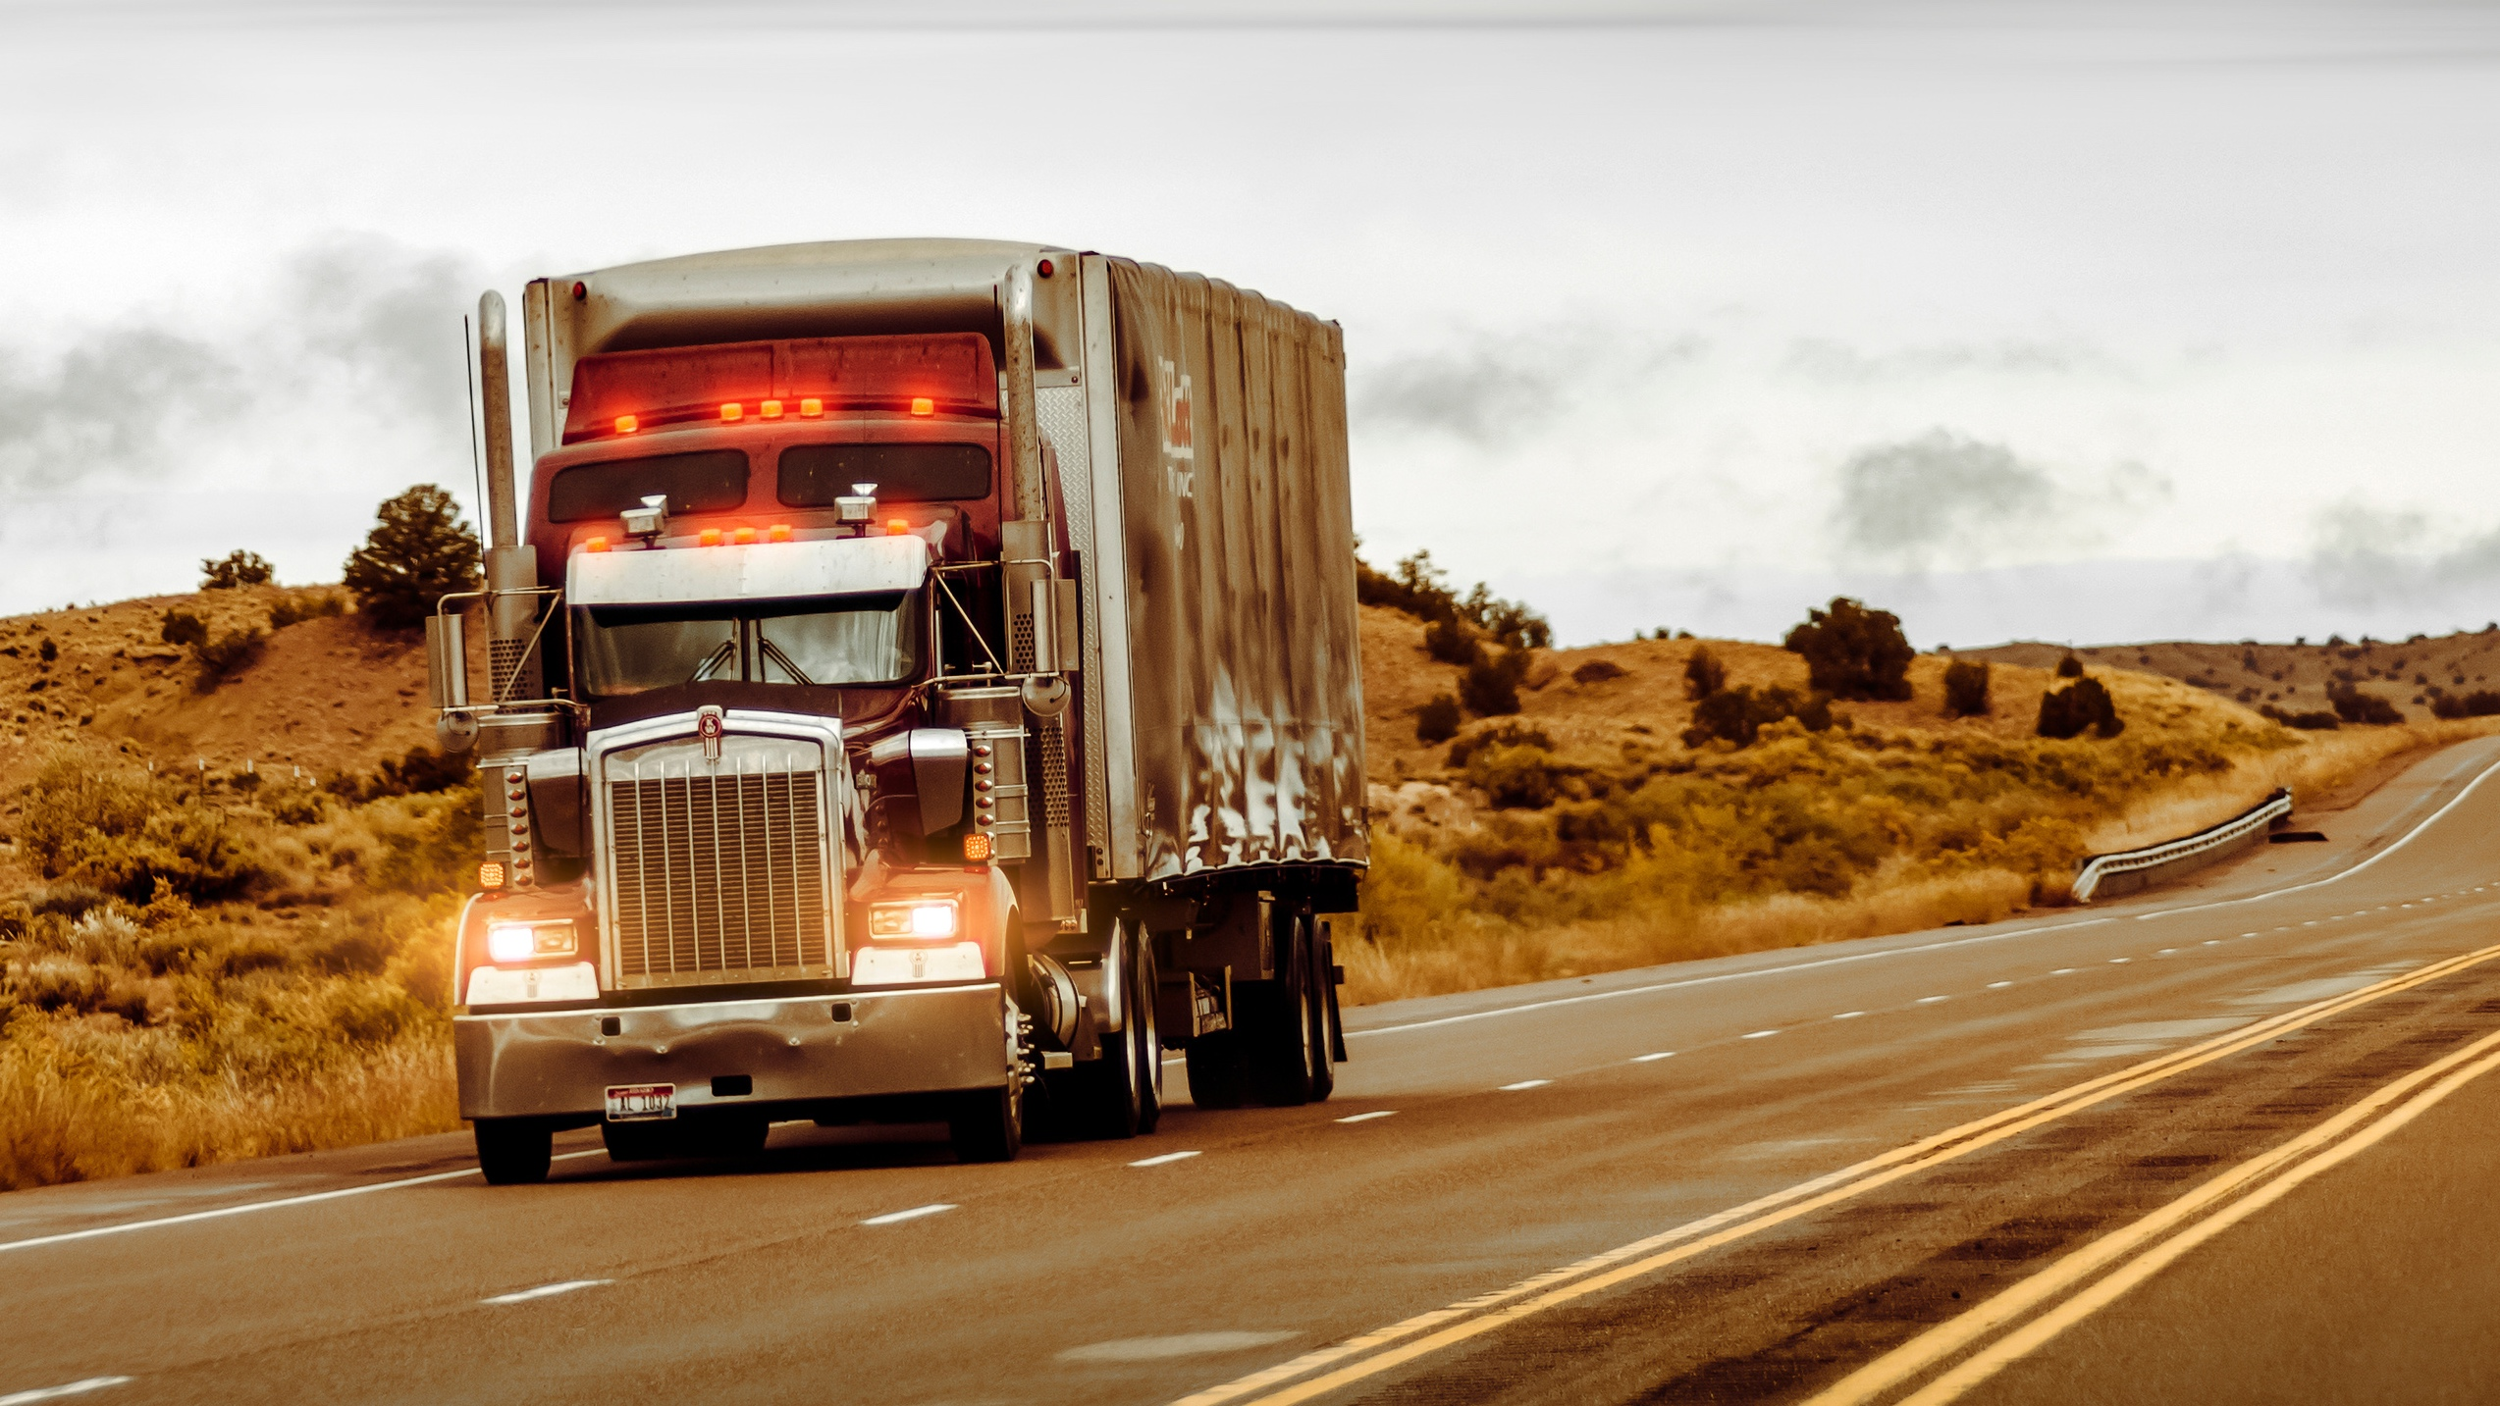

WHAT SOLUTIONS CAN WE PROVIDE FOR YOU?
www.frachtgroup.com

