Slide 1
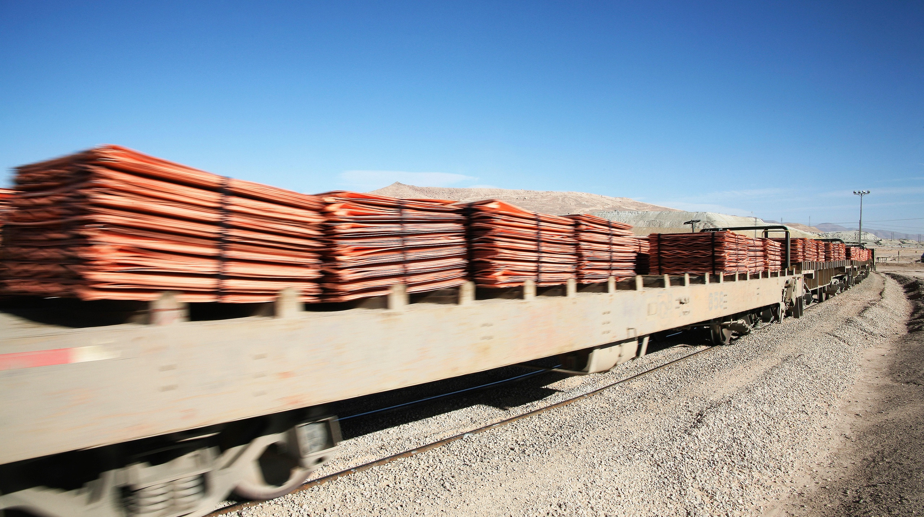

RAIL FREIGHT

Slide 2

RAIL FREIGHT

Slide 3
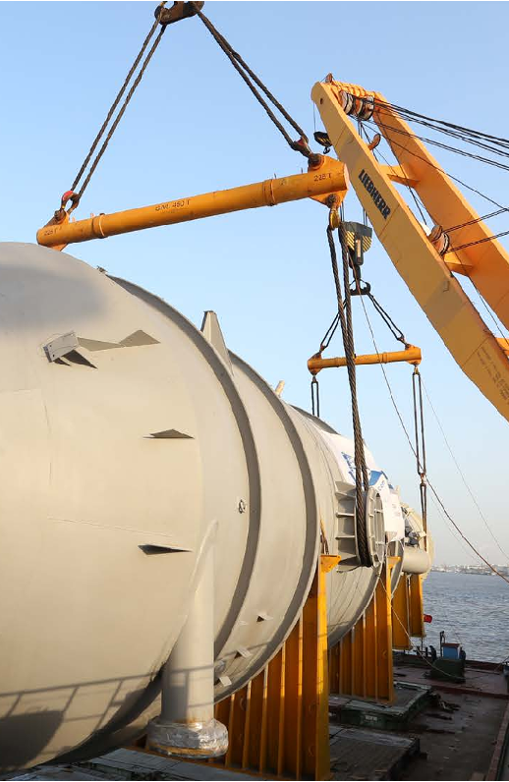


WHY RAIL FREIGHT FORWARDING?
How railfreight originally was like
When it comes to transporting Project Cargo, rail freight forwarding offers significant advantages. It provides cost and time savings, while accommodating heavy and oversized components that road freight cannot.
Originally, state railways were solid, strategical partners, who offered and performed.
SINGLE WAGONS
GROUPS OF WAGONS
BLOCK TRAINS
More and more state railways reduce their single wagon systems, even abolished them with a strategy of:
Making rail charges more and more expensive.
Closing rail stations and sidings (longer pre- and on-carriage).
Not expanding infrastructure.
Under these conditions and with the background of the growing importance of green logistics, that is supported by Mr. Reisdorf, we are forced to think about developing alternative solutions.
RAIL FREIGHT - EUROPE
102
102

Slide 4
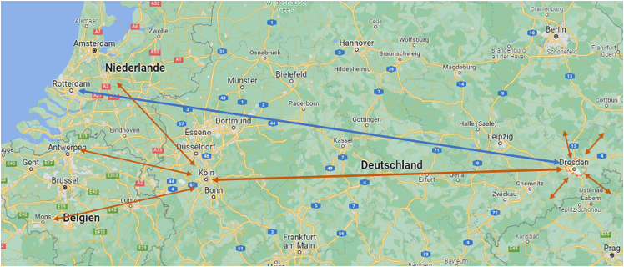
FRACHT AG – CREATING A TRAIN SYSTEM
STRONG PRIVATE PARTNERS
OUR INITIAL CONCEPT
Concentration on East-West-Bound - between area of Dresden (DE) and ARA ports.
Either direct routing or using transshipment terminals + pre- and on-carriage by truck.
Under inclusion of strategic partners on that route.
Use of conventional wagons and container wagons with cargo-specific equipment.
Types of wagon: 2x30ft / 2x40ft / 2x45ft / 80ft.
BASED ON PRIVATE SOLUTIONS
INDEPENDENT FROM STATE RAILWAYS
OBJECTIVES
Combine delivery quantities of different shippers + different kind of goods on one train.
Save truck capacities on the roads.
Make main route cheaper for the client.
Reduce CO2e footprint for the client.
RAIL FREIGHT - EUROPE
103

Slide 5
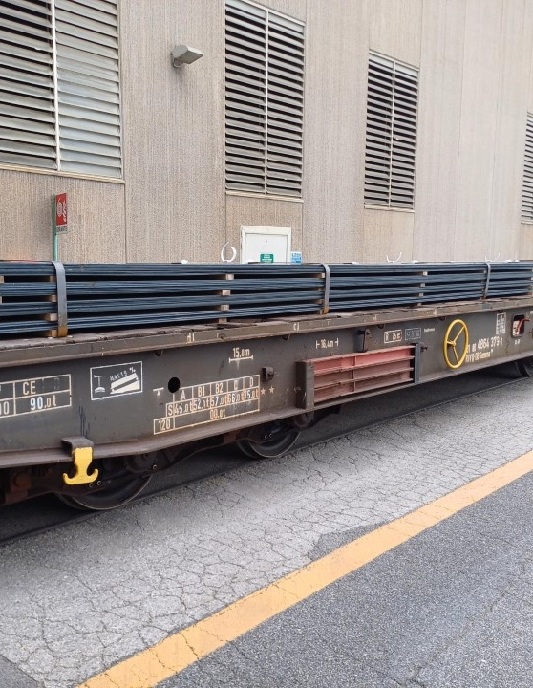

OUR STRATEGIC PARTNERS AND THEIR STRENGTHS
Private railways /
Wagon rental company
Sächsische Binnenhäfen
In contact with several well-known partners, e. g. Lineas, Captrain.
Strong on main route.
Checked offers for wagon rental.
Transshipment opportunities (Saxony + CZ).
Technical support (adaption of container / handling equipment).
Transwaggon GmbH
Innofreight GmbH
Partner for wagon rental.
1st step in project: already. running train between CZ and Rotterdam, NL.
Concept of container wagon + special equipment.
Developing customized solutions.
RAIL FREIGHT - EUROPE
104

Slide 6
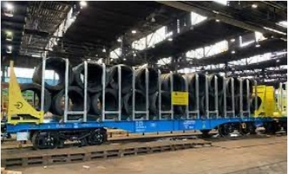
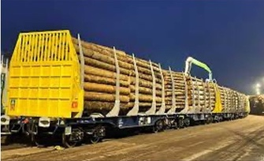
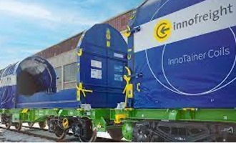
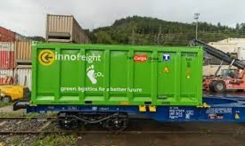
THE SYSTEM OF INNOFREIGHT GMBH
DIFFERENT EQUIPMENT
Development of heavy
lift pallet
Maneuver transports
Heavy and compact cargo
WireStanchion System
Wire rolls
Smart GigaWood
Logs
CoilPalette
Different coils
Standard Box Container
Any type of palletized cargo
ONE TYPE OF BASE WAGON
MORE EFFICIENT SYSTEM
RAIL FREIGHT - EUROPE
105

Slide 7
PARAMETERS AS THE BASIS FOR POTENTIAL ANALYSIS
CATEGORIES
QUANTITIES
TRAFFIC RELATIONS
EXCLUSION CRITERION
Concentration on
Steel (heavy, compact parts)
Concrete parts/ Building industry
Maneuver transports (contact to Nato/local army)
Palletized goods (e.g. beverage industry)
Continuous Quantities
min. 500 tons per week.
min. 1.000 tons per month.
20-30 truck loads per week.
Projects
min. 1.000 – 1.500 tons per shipment.
Distance
min. 300 km.
ideal scenario: > 800 km.
Uninteresting lanes
Traffic relations to seaports (container transports).
No cross-border traffic FR – ES.
UK bound traffic.
Exceedance of loading gauge
width max. 3,15 m
height depends on clearance profile and height of wagon floor (1,25 – 1,30 m)
loading gauges vary in certain countries (FAG CHE will check for you in detail)
RAIL FREIGHT - EUROPE
106

Slide 8
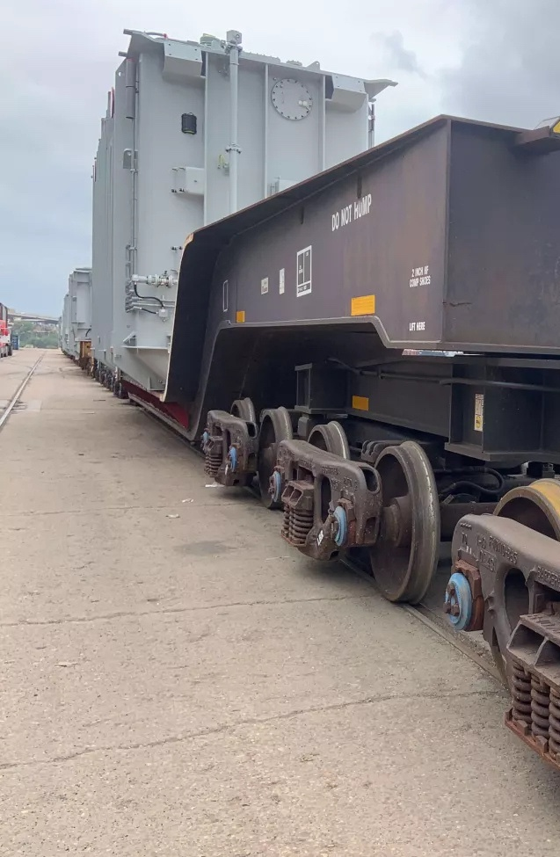
23
Fracht-owned Railcars
USA RAIL FREIGHT HIGHLIGHTS
Fracht USA has a designated rail team, consisting of in-house engineers and transport specialists.
The Fracht rail fleet has recently expanded, allowing us to deliver exciting new options for your transport needs.
50+
Includes 8-, 12-, and 16-axle flatcars, and a 20-axle depressed platform car.
The 12-axle “GO PINK” car stands ready for the most challenging projects.
Designed to handle cargo of any size or complexity.
Long-term Leased & Managed Railcars
At Fracht, our Houston-based rail team, consisting of engineers, supervisors, project managers, and coordinators, handles over 200 rail moves annually with a 100% success rate.
450+
Heavy Lifts in North America Annually
RAIL FREIGHT - NORTH AMERICA
107

Slide 9
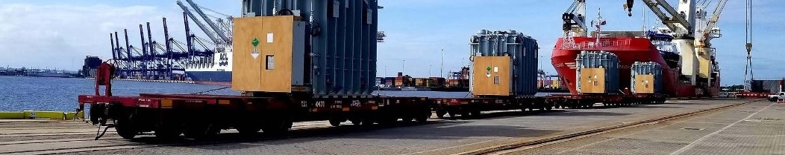
INNOVATION AND EXPERTISE
At Fracht, innovation and engineering expertise go hand in hand:
Railcars are made with T1 steel for lighter weight and greater efficiency.
Depressed deck designs ensure safe transport for taller cargo.
Solutions include counterweights and turntables for unconventional dimensions.
With over 100 years of combined experience and a 100% delivery success rate, we ensure that your shipment is handled with exceptional care and expertise.
RAIL FREIGHT - NORTH AMERICA
108

Slide 10
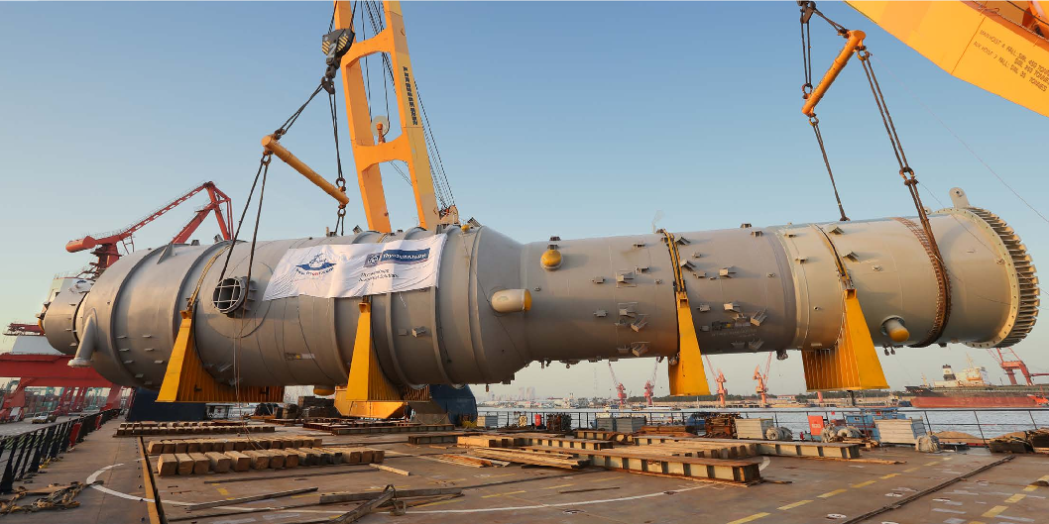
REFERENCES

Slide 11
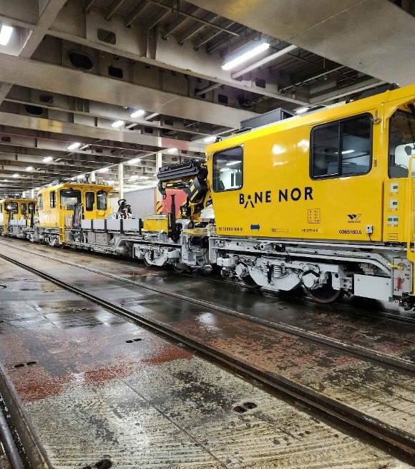
OUR REFERENCE
10 railcars for Norwegian railway
DIMENSIONS
Each 18,000 x 3,053 x 4.170 mm
Each 61 TO
Rheine, DE
Hokksund, NO
Rail
ORIGIN
DESTINATION
TRANSPORT MODES
First 3 railcars arrived in Norway on 2.11.2023. The remaining 7 will be delivered separately:
The Railcars have been towed from the origin via railway ferry to final destination.
Challenge was to get all needed permissions as the machines had only Norwegian registration.
RAIL FREIGHT
110

Slide 12
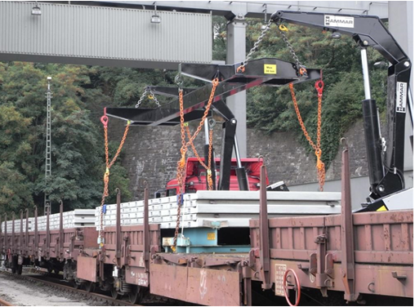
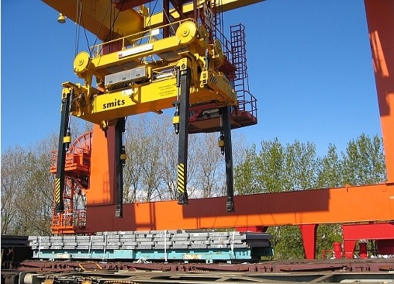
OUR REFERENCE
Concrete plates on flat racks
MAX. DIMENSIONS
850 x 250 x 100 cm,
ca. 27 to/Flatrack
Vrdy, CZ
Various destinations in DE, AT
Rail, road
ORIGIN
DESTINATION
TRANSPORT MODES
Construction sites with different quantities (largest with 2.200 flats):
Block trains / groups of wagons loaded at the manufacturers workshop and transported to transshipment terminal.
Unloading of the wagons with a side loader and delivery to the job site per truck.
Precise disposition just in time to the specific crane on job site.
RAIL FREIGHT
111

Slide 13
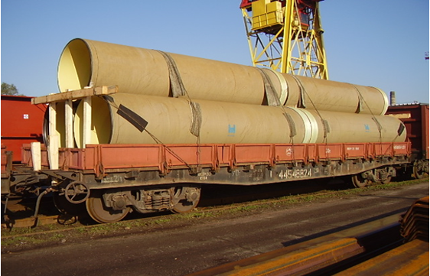
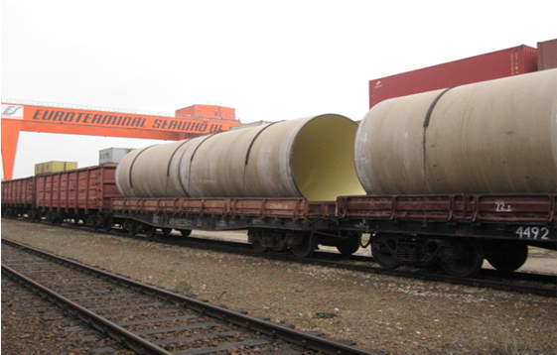
MAX. DIMENSIONS
Different length,
Diameter max. 260 cm
Mühlheim, DE
Different railway stations, CZ
Rail
Europipe project in CZ:
Delivery of 73 block trains for Europipe within 6 months.
Rental of 9 sets of wagons.
Organization of 1 to 2 buffer trains to avoid delays on job site.
OUR REFERENCE
Pipelines for the construction industry
ORIGIN
DESTINATION
RAIL FREIGHT
TRANSPORT MODES
112

Slide 14
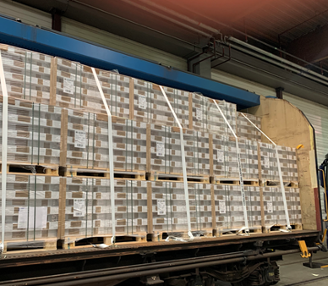
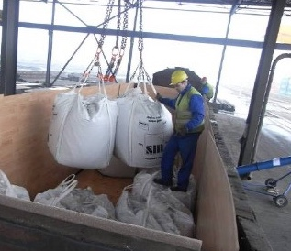
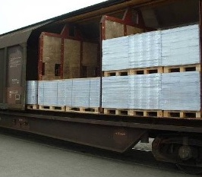
OUR REFERENCE
Use of covered H wagons for cargo on pallets
Use of open E wagons for cargo in Big Bags
Palletized goods & Big Bags
Loading width 2.84 m
Loading length 22 m
Several destinations
Several destinations
Rail / road
Kamenz, DE
MAX. DIMENSIONS
ORIGIN
Krono flooring floor laminates to the Baltic states:
Partition walls for load securing.
Currently bird seed from Marchtrenk AT to Hammenhög SE.
Belarus
DESTINATION
ORIGIN
TRANSPORT MODES
Rail / road
DESTINATION
GOODS
Kaolin
RAIL FREIGHT
TRANSPORT MODES
113

