Slide 1
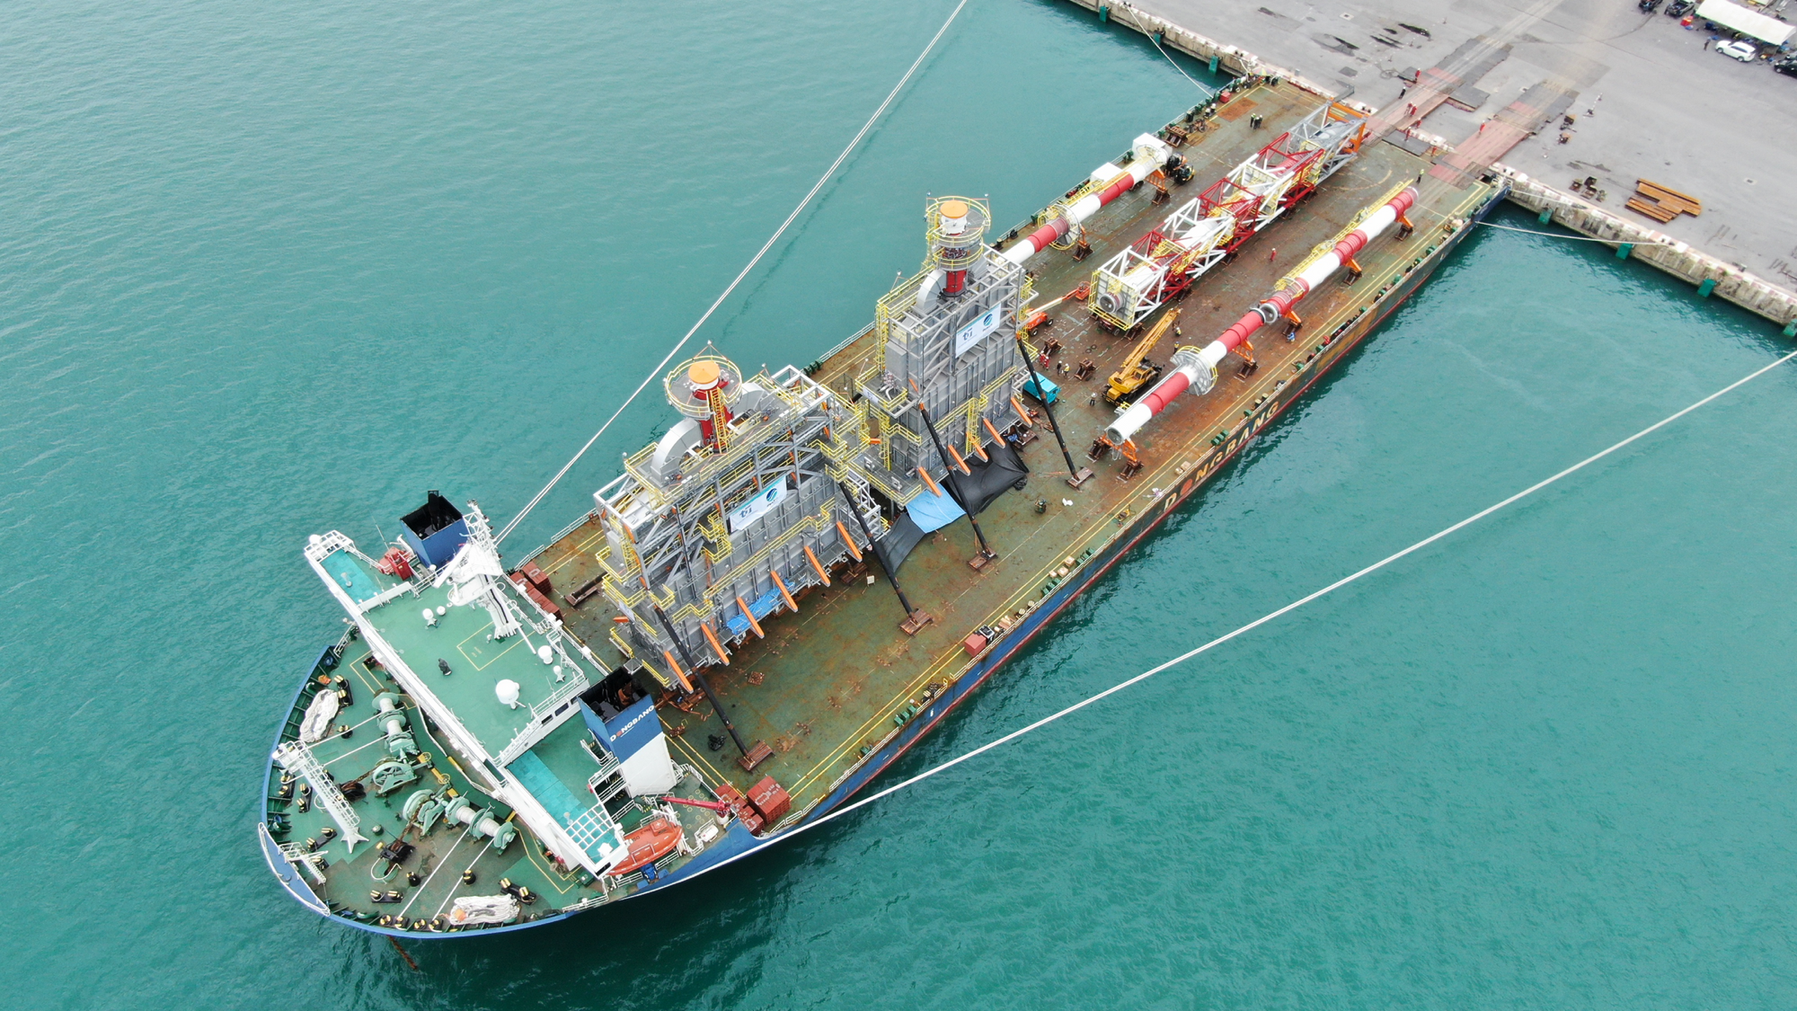

PROJECT CARGO

Slide 2

PROJECT CARGO

Slide 3
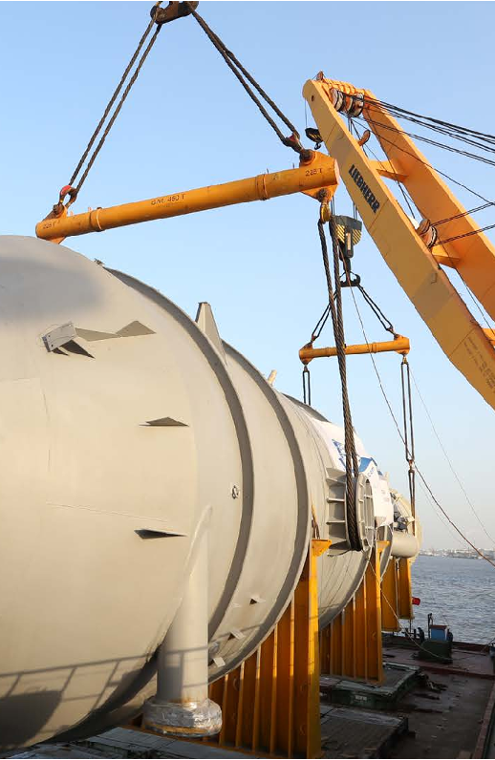


FRACHT GROUP
Project Cargo transport always represents a special and unique challenge given that every project brings new tasks which must be resolved to the millimeter and in the shortest possible time to satisfy the individual needs of each Project.
At Fracht Group, we have a dedicated team of experts & engineers to handle every aspect of your project.
Full And Partial Charters
Break Bulk And Ro/Ro Cargo.
Aircraft Chartering.
Barging Services.
Heavy Duty Rail Solutions.
Overland And Modular Transport.
Rigging oversized Cargo And Heavy Lift.
Special Packing.
Material Management Services.
Transport Engineering.
Installation Of Equipments.
Operational Tracking System.
Customs Brokerage Services.
PROJECT CARGO
79

Slide 4

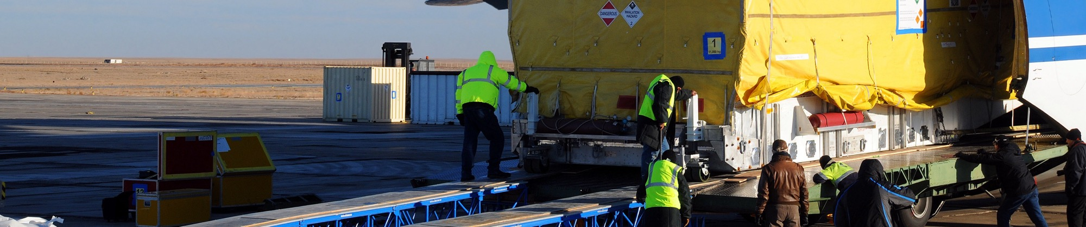
CORE PRODUCTS
Chartering
Identifying Suitable Vessel, Aircraft and Rail Cars types based on Customer & Cargo Requirements.
Technical Support with Tailor-Made Loading and Stowage Plans, Lifting & Lashing Calculations.
Voyage / Journey Management & Post Fixing Support.
Risk Mitigation through Due Diligence and Compliance Review of the Carrier Portfolio.
BENEFITS
Global coverage with presence in strategic core locations.
Full and real-time visibility across time zones.
Experts in charter contract management, optimization, and technical solutions.
PROJECT CARGO
80

Slide 5
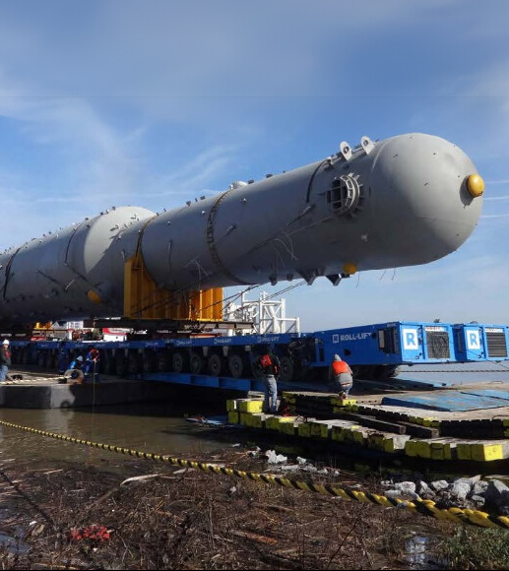
CORE PRODUCTS
Engineering
Technical Drawings & Design Studies.
Method Statements & Calculations.
Feasibility Studies & Route and Port Surveys.
BENEFITS
3d model simulation of operations.
Consulting services on equipment design.
Verification of all third-party equipment operations/calculations & documentations.
Design, manufacturing, and testing of handling and lifting equipment.
Heavy-lift concept design & optimization.
Lower risk exposure to cargo damage.
PROJECT CARGO
81

Slide 6
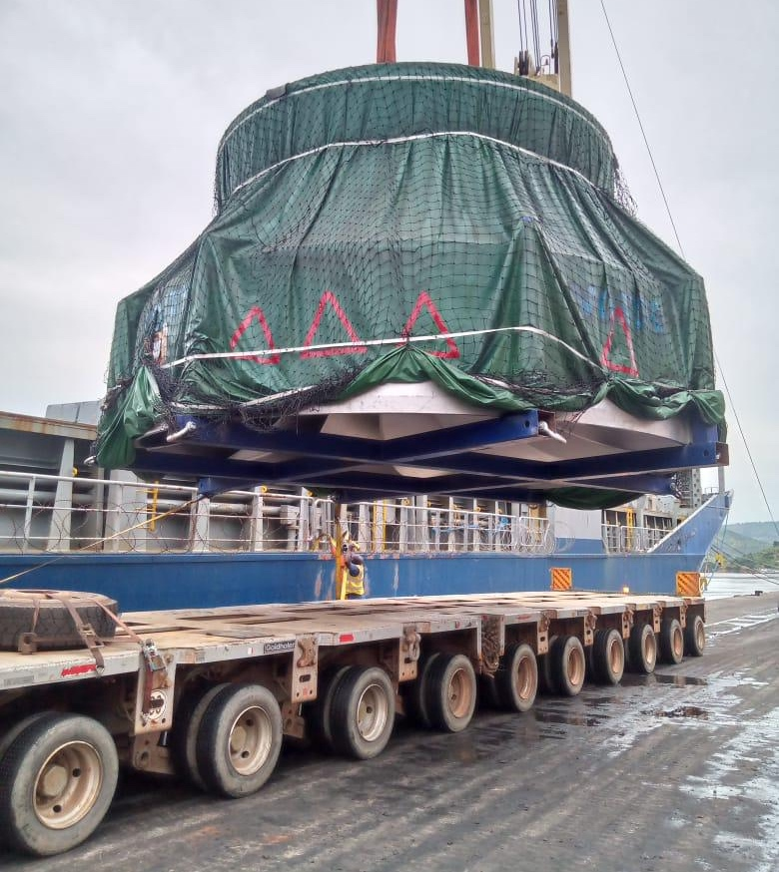


CORE PRODUCTS
Project Execution
Infrastructure Studies, Route Surveys.
Expediting Solutions, Project Logistics and Risk Management.
Export Packing, Engineering Support.
End-to-end logistics visibility.
BENEFITS
Vendor performance KPI reporting.
Global network of project experts.
Risk assessment and compliance.
Budget support & cost optimization.
Cargo damage risk prevention.
Delivery time forecast and improvement.
PROJECT CARGO
82

Slide 7
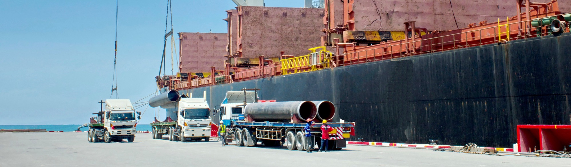
CORE PRODUCTS
Safety
Safety is our key priority.
Our mission is to operate supply chain with no harm to people and the environment.
PROJECT CARGO
83

Slide 8
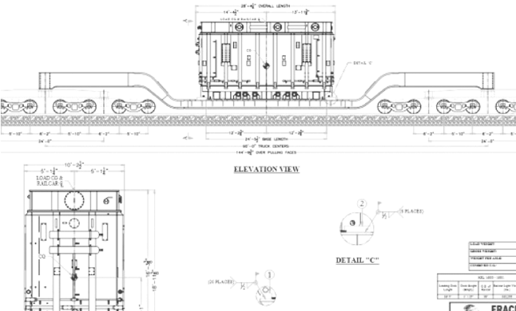
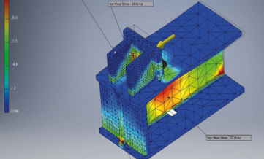
TRANSPORT ENGINEERING
TECHNICAL EXPERTISE,
METHOD STATEMENTS & ROUTE STUDIES.
TECHNICAL EXPERTISE,
METHODSTATEMENTS & ROUTE STUDIES.
PROJECT CARGO
84

Slide 9
IMPLEMENTATION PROCESS
Project Management Timeline
Project Logistics Early Planning Preliminary scope given to Fracht
Project Execution
During course of project
Delivery & Beyond
Analyzed by subject matter experts to prepare best to discuss concept & budgetary quotes/feasibility studies submitted to client.
Designated project team will be assigned to manage & deliver project.
Regular communication with all involved parties to obtain maximum efficiency.
Post project review.
Safety records & cost analysis.
Kick-off meeting where conceptual ideas, requirements & KPI’s will be set.
Constant monitoring of GPS will be kept making sure routes are kept & cargo is safe.
Face to face meetings to discuss suggested proposals.
Lessons learned.
Vendors will be vetted and introduced into team.
Once awarded to Fracht, method statements & route studies will be submitted to the client for final approval.
Site supervisor will make frequent visits to loadings/unloadings to verify all cargo in accounted for.
SOP will be presented where KPI’s & measurability of KPI’s will be outlined.
KPI’s regularly submitted to client for review.
Track & Trace system will be discussed and set.
PROJECT CARGO
85

Slide 10
PROJECT IMPLEMENTATION & SUPPLY CHAIN PROCESS
Our fail-safe implementation
PROJECT LOGISTICS EARLY PLANNING PRELIMINARY SCOPE GIVEN TO FRACHT
DURING COURSE
OF PROJECT
PROJECT EXECUTION
DELIVERY & BEYOND
Expert analyzation/quote & feasibility studies submitted to client.
Meeting to discuss proposal, client expectations & identify go-live date.
Method statement & route studies.
It & visibility solutions.
Kick off meeting with dedicated projects team.
Identify project timeline.
Vendors chosen & vetted.
SOP presentation|KPIS outlined wisetech/logit one.
Regular communication.
Consistent GPS monitoring for route and cargo safety assurance.
Regularly submitted KPIs to client.
Clear visibility & reporting.
Quarterly QBRs.
Post project review.
Safety records & cost analysis lessons learned.
PROJECT CARGO
86

Slide 11
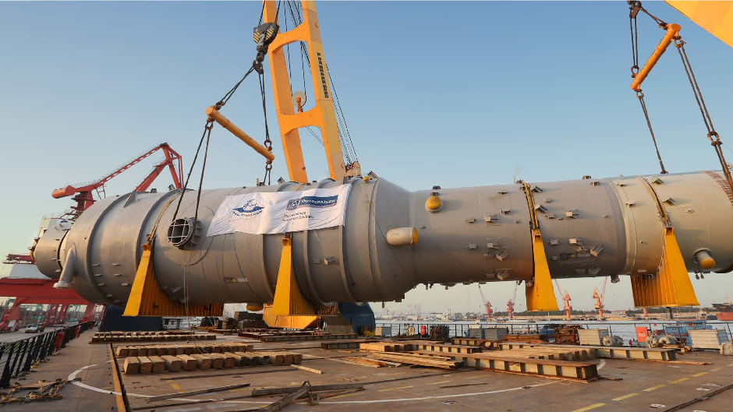
OUR EXPERIENCE

Slide 12
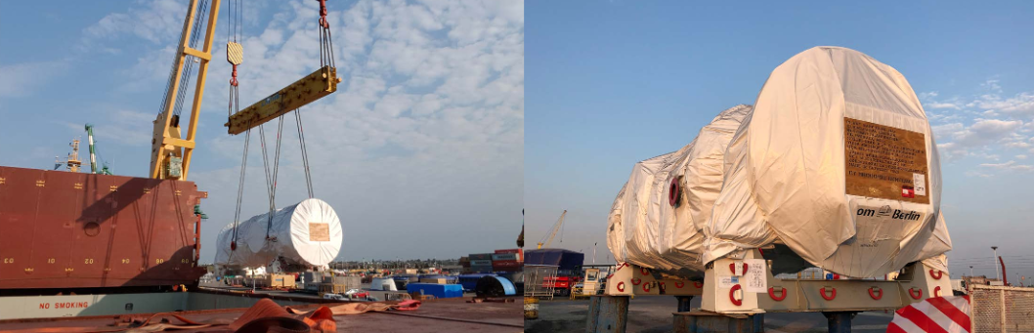
60,000
OUR EXPERIENCE
PROJECT:
Projects in Argentina
Genelba Power Plant
FRT
PROJECT CARGO
88

Slide 13


PROJECT:
15,000
OUR EXPERIENCE
INGA hydroelectric power plant
Projects in DRC
FRT
PROJECT CARGO
89

Slide 14
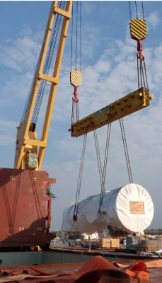
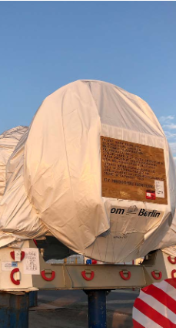
OUR EXPERIENCE
Projects in Argentina
PROJECT:
Genelba Power Plant
60,000
FRT
PROJECT CARGO
90

Slide 15
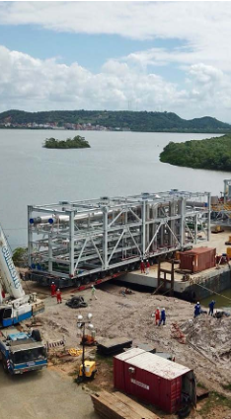
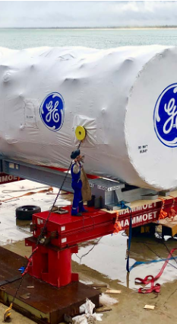
OUR EXPERIENCE
Projects in Brazil
PROJECT:
Thermo Power Plant
20,048
FRT
PROJECT CARGO
91

Slide 16
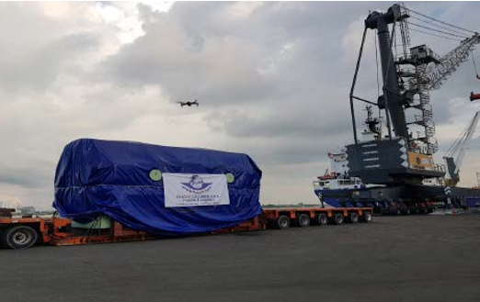
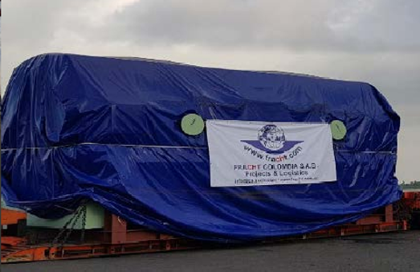
158.65
OUR EXPERIENCE
PROJECT:
Projects in Colombia
Thermoelectric Generator
FRT
PROJECT CARGO
92

Slide 17
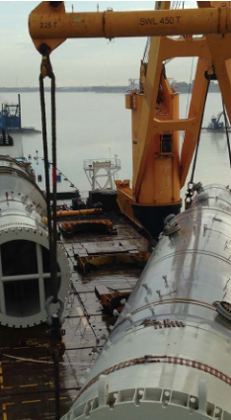
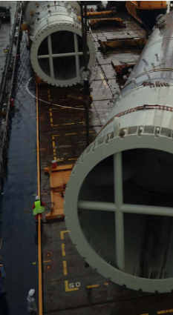
OUR EXPERIENCE
Projects in USA
PROJECT:
Fertilizer Plants
in Louisiana & Iowa
210,000
FRT
120 HEAVY LIFTS UP TO 720 TONS
PROJECT CARGO
93

Slide 18

PROJECT:
62,000
OUR EXPERIENCE
FRT
Construction of 4 Substations
Projects in Canada
16 Transformers on Fracht’s 16-axle railcars to Canada.
PROJECT CARGO
94

Slide 19



COMPLIANCE & SAFETY
ISO 9001:2015
Certified; along with high customer satisfaction, our goals include zero legal compliance issues.
Knowledgeable and properly trained staff in accordance to each project’s requirements.
Dedicated compliance team oversees ISO program and ensures compliance of all regulatory bodies.
The performance of our vendors reflects on us; vetting processes are in place to find qualified and reliable partners.
Responsibility and attention recognized by Board of Directors and Management Board
Comprehensive and risk-based Ethics & Compliance framework
Clear demands on our sub-contracted third parties
Leading Ethics & Compliance industry standards serving our customers, and preventing harm to Fracht Group and its stakeholders
WRITE HERE ABOUT YOUR OWN COMPLIANCE & CERTIFICATES
ISO 14001:2015, ISO 45001:2018
Our goals include zero recordable hazardous spills and zero recordable injuries.
We work together with our vendors and clients to evaluate risks and formulate project procedures that minimize the potential for injury and environmental hazards.
PROJECT CARGO
95

Slide 20
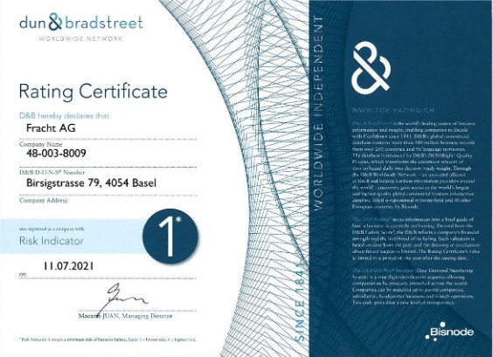
D&B FINANCIAL STRENGTH
PROJECT CARGO
96

Slide 21
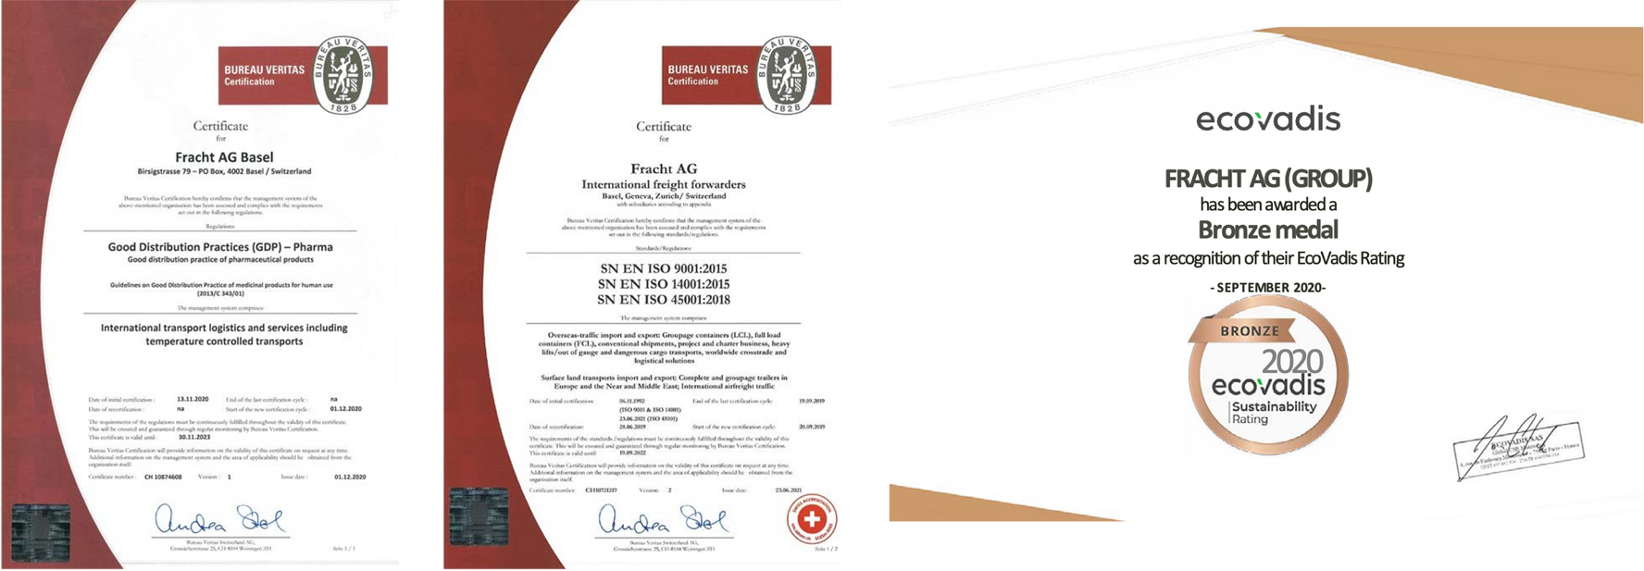
CERTIFICATIONS
PASTE HERE YOUR OWN CERTIFICATIONS
PROJECT CARGO
97

Slide 22





























OUR GLOBAL SATISFIED CLIENTS
PROJECT CARGO
98

Slide 23
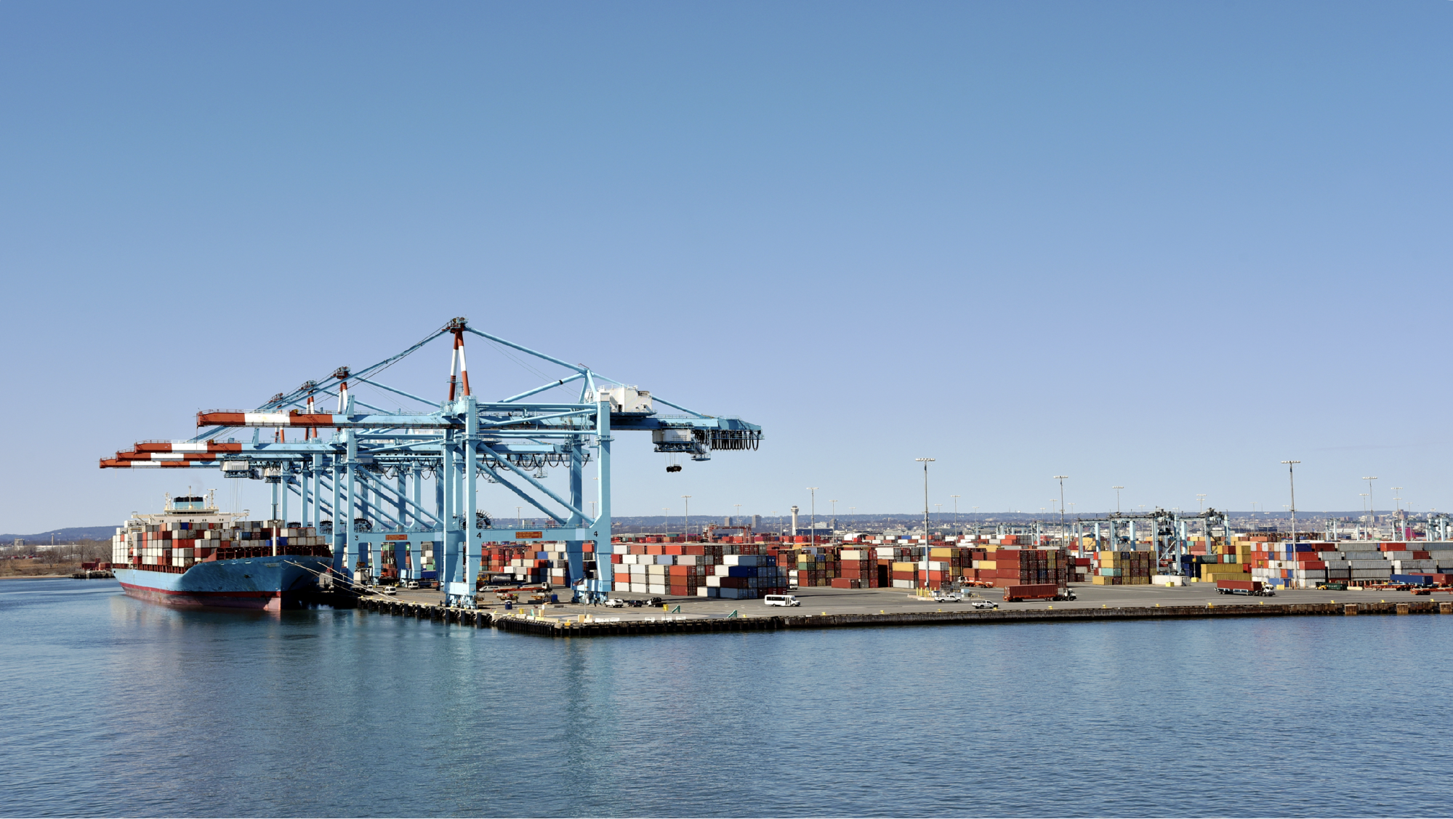

WHAT SOLUTIONS CAN WE PROVIDE FOR YOU?
www.frachtgroup.com

