Slide 1
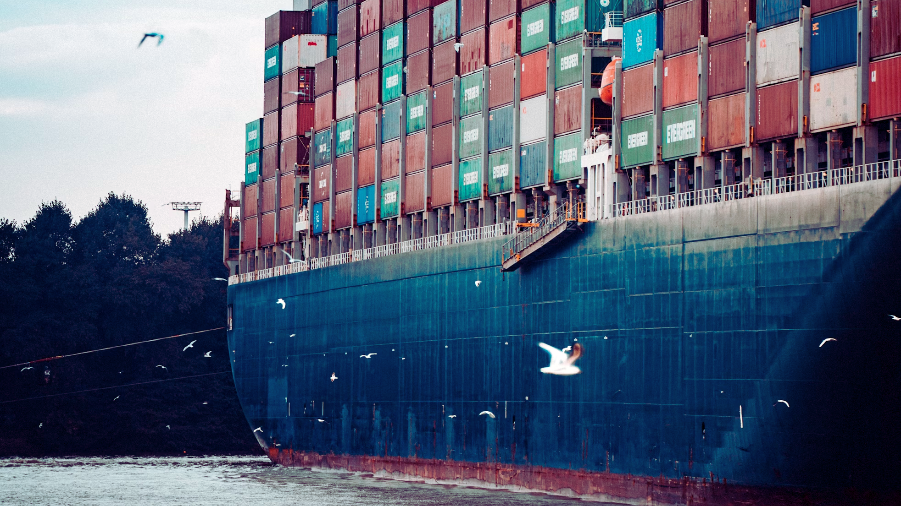

OCEAN FREIGHT

Slide 2

OCEAN FREIGHT

Slide 3
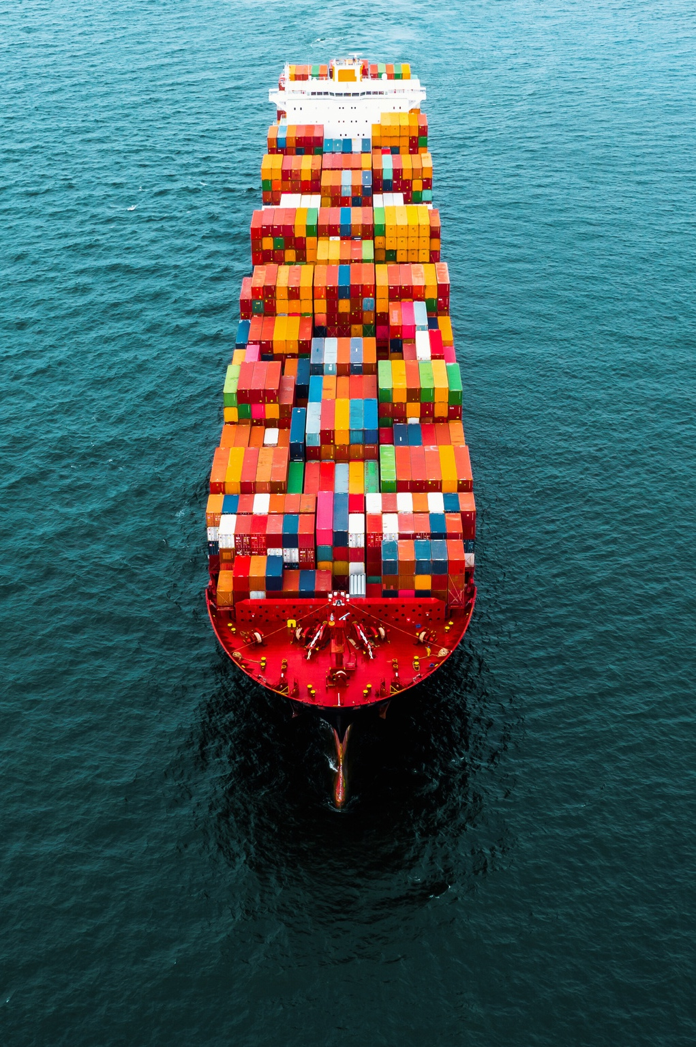

FRACHT IS YOUR TRUSTED PARTNER FOR OCEAN FREIGHT SOLUTIONS
As a licensed and bonded NVOCC (Non-Vessel Operating Common Carrier) and traditional ocean freight forwarder, Fracht works with international leading ocean carriers. This gives us the flexibility to adapt to your specific needs and ensure cost-effective and reliable transport of your cargo.
OUR SOLUTIONS
Whatever solution you need, Fracht is your single point of contact for the entire transport of your goods, from the removal to the final delivery.
  Full-Container-Load (FCL): If your cargo requires it, you can have a dedicated container for which you will have the loading and unloading conditions control.
  LCL (Less-Than-Container-Load) service: We consolidate shipments from multiple customers into a single container, optimizing space and reducing costs.
  Door-to-door: Fracht manages the transport of your goods from the point of departure to the final destination.
OCEAN FREIGHT
65

Slide 4
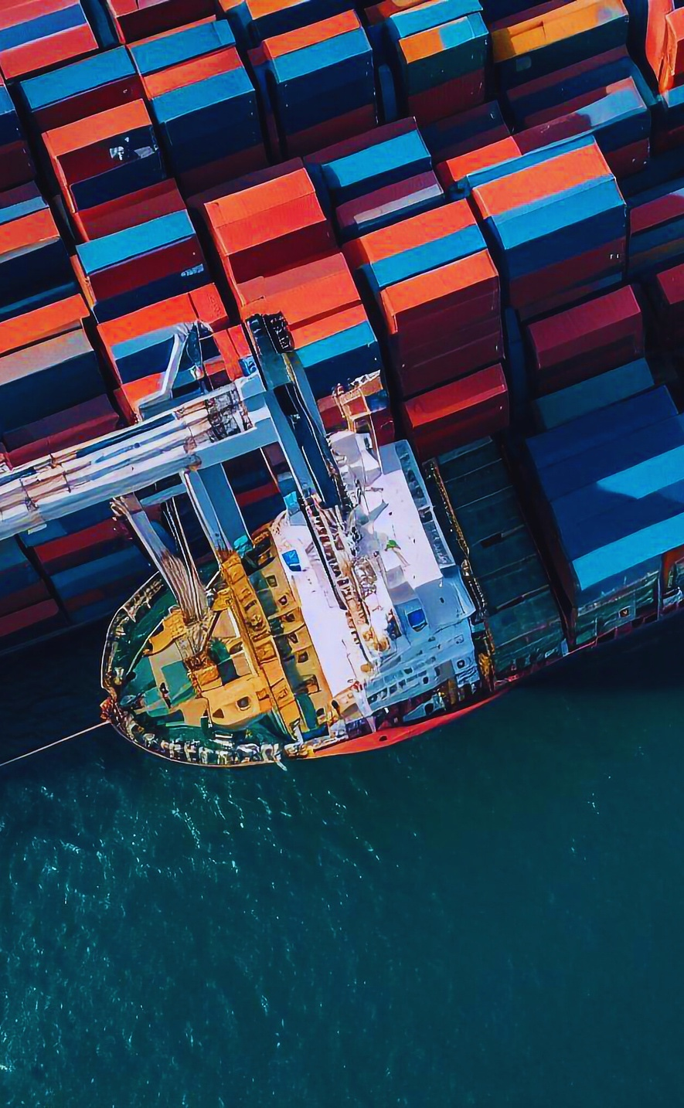


WITH FRACHT, SAIL THE WORLD'S WATERS WITH EASE
Because we know that the world of maritime freight is vast and complex, we are constantly developing our strengths in order to be able to offer efficient and tailor-made support.
OUR STRENGTHS
Our global network and expertise streamline the process, ensuring efficiency and peace of mind.
  Excellent relationships with all carriers: the quality and extent of our network allows us to offer professional service and competitive prices.
  Priority on available space on ships and special equipment,
  with many carriers.
  Online tracking and tracing platform.
OCEAN FREIGHT
66

Slide 5
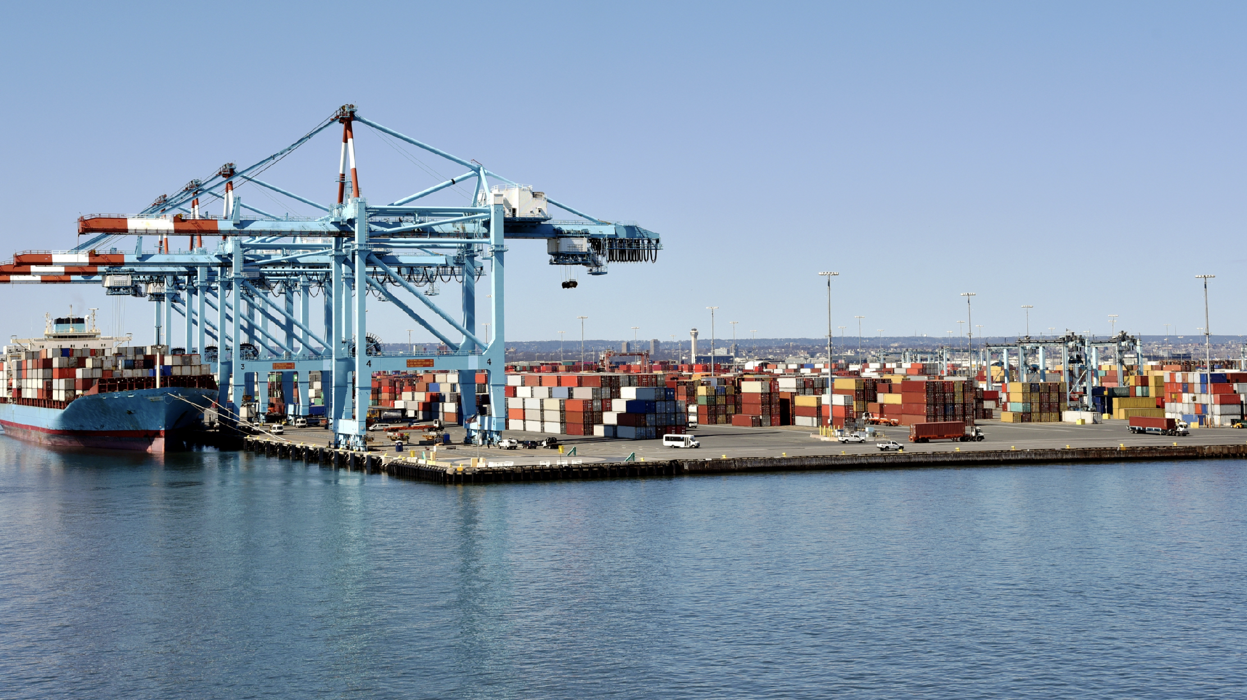

WHAT SOLUTIONS CAN WE PROVIDE FOR YOU?
www.frachtgroup.com

