Slide 1



GENERAL CARGO

Slide 2

GENERAL CARGO

Slide 3
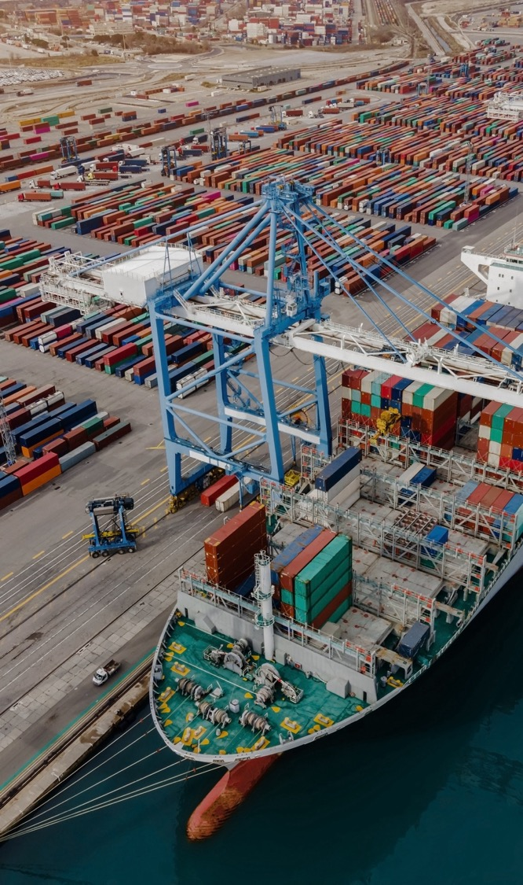


INDUSTRIES WE SERVE
ALTERNATIVE &
RENEWABLE ENERGIES
CHEMICALS
MINING
EPC CONTRACTORS
PHARMA &
HEALTHCARE
CUSTOMER GOODS
& RETAIL
WOOD, PULP & PAPER
COMMODITY & TRADING
RAILWAY &
ROLLING STOCK
AUTOMOTIVE
AID & RELIEF
OIL & GAS
GENERAL CARGO
16

Slide 4

EDI, TRACKING & CUSTOMER VISIBILITY
Fracht Group employs an industry leading integration application that allows us to send and receive Business documents in a variety of formats.
With our EDI messages, clients gain visibility and predictability into their shipments and can make more informed decisions.
Fracht Integration services provides a robust platform for data exchange in many different technologies such as:
EDI INTEGRATION
API INTEGRATION
CSV AUTOMATION
Our platform is capable of any to any translation and can communicate using any of the modern communication protocols such as AS2, SFTP or HTTPS.
GENERAL CARGO
17

Slide 5
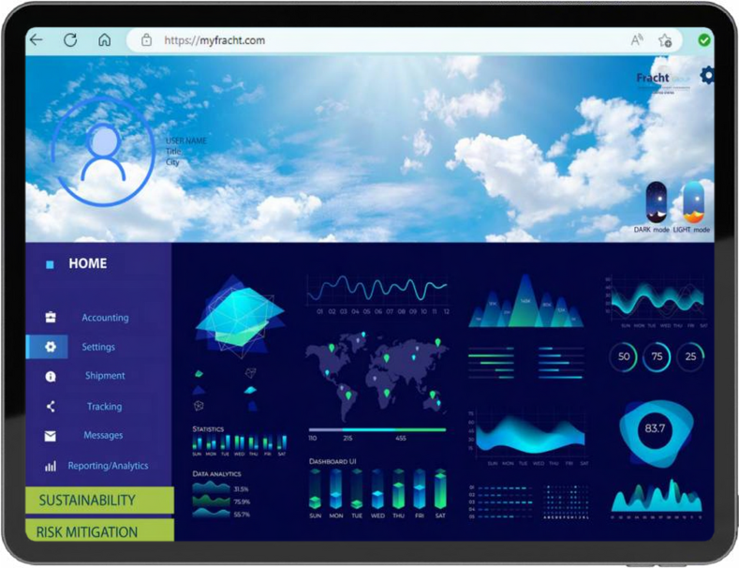
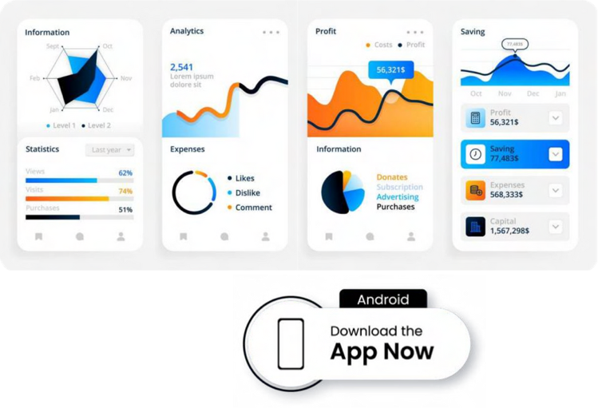

MY FRACHT
Empowering You with a Unified Global Shipment View
ASK US ABOUT OUR APP
GENERAL CARGO
18

Slide 6
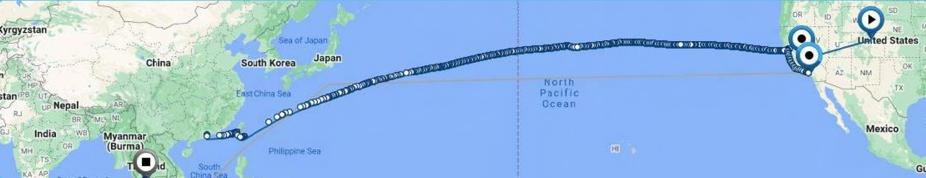
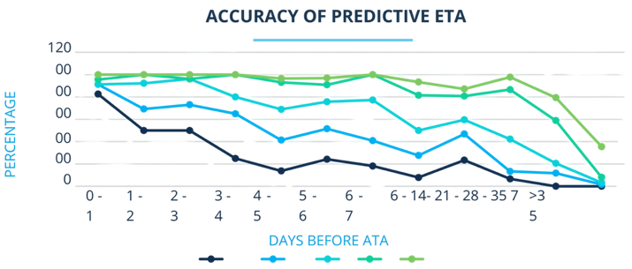
PREDICTIVE ETA’S
Geofencing + Speed + Algorithm = Accuracy
PREDICTIVE ETA
  System produced estimate
  Increased accuracy to the hour as vessel approaches
  Learns with every shipment tracked
GENERAL CARGO
19

Slide 7

ACCOUNT
MANAGEMENT
Client Implementation
  DNB credit analytics for credit term agreement.
  Fracht-provided credit application for client review and completion.
  Fracht or client-provided freight forwarding agreement for review and completion.
  Import/export POA for client review and completion.
  Fracht-provided client company profile for review
  and completion.
  Fracht to provide W9 and banking details.
GENERAL CARGO
20

Slide 8
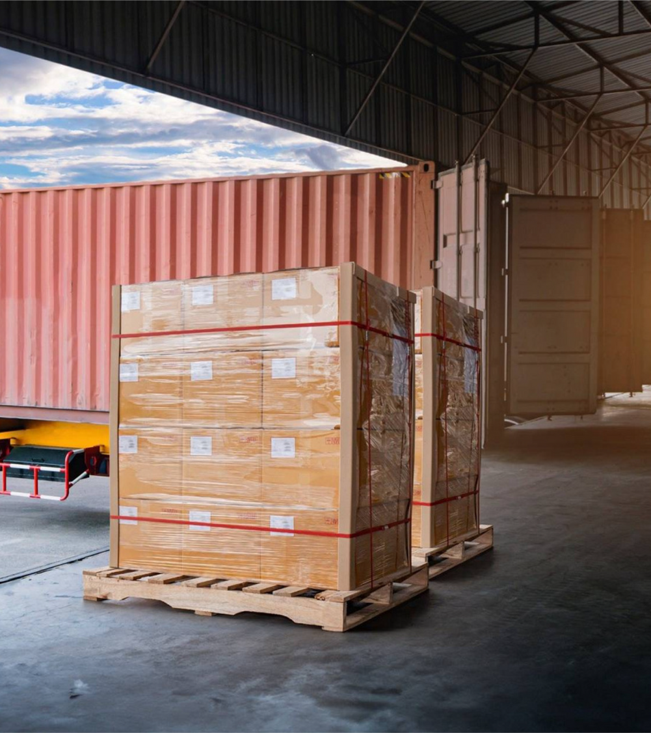
ACCOUNT
MANAGEMENT
SOP Creation
  Database of all global client contact information.
  Database of all global client collection/delivery locations with contact information.
  Expected commodity & HTS code(s) database.
  Client documentation milestones contacts and instructions.
  Client freight movement milestones contacts and instructions.
  Client insurance requirements.
  Client invoicing instructions.
  Client technology, tracking, and EDI requirements.
  Additional, client-guided SOP information based on the specific account.
GENERAL CARGO
21

Slide 9

CUSTOMS BROKERAGE
Fracht stands out as one of the few companies with a FULL team of Compliance professionals, boasting a combined experience of over 100 years.
  7 full-time, licensed customs brokers.
  40% of our customs brokerage staff are licensed customs brokers.
  100% entry audit post release.
  Single point of contact.
  Robust compliance team that ensures top notch import & export regulatory compliance support.
  Automated clearinghouse (ach) & cash flow assistance with period monthly statement (PMS) set up.
  Assistance in determination of rules of origin and special performance indicator (SPI) programs.
  Key performance indicators
  (KPIs) measurements.
  Customizable entry reports.
  Product database with HTS# and country of origin capabilities.
  100% pre-arrival entry filling – where possible.
  Bond maintenance and management.
  Penalty mitigation.
  Preparation of customs binding
  rulings applications.
GENERAL CARGO
22

Slide 10
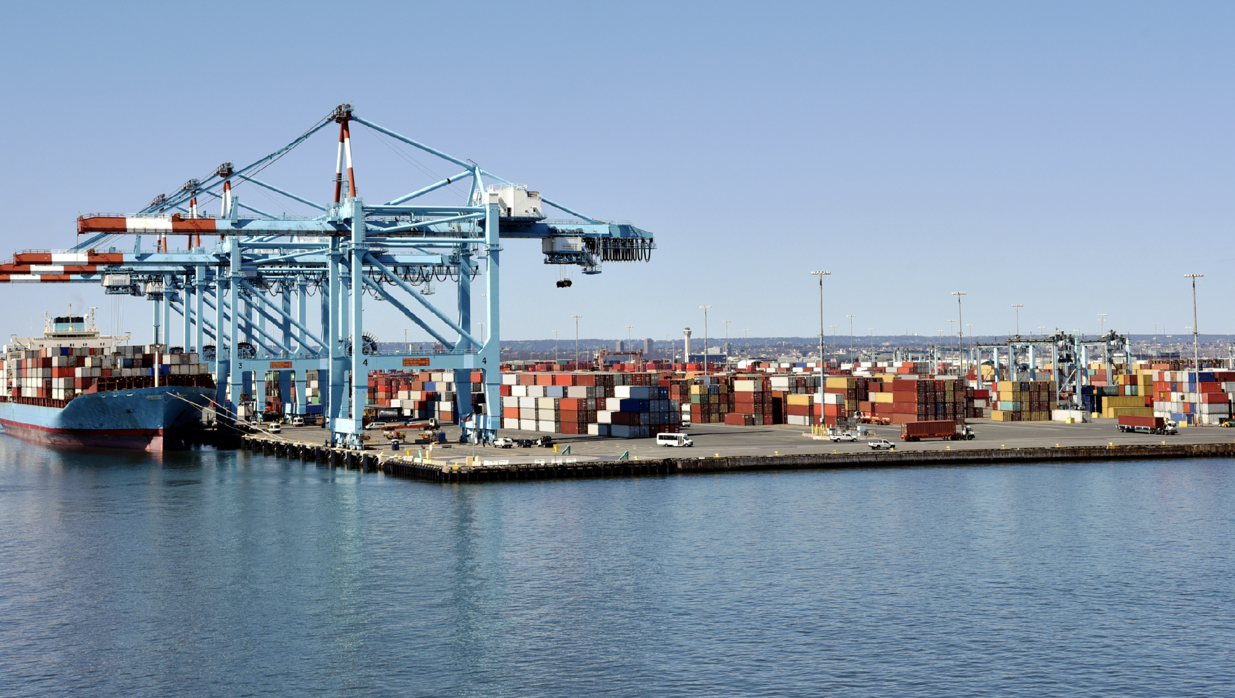

WHAT SOLUTIONS CAN WE PROVIDE FOR YOU?
www.frachtgroup.com

