Slide 1


AIR FREIGHT

Slide 2

AIR FREIGHT

Slide 3




FLY FRACHT
Our Air Freight Portfolio / International or Domestic
SPEED +
Just In Time / Express / Priority Shipments.
On Direct or Back to Back basis.
STANDARD
Faster than Economy but not Express or Priority.
On Direct or Back to Back basis.
ECONOMY
Consolidation MAWB with Allocations in place.
MAWB only to Fracht Agents only.
CHARTER
Dedicated 24/7 Charter team for worldwide opeations.
ON BOARD COURIER
Dedicated 24/7 Team which is able to provide OBS Services World Wide.
PART CHARTER
Dedicated Team locally in coordination with the Charter Team to ensure correct handling.
AIR FREIGHT
25

Slide 4
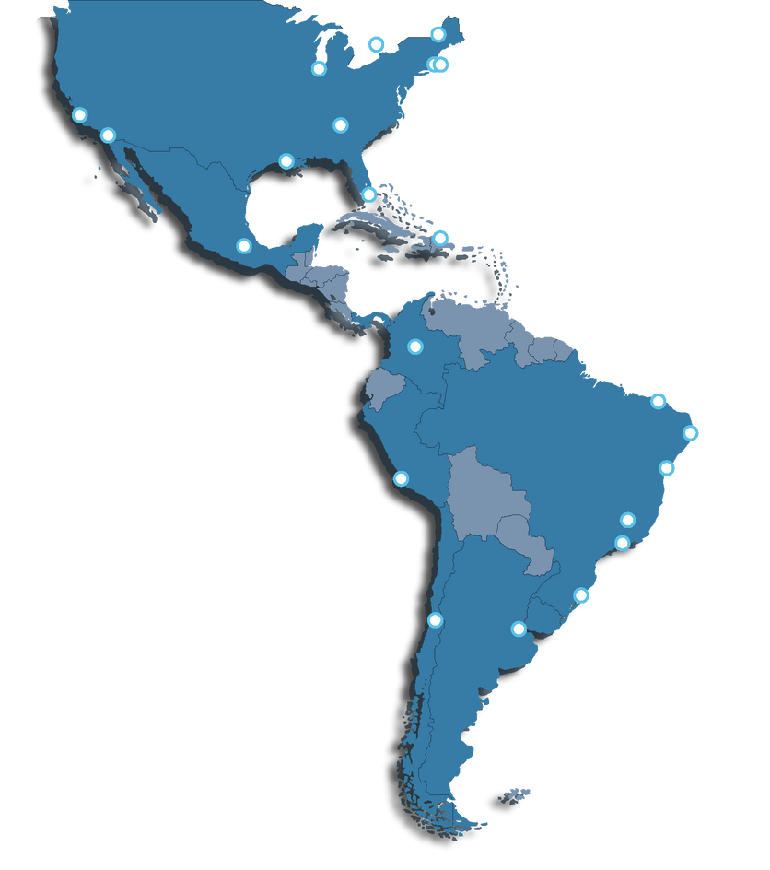
FLY FRACHT
Our Reach in North & South America
FRACHT AMERICAS
TORONTO
BOSTON
8
CHICAGO
NEW YORK
FRACHT OFFICES IN
LOS ANGELES
ATLANTA
NORFOLK
AMERICAS COUNTRIES
SAN DIEGO
HOUSTON
MIAMI
SAN JUAN
MEXICO CITY
21
BOGOTA
FRACHT OWN OFFICES
FORTALEZA
LOCATIONS
RECIFE
LIMA
SALVADOR
GUARULHOS
SAO PAOLO/SANTOS
REGIONAL HUBS IN
NAVEGANTES
SANTIAGO
USA, MEXICO, BRAZIL, CANADA, CHILE,
ARGENTINA, PERU, COSTA RICA, COLOMBIA.
BUENOS AIRES
AIR FREIGHT - USA
26

Slide 5
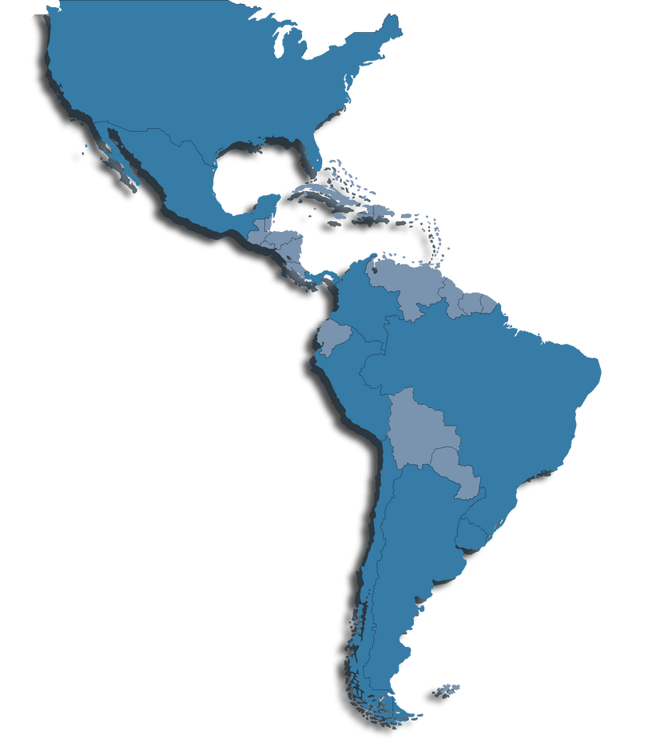
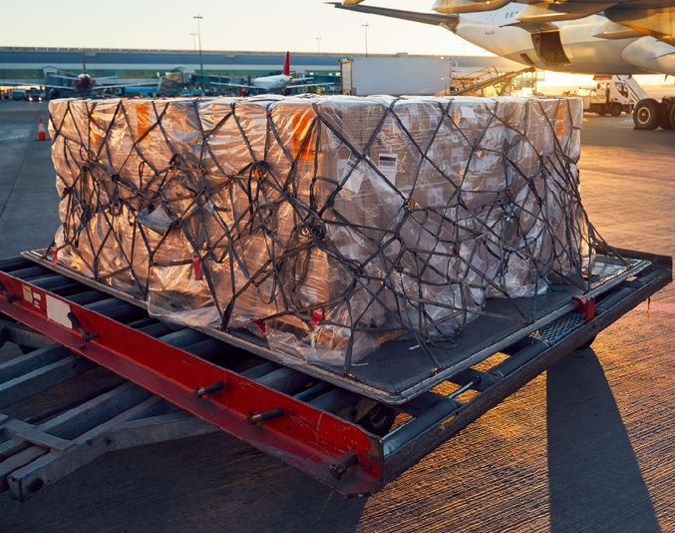
FLY FRACHT
Weekly USA Outbound to LATAM Consolidations
CONSOLIDATION
& DIRECT SERVICE
EX MIAMI TO
Bogota, Guarulhos, Lima, Santiago De Chile, Buenos Aires, Mexico City.
AIR FREIGHT - USA
27

Slide 6


WHY CUSTOMERS
CHOOSE FRACHT
Our Service Control Tower
QUALITY SERVICE
Value-added services to serve your need for high-performance and flexible distribution infrastructure.
LONG-TERM PROFESSIONAL RELATIONSHIP
Regular and proactive communication to ensure our services meet your immediate needs - always.
SECURITY
High security compounds to protect your inventory and assets.
STRONG I.T. COMPETENCE
Real-time information and transparency along your supply chain.
KEY ACCOUNT MANAGEMENT FOR EVERY CUSTOMER
Customer Centric approach and make for predictability and increased planning reliability.
ASSURANCE
Dedicated teams to ensure safe and timely deliveries and storage, and high performance.
AIR FREIGHT
28

Slide 7

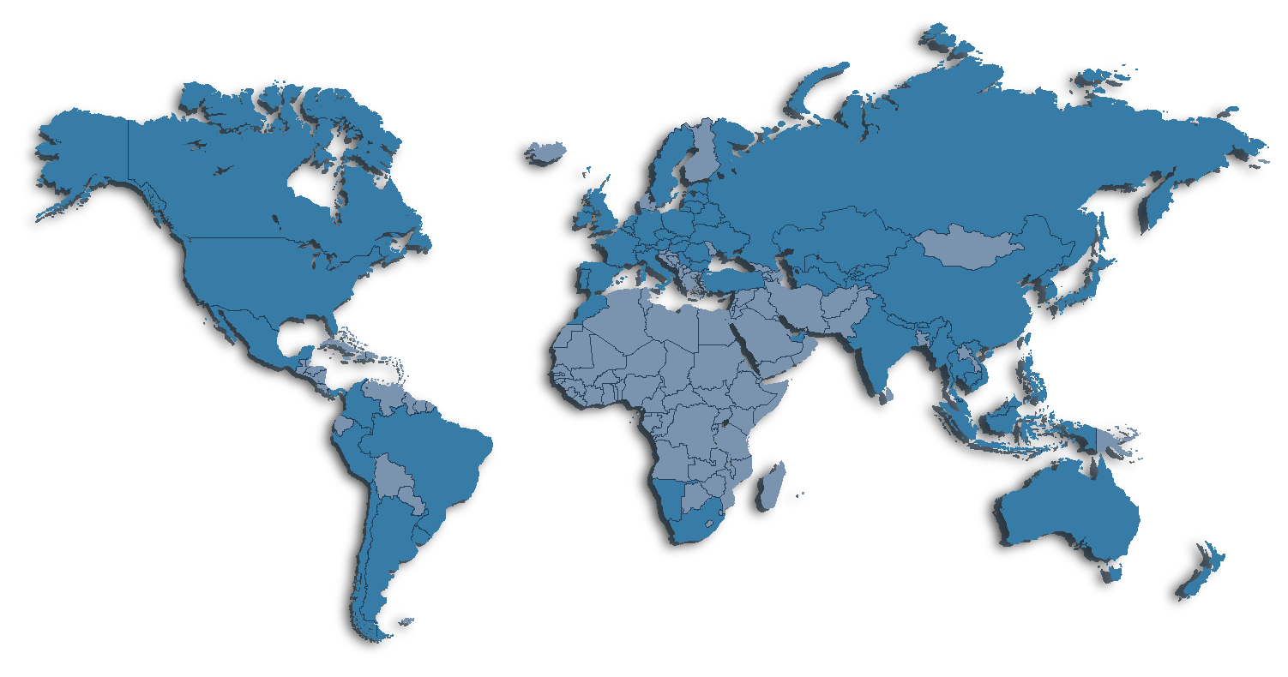
FLY FRACHT
Our Air Hubs
  Our AMS Hub has weekly consolidations from Europe to Asia, LATAM, and USA.
  Miami Hub has weekly consolidations to LATAM.
  Our Air Hubs in the USA have weekly shipments to and from Europe, China, and LATAM.
FRANKFURT
AMSTERDAM
MIAMI
AIR FREIGHT
29

Slide 8
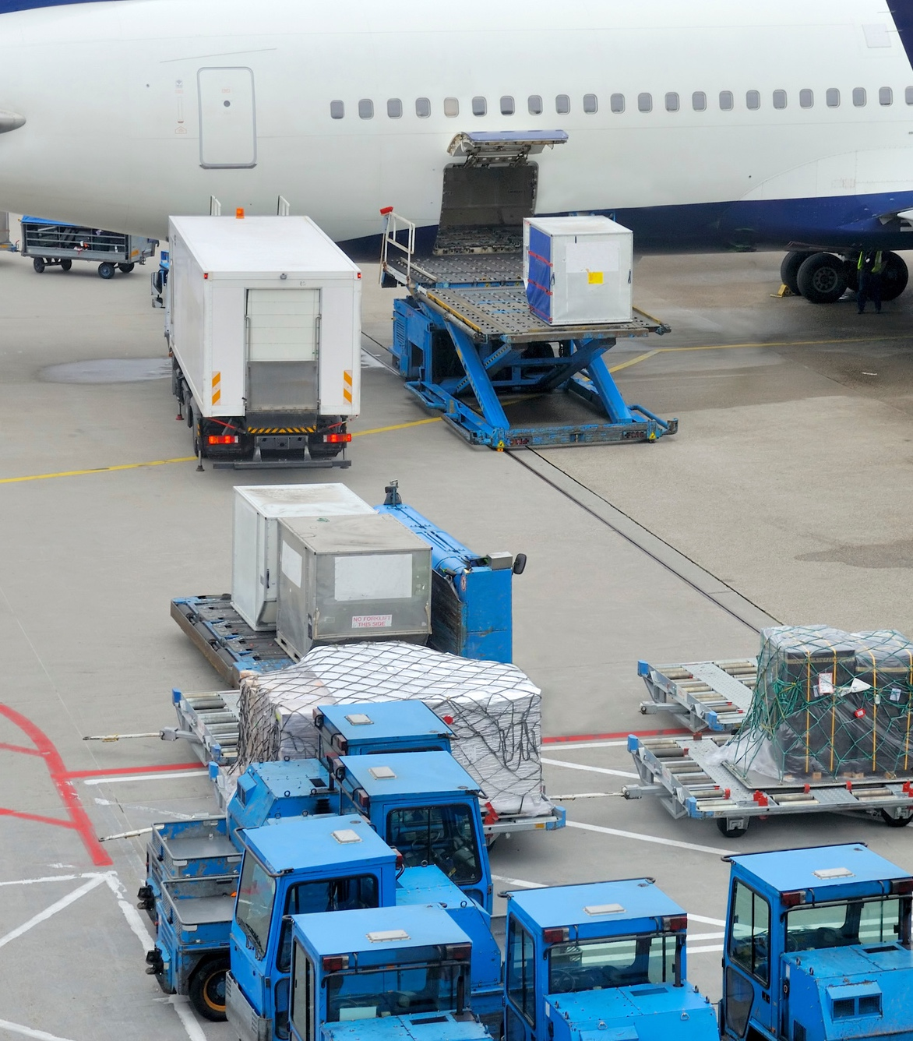
FLY FRACHT
Our Value - Added Services / Certifications
Special Handling
Oversized and Heavy lift Cargo Handling / Valuable Cargo, Dangerous Cargo Handling, Lithium Battery Handling, AOG / Aerospace, Perishables, Temperature Control, Healthcare, Time Critical.
PACKING
We understand that sometimes reconfiguring your cargo for safe air transportation can be confusing. Fracht's expert design and engineer team can collaborate with you to repack your cargo.
SEA TO AIR
To optimise on transit times and improve cost efficiency, multi-modal solutions can often be the best transportation option for customers on sending intercontinental cargo.
WAREHOUSING / CONSOLIDATION
To optimise on transit times and improve cost efficiency, multi-modal solutions can often be the best transportation option for customers on sending intercontinental cargo.
AIR FREIGHT
30

Slide 9
COMPLIANCE & SAFETY
COMPLIANCE
Seamless Compliance for Uninterrupted Trade
Maintaining ethical business practices and adhering to international regulations are vital aspects of sustaining successful global trade. At Fracht, we take compliance seriously, ensuring your shipments move seamlessly across borders while safeguarding your reputation and business integrity. By partnering with us, you're choosing a team dedicated to steering your trade journey within the boundaries of legality and transparency.
QHSES
WRITE HERE ABOUT YOUR OWN COMPLIANCE
At Fracht, we embrace our responsibility to create a better future for our employees, customers, and the environment. Our QHSE and Security program is at the core of our operations, ensuring that we consistently deliver excellence in quality, health, safety, and safety, and environmental management. We are committed to continuously improving our practices and setting new benchmarks in the industry. Our guiding QHSE principles drive our actions:
Achieve Corporate Compliance and Peace of Mind
Upholding high standards and adhering to the rule of law are not only crucial for ensuring smooth and timely transportation of your cargo but also for maintaining corporate compliance. At Fracht, we prioritize the adherence to laws and regulations to avoid heavy civil and criminal penalties, such as hefty fines or, in severe cases, even jail time. Our commitment to compliance helps you navigate the complex landscape of international trade with confidence and peace of mind.
  Quality Commitment.
  Health and Safety Excellence.
  Environmental Stewardship.
Our Comprehensive Compliance Programs
Fracht's Compliance Team works diligently to ensure that all employees are well-versed and fully trained in the programs that impact our business. Compliance with these programs is mandatory at Fracht and upholding them is a duty we take very seriously. Our comprehensive corporate compliance programs cover various aspects, including anti-bribery, code of conduct, and numerous industry certifications.
AIR FREIGHT
31

Slide 10

















QUALITY & COMPLIANCE
GOVERNMENT AGENCY FAMILIARITY & UNDERSTANDING
AIR FREIGHT
32
AIR FREIGHT

Slide 11

FRACHT CHARTER SERVICES
The Fracht Charter Team utilizes years of technical knowledge and experience to optimize on the best, and most cost-effective transport solutions. Fracht Group has historically chartered a spectrum of different aircraft types and services for all types of cargo.
OBC
PART CHARTER
FULL CHARTER
TIME CRITICAL CARGO
AIR FREIGHT
33

Slide 12
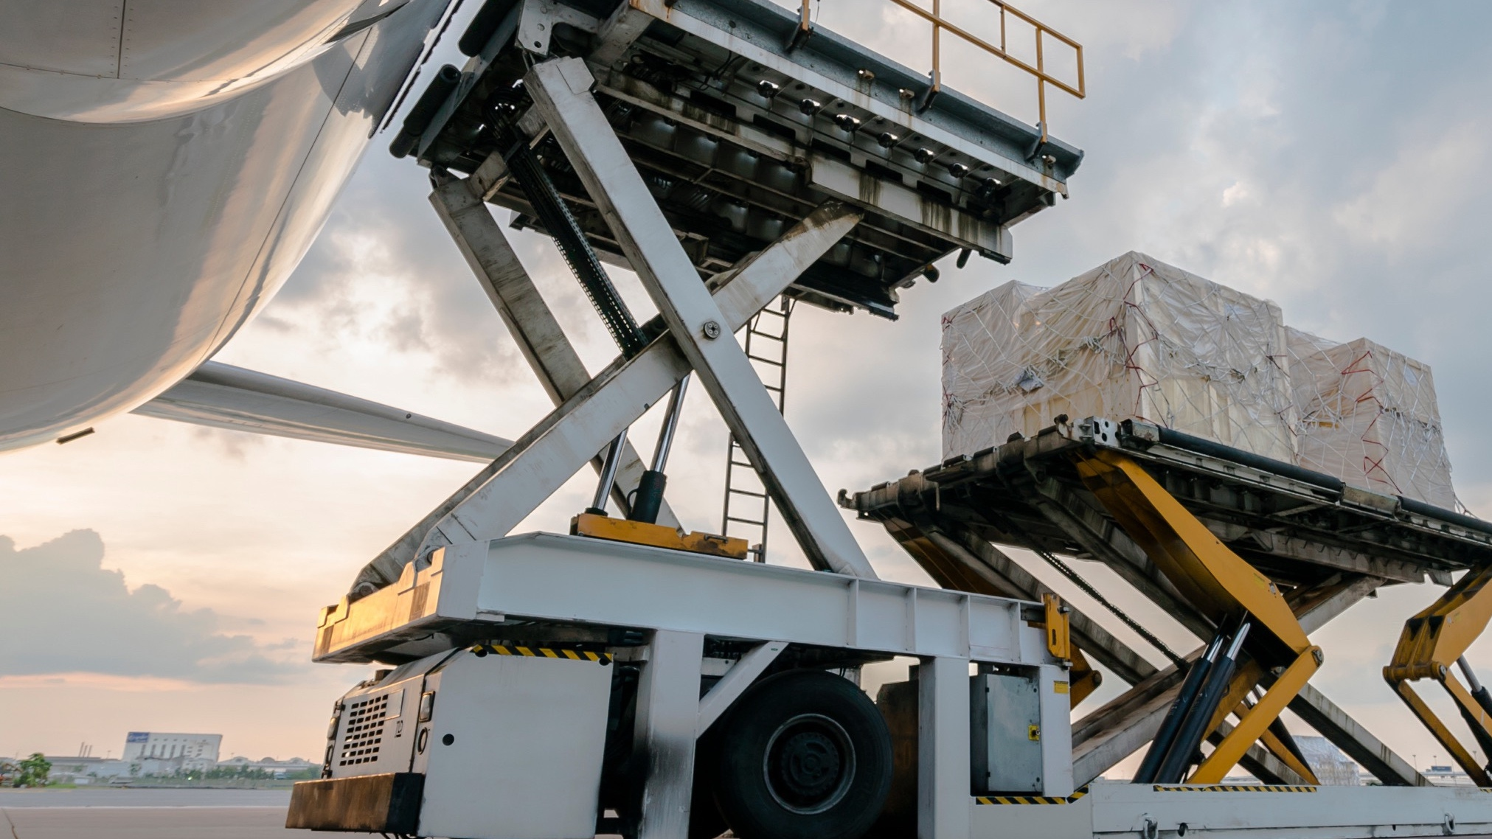

WHAT SOLUTIONS CAN WE PROVIDE FOR YOU?
www.frachtgroup.com

