Slide 1
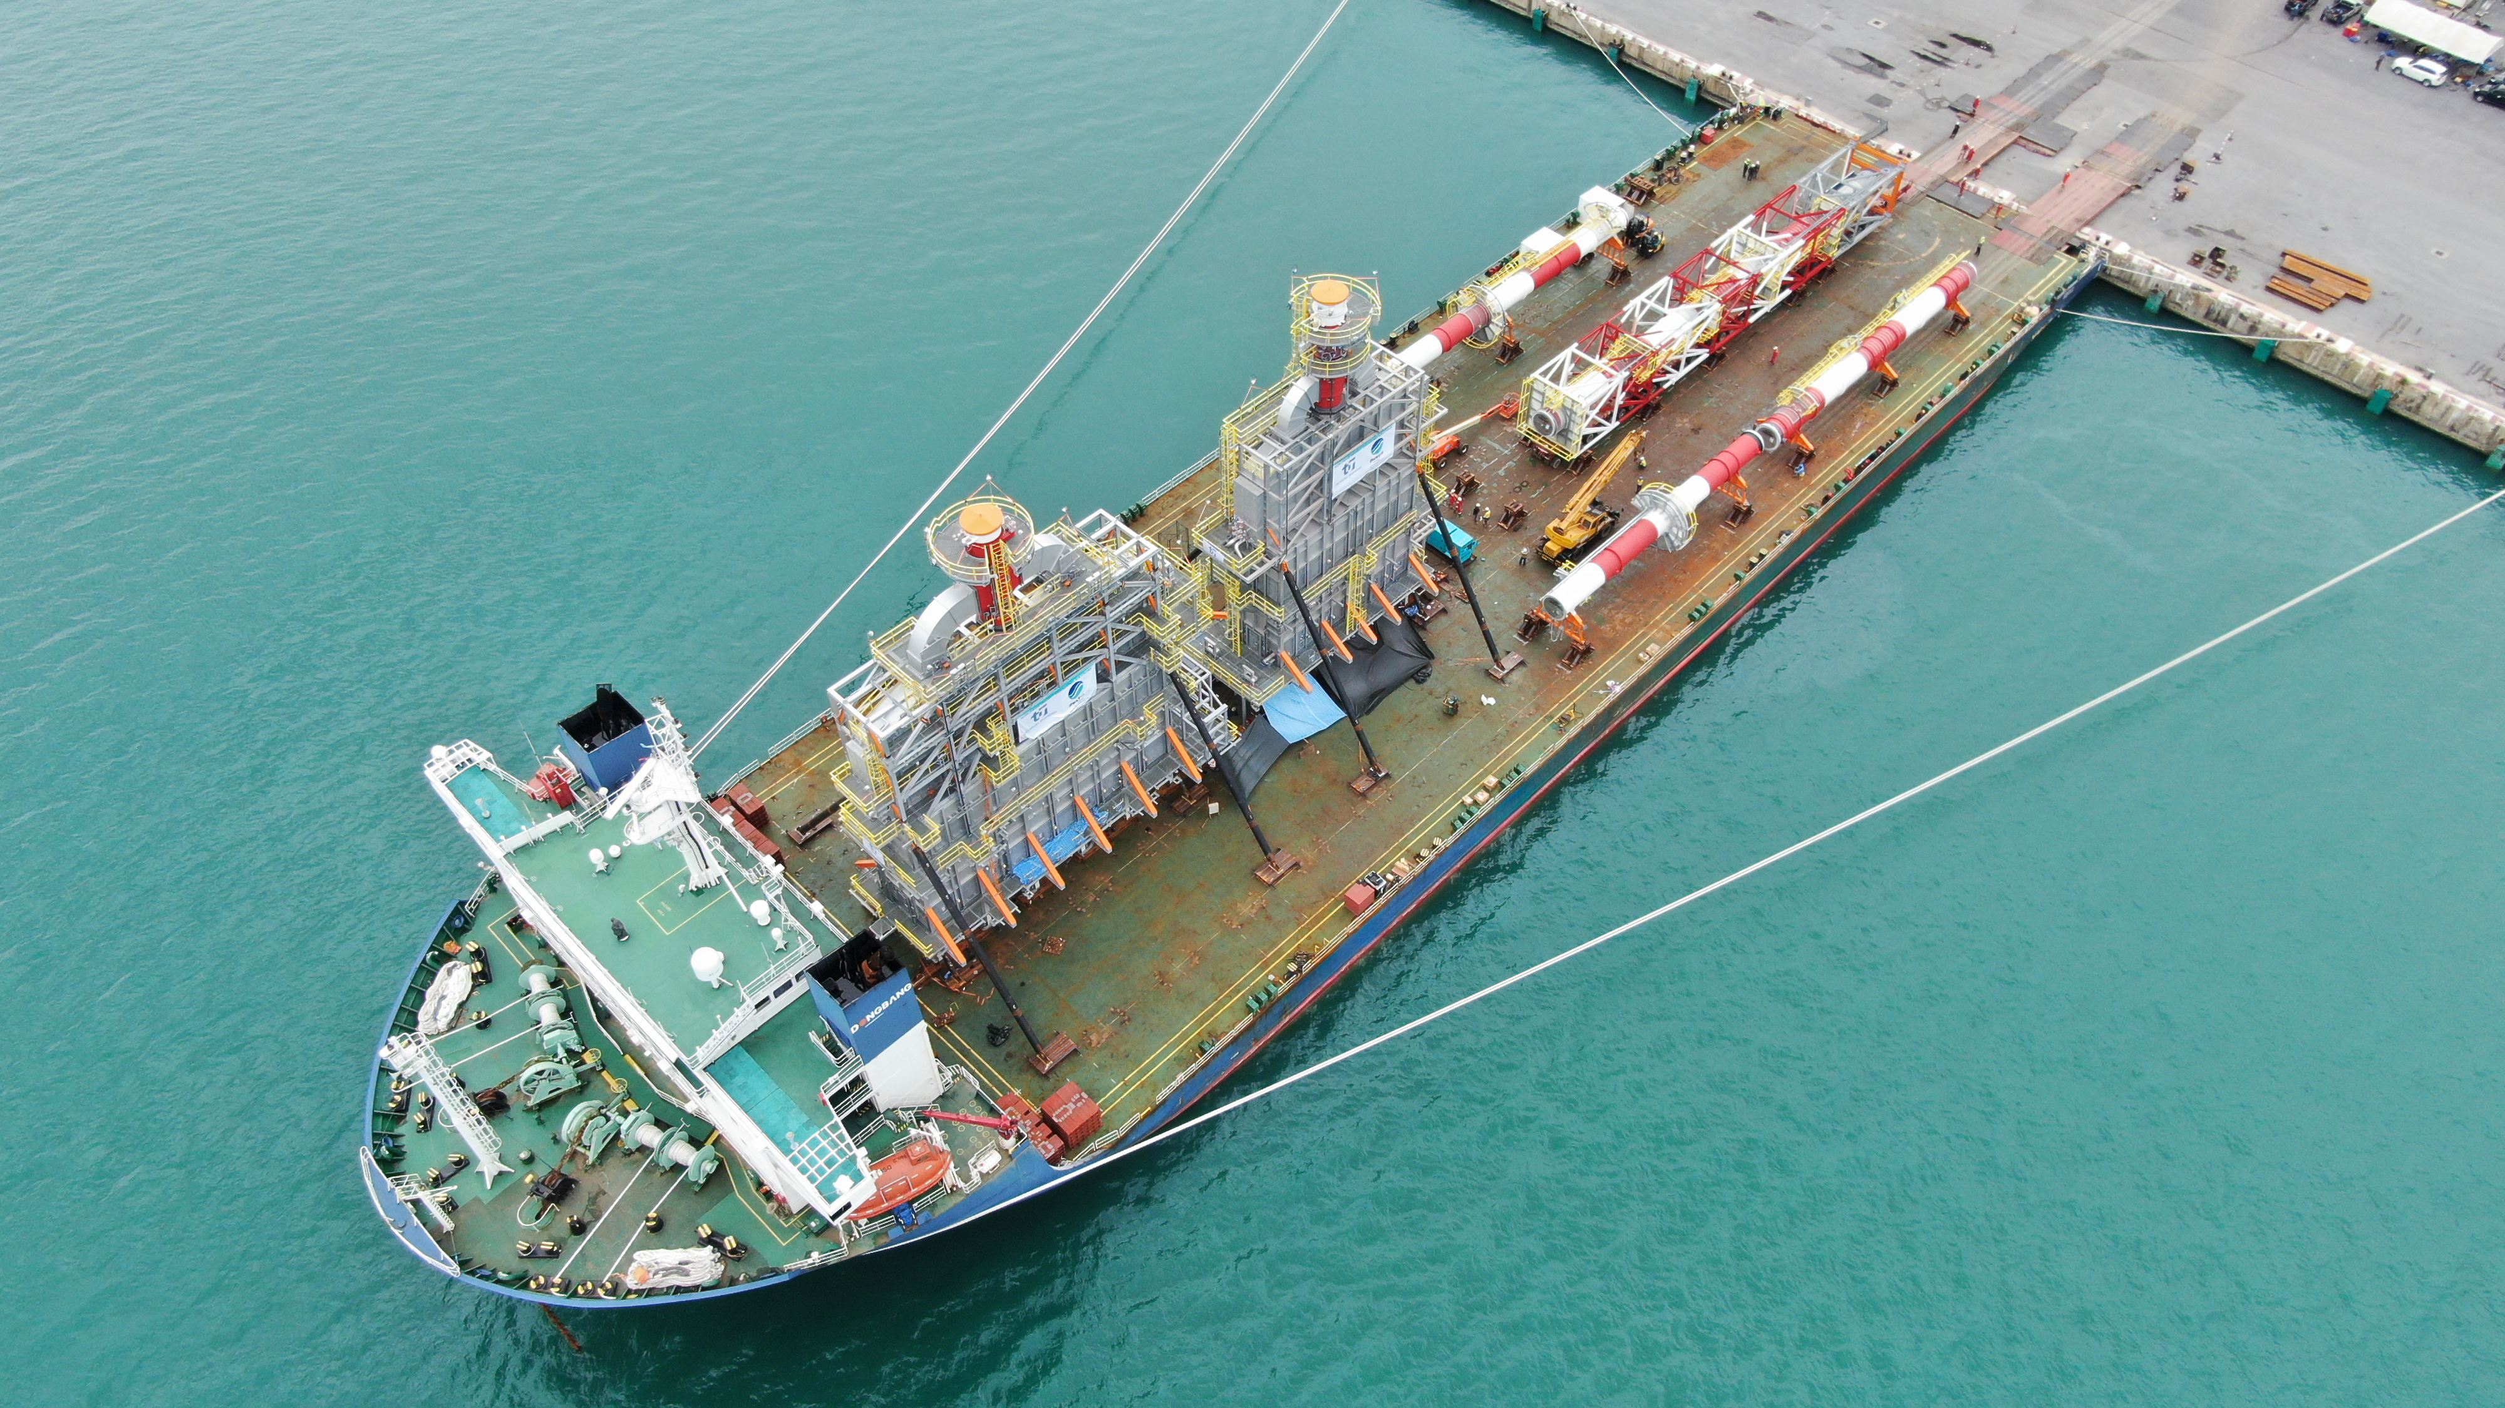

INTRODUCING

Slide 2
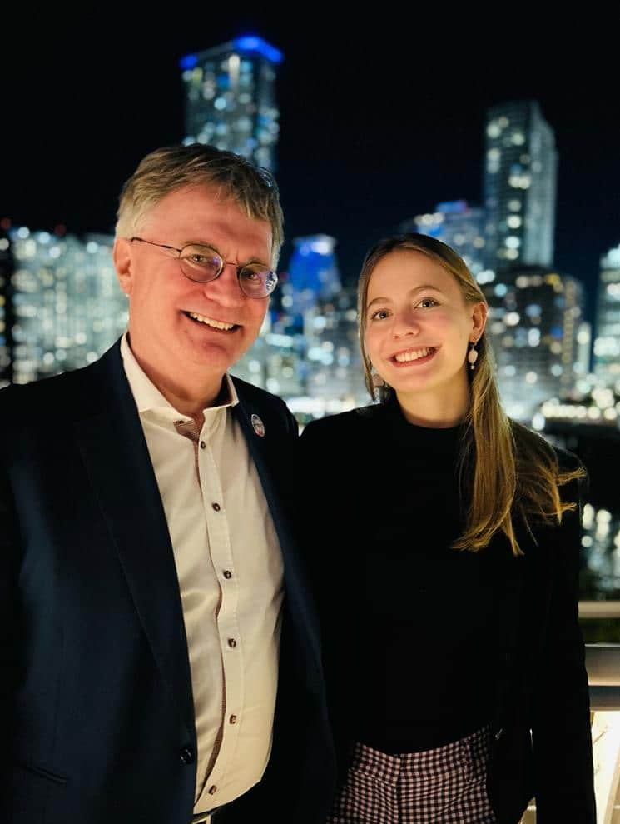

OUR PHILOSOPHY
WE ARE A GLOBAL FAMILY
The heart of our business is upheld by dedicated professionals who focus on our customers’ needs and provide outstanding quality and operational excellence. Our relationships with our clients, subcontractors, and employees are informed by an attitude of partnership, a philosophy that we have consistently practiced since the firm was established back in 1955.
Our goal is to deliver innovative
and sustainable
SOLUTIONS IN EVERY DIRECTION.
2

Slide 3
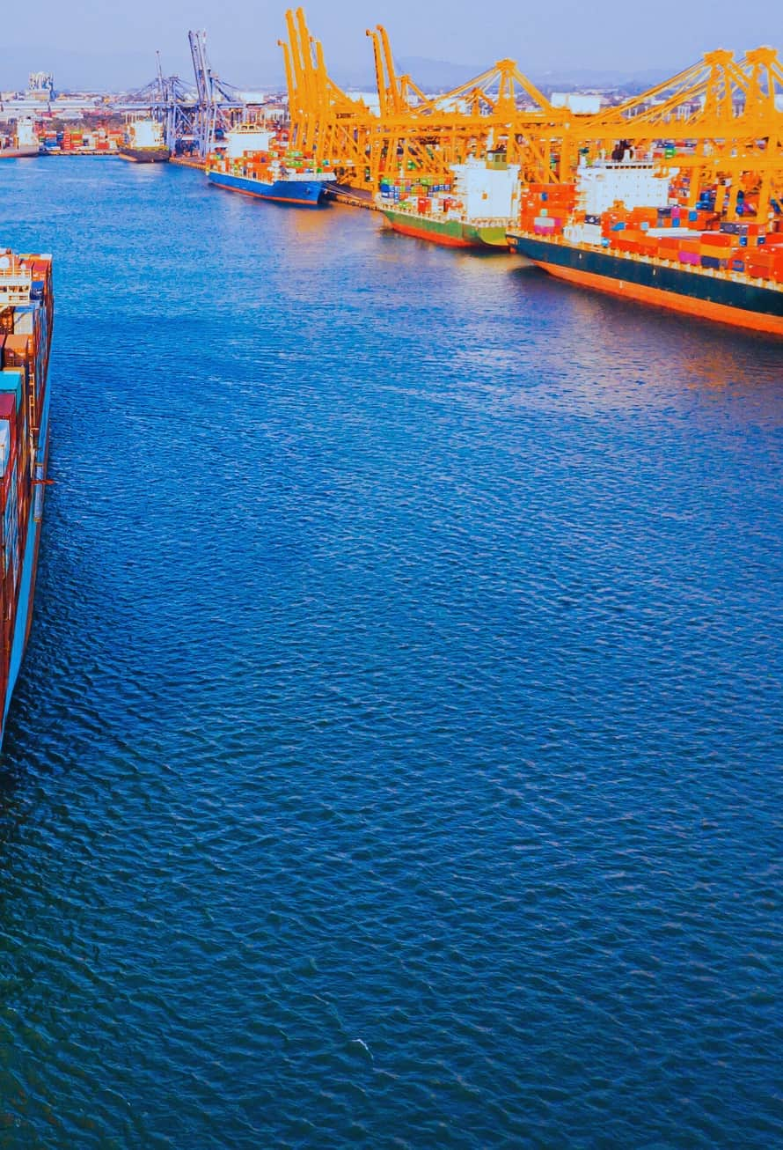


OUR CORE VALUES
GUIDELINES
RESPECT
INTEGRITY
We treat everyone
with respect.
We believe in a
moral compass.
PASSION
POSITIVITY
We demonstrate perserverance
and determination.
We exemplify gratitude and appreciation towards all.
At Fracht Group, our values define who we are and how we work. Respect ensures fairness and amplifies every voice, while Integrity guides us to uphold our principles. With Passion, we push boundaries, always striving for excellence. Positivity fuels our mindset, turning challenges into opportunities. Through Leadership, we foster growth in ourselves and others. And at our core, Empathy drives us to care deeply for our team and the communities we serve. These values aren’t just words—they’re how we move forward together. We are Fracht.
LEADERSHIP
EMPATHY
We promote self-growth.
We care about people.
We are Fracht

Slide 4
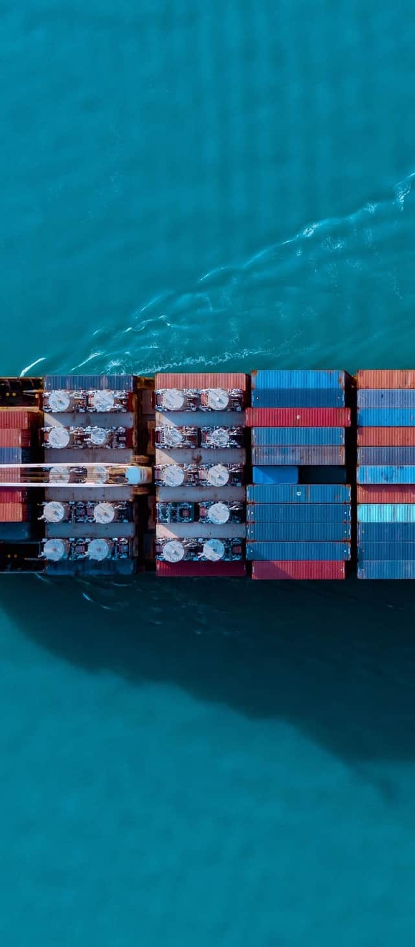


WHO WE ARE
1955
150+
2500+
BASEL,
SWITZERLAND
WORLDWIDE
LOCATIONS
CURRENT
EMPLOYEES
Commitment, Reliability and Punctuality
COMMITMENT
As an international company, we have a deep understanding of the global markets. Born as project forwarders, we have a rich history dating back to 1955.
RELIABILITY
We offer our clients customized options to best fit their timelines. With full logistics services at origin and destination, tailor-made solutions & over 150 offices worldwide, we pride ourselves on being outstanding strategic providers.
PUNCTUALITY
We are of Swiss origin and we honor the principles of commitment, reliability, and punctuality. We extend these values to our clients every step of the way.
4
INTRODUCING FRACHT GROUP

Slide 5
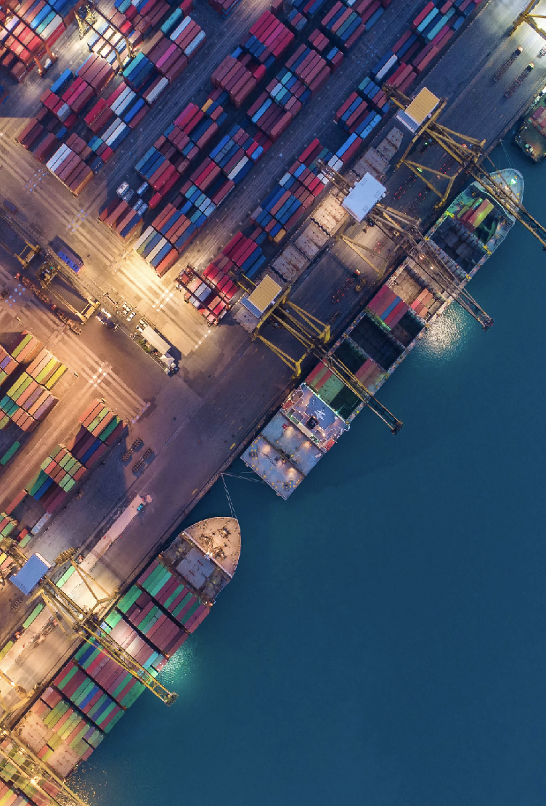
INTRO
GLOBAL NUMBERS
The Fracht Group handles a wide variety of general cargo from all corners of the world!
250,000 TEUS
MOVED IN 2024.
18 Million Kilos
OF AIR SHIPMENTS IN 2024.
123 Air Charters
MOVED SINCE 2023.
5

Slide 6

GLOBAL OFFICES
35+
NORTH &
SOUTH AMERICA
UNITED STATES, MEXICO, CANADA, COLOMBIA, ARGENTINA, EL SALVADOR, BRAZIL, PERU, URUGUAY, CHILE.
28+
AFRICA
IVORY COAST, MALI, BURKINA FASO, BURUNDI, MOROCCO, SENEGAL, TANZANIA, SOUTH AFRICA, UGANDA, RWANDA, CONGO- KINSHASA, ZIMBABWE, TOGO, ZAMBIA, KENYA, NIGER, MAURITIUS, NAMIBIA.
50+
EUROPE & MIDDLE EAST
ITALY, BELGIUM, SWITZERLAND, SPAIN, GERMANY, UNITED KINGDOM, FRANCE, ROMANIA, AUSTRIA, SWEDEN, POLAND, CZECHIA, HUNGARY, PORTUGAL, NETHERLANDS, FINLAND, UNITED ARAB EMIRATES, TURKEY, EGYPT, SAUDI-ARABIA, UZBEKISTAN, IRELAND.
28+
ASIA & OCEANIA
NETWORK
EXPANSION
Network expansion includes, on average, the addition of 7 new offices each year.
CW implementation of operating systems in Germany, Switzerland and other countries.
THAILAND, CHINA, VIETNAM, HONG KONG SAR CHINA, INDONESIA, PAKISTAN, PHILIPPINES, JAPAN, INDIA, SINGAPORE, TAIWAN, AUSTRALIA.
INTRODUCING FRACHT GROUP

Slide 7

DOOR-TO-DOOR GLOBAL LOGISTICS
Tailored, End-to-End Solutions
SERVICE HIGHLIGHTS
We assess and optimize your supply chain using custom strategies backed by a global network and deep carrier relationships.
Core Services:
Seafreight
Airfreight
Project Cargo
Rail
Trucking
Warehousing
Specialized Solutions:
White Glove Delivery
Supervised Offloading
Barge Services & Final Mile
Custom Services (Export/Import)
3PL/4PL
Charters (Air/Ocean)
KEY CAPABILITIES
Priority space allocations with top ocean & air carriers.
Custom logistics solutions across all commodities.
Visibility tools with real-time tracking & reporting.
Strong presence through global offices & exclusive agents.
7
INTRODUCING FRACHT GROUP

Slide 8
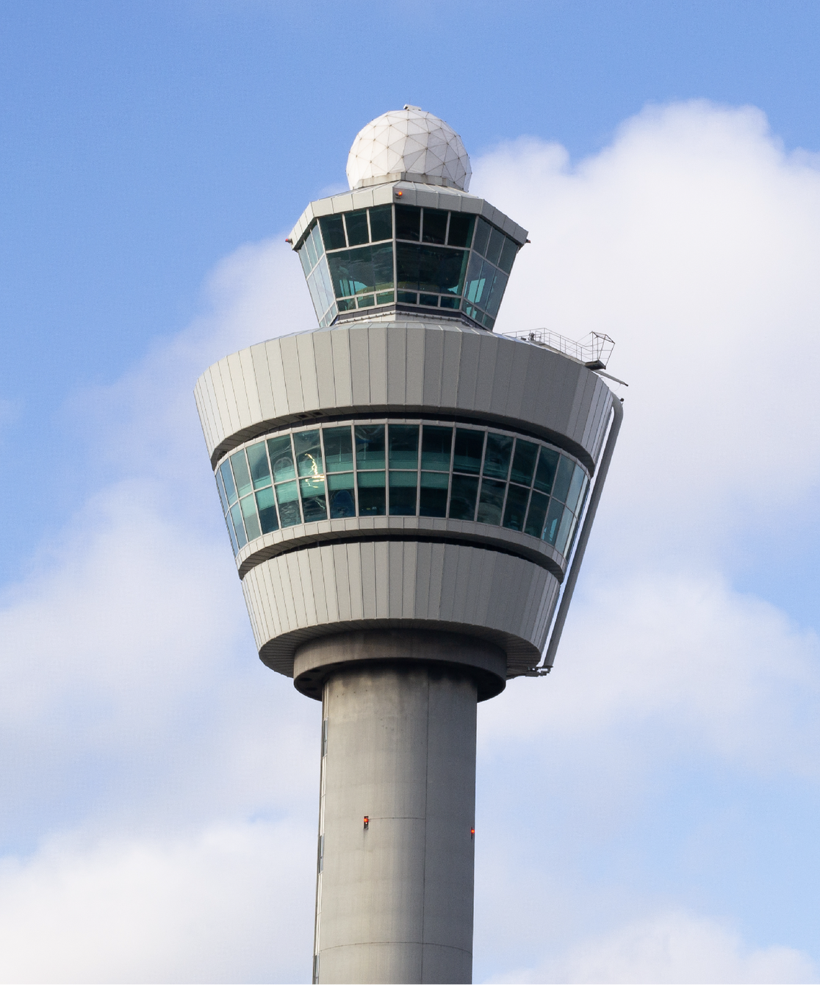
ACCOUNT MANAGEMENT
Control Tower Methodology
Fracht’s global control tower methodology allows for a hub and centralized solution for visibility, decision-making processes, and execution of transportation/logistics services.
BENEFITS
Single point of contact.
Global Network.
Custom Solutions.
End-to-end visibility & control.
Global Reach & Local Support.
Finance & Reporting.
INTRODUCING FRACHT GROUP

Slide 9
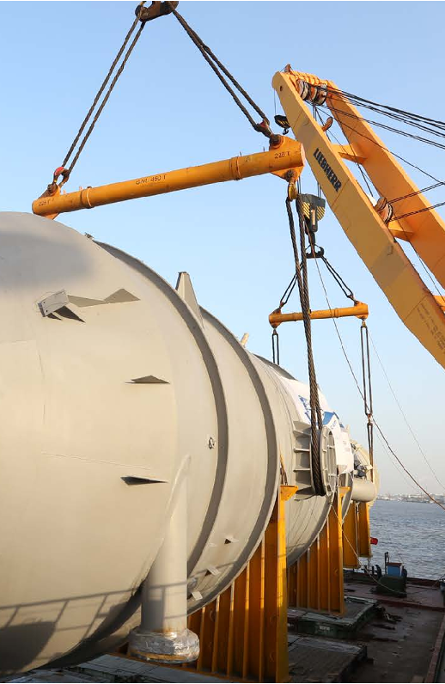
PROJECT CARGO
Project Cargo transport always represents a special and unique challenge given that every project brings new tasks which must be resolved to the millimeter and in the shortest possible time to satisfy the individual needs of each Project.
At Fracht Group, we have a dedicated team of experts & engineers to handle every aspect of your project.
Full And Partial Charters
Break Bulk And Ro/Ro Cargo.
Aircraft Chartering.
Barging Services.
Heavy Duty Rail Solutions.
Overland And Modular Transport.
Rigging oversized Cargo And Heavy Lift.
Special Packing.
Material Management Services.
Transport Engineering.
Installation Of Equipments.
Operational Tracking System.
Customs Brokerage Services.
9

Slide 10
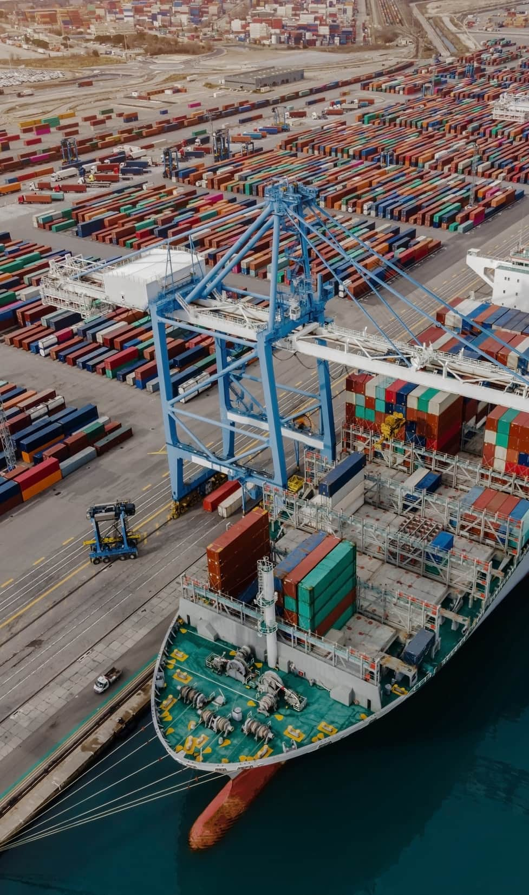
INDUSTRIES WE SERVE
ALTERNATIVE &
RENEWABLE ENERGIES
CHEMICALS
MINING
EPC CONTRACTORS
PHARMA &
HEALTHCARE
CUSTOMER GOODS
& RETAIL
WOOD, PULP & PAPER
COMMODITY & TRADING
RAILWAY &
ROLLING STOCK
AUTOMOTIVE
AID & RELIEF
OIL & GAS
INTRODUCING FRACHT GROUP

Slide 11
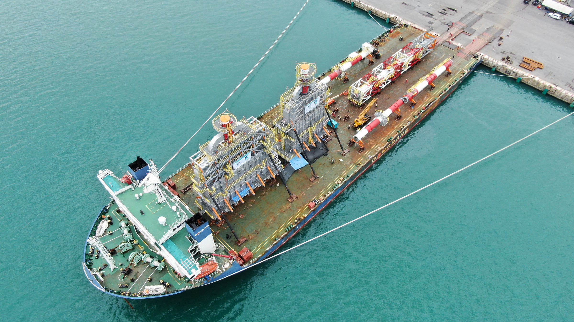
PROJECT CARGO

Slide 12
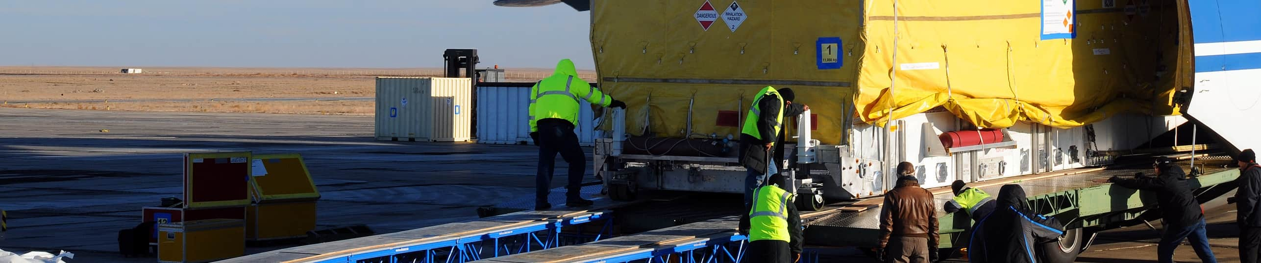
CORE PRODUCTS
Chartering
Identifying Suitable Vessel, Aircraft and Rail Cars types based on Customer & Cargo Requirements.
Technical Support with Tailor-Made Loading and Stowage Plans, Lifting & Lashing Calculations.
Voyage / Journey Management & Post Fixing Support.
Risk Mitigation through Due Diligence and Compliance Review of the Carrier Portfolio.
BENEFITS
Global coverage with presence in strategic core locations.
Full and real-time visibility across time zones.
Experts in charter contract management, optimization, and technical solutions.
12
PROJECT CARGO

Slide 13
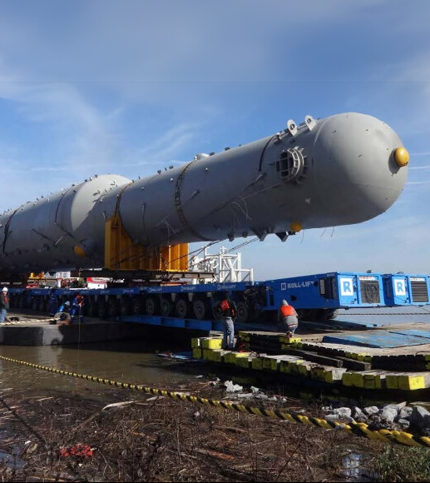
CORE PRODUCTS
Engineering
Technical Drawings & Design Studies.
Method Statements & Calculations.
Feasibility Studies & Route and Port Surveys.
BENEFITS
3d model simulation of operations.
Consulting services on equipment design.
Verification of all third-party equipment operations/calculations & documentations.
Design, manufacturing, and testing of handling and lifting equipment.
Heavy-lift concept design & optimization.
Lower risk exposure to cargo damage.
PROJECT CARGO

Slide 14
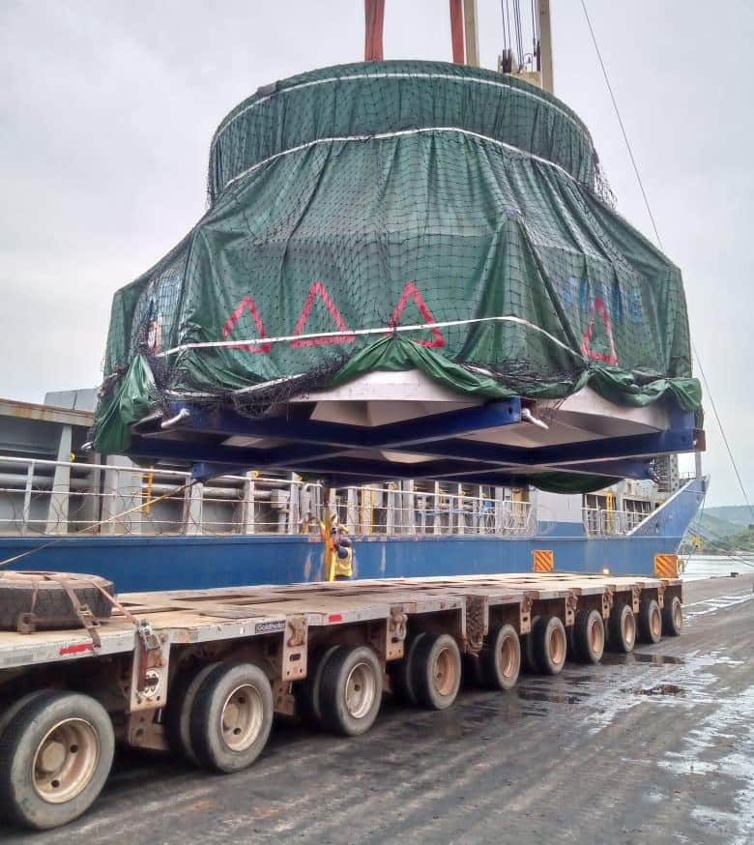
CORE PRODUCTS
Project Execution
Infrastructure Studies, Route Surveys.
Expediting Solutions, Project Logistics and Risk Management.
Export Packing, Engineering Support.
End-to-end logistics visibility.
BENEFITS
Vendor performance KPI reporting.
Global network of project experts.
Risk assessment and compliance.
Budget support & cost optimization.
Cargo damage risk prevention.
Delivery time forecast and improvement.
14
PROJECT CARGO

Slide 15
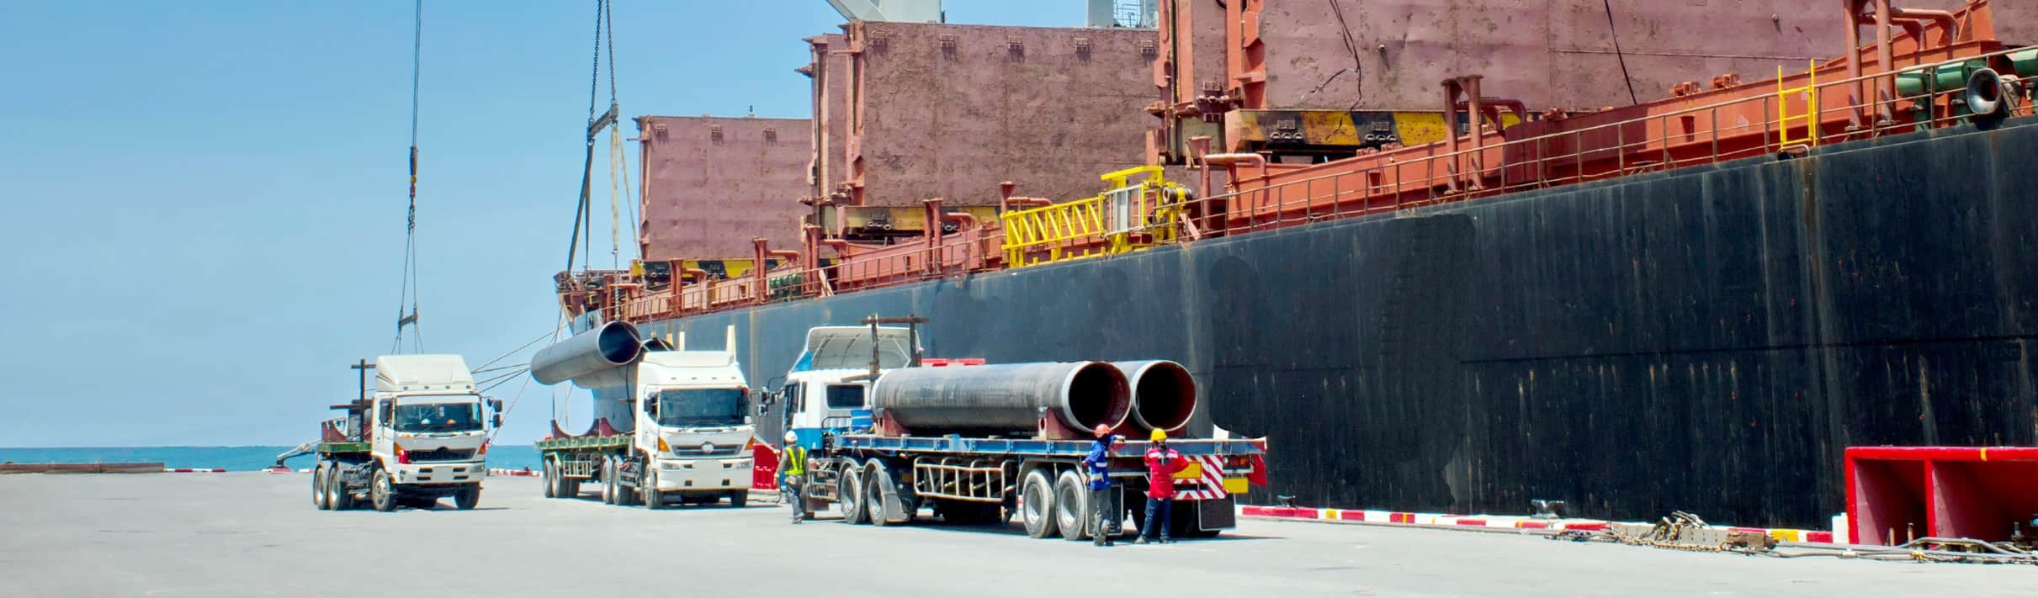
CORE PRODUCTS
Safety
Safety is our key priority.
Our mission is to operate supply chain with no harm to people and the environment.
15
PROJECT CARGO

Slide 16
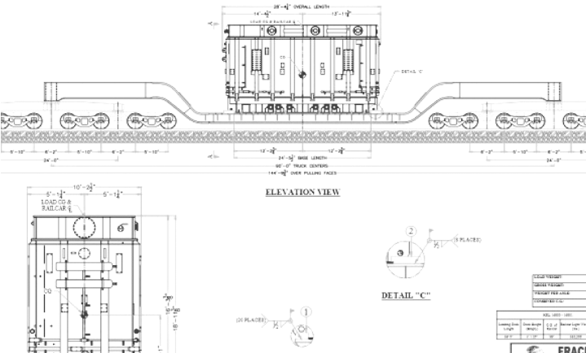
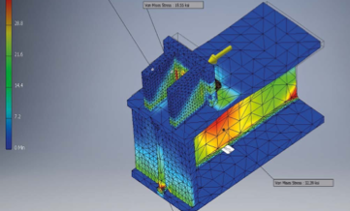
TRANSPORT ENGINEERING
TECHNICAL EXPERTISE,
METHOD STATEMENTS & ROUTE STUDIES.
TECHNICAL EXPERTISE,
METHODSTATEMENTS & ROUTE STUDIES.
PROJECT CARGO

Slide 17
IMPLEMENTATION PROCESS
Project Management Timeline
Project Logistics Early Planning Preliminary scope given to Fracht
Project Execution
During course of project
Delivery & Beyond
Analyzed by subject matter experts to prepare best to discuss concept & budgetary quotes/feasibility studies submitted to client.
Designated project team will be assigned to manage & deliver project.
Regular communication with all involved parties to obtain maximum efficiency.
Post project review.
Safety records & cost analysis.
Kick-off meeting where conceptual ideas, requirements & KPI’s will be set.
Constant monitoring of GPS will be kept making sure routes are kept & cargo is safe.
Face to face meetings to discuss suggested proposals.
Lessons learned.
Vendors will be vetted and introduced into team.
Once awarded to Fracht, method statements & route studies will be submitted to the client for final approval.
Site supervisor will make frequent visits to loadings/unloadings to verify all cargo in accounted for.
SOP will be presented where KPI’s & measurability of KPI’s will be outlined.
KPI’s regularly submitted to client for review.
Track & Trace system will be discussed and set.
17
PROJECT CARGO
INTRODUCING FRACHT GROUP

Slide 18
PROJECT IMPLEMENTATION & SUPPLY CHAIN PROCESS
Our fail-safe implementation
PROJECT LOGISTICS EARLY PLANNING PRELIMINARY SCOPE GIVEN TO FRACHT
DURING COURSE
OF PROJECT
PROJECT EXECUTION
DELIVERY & BEYOND
Expert analyzation/quote & feasibility studies submitted to client.
Meeting to discuss proposal, client expectations & identify go-live date.
Method statement & route studies.
It & visibility solutions.
Kick off meeting with dedicated projects team.
Identify project timeline.
Vendors chosen & vetted.
SOP presentation|KPIS outlined wisetech/logit one.
Regular communication.
Consistent GPS monitoring for route and cargo safety assurance.
Regularly submitted KPIs to client.
Clear visibility & reporting.
Quarterly QBRs.
Post project review.
Safety records & cost analysis lessons learned.
PROJECT CARGO

Slide 19
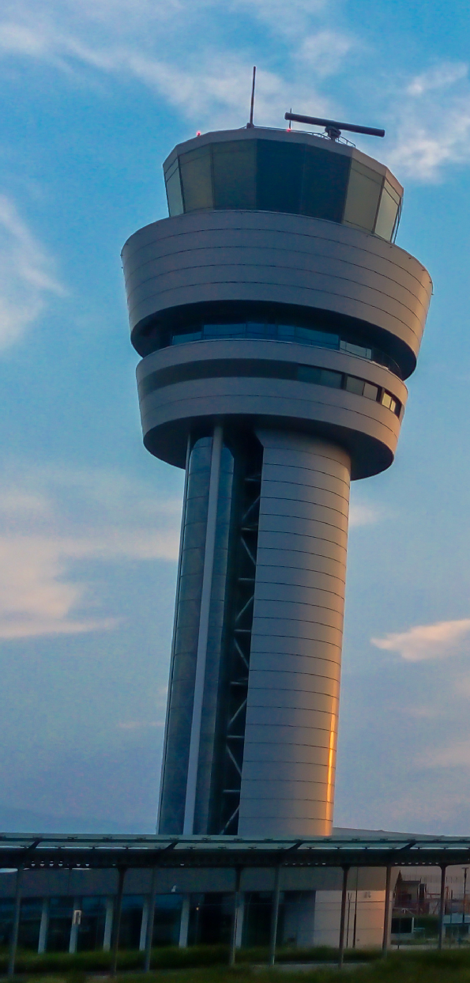
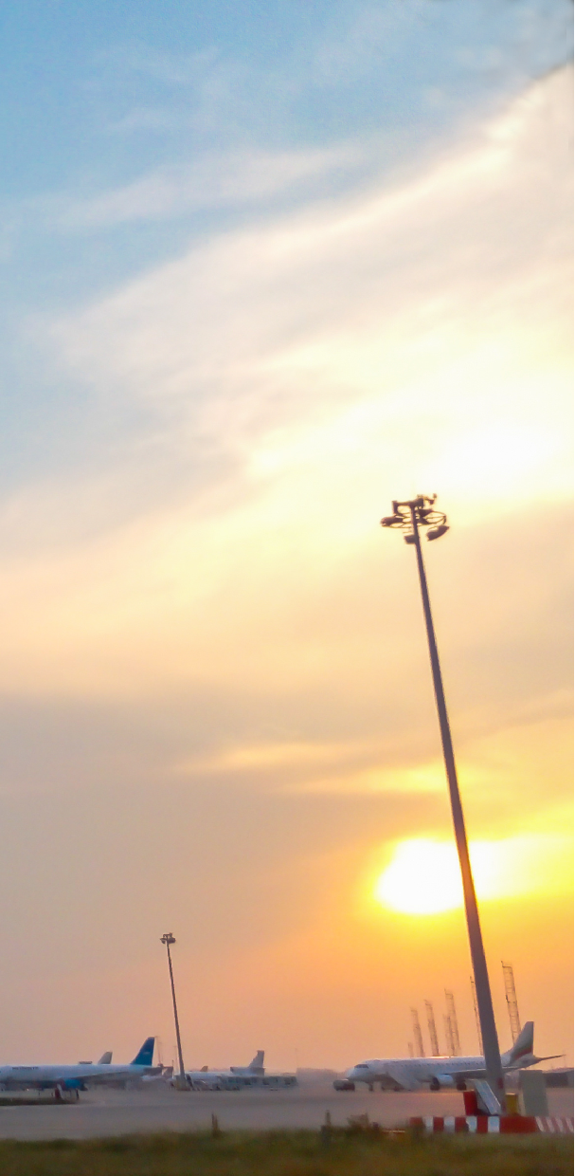
WHY CUSTOMERS
CHOOSE FRACHT
Our Service Control Tower
QUALITY SERVICE
Value-added services to serve your need for high-performance and flexible distribution infrastructure.
LONG-TERM PROFESSIONAL RELATIONSHIP
Regular and proactive communication to ensure our services meet your immediate needs - always.
SECURITY
High security compounds to protect your inventory and assets.
STRONG I.T. COMPETENCE
Real-time information and transparency along your supply chain.
KEY ACCOUNT MANAGEMENT FOR EVERY CUSTOMER
Customer Centric approach and make for predictability and increased planning reliability.
ASSURANCE
Dedicated teams to ensure safe and timely deliveries and storage, and high performance.
19
INTRODUCING FRACHT GROUP

Slide 20




CONTINGENCY PLAN
Long-term bookings
and contracts
Strong carrier relationships & negotiating power.
Alternative routes
& means of transportation
Natural Disasters
Any acts of nature such as hurricanes, etc, affecting infastructure.
Civil Unrest
Strikes affecting ports, critical infrastructure and means of transportation.
Political Unrest
Situations such as the current Red Sea crisis affecting safety, capacity & transit times
Capacity Shortage
Container or vessel shortage affecting capacity, transit times & pricing.

Slide 21



COMPLIANCE & SAFETY
ISO 9001:2015
Certified; along with high customer satisfaction, our goals include zero legal compliance issues.
Knowledgeable and properly trained staff in accordance to each project’s requirements.
Dedicated compliance team oversees ISO program and ensures compliance of all regulatory bodies.
The performance of our vendors reflects on us; vetting processes are in place to find qualified and reliable partners.
Responsibility and attention recognized by Board of Directors and Management Board
Comprehensive and risk-based Ethics & Compliance framework
Clear demands on our sub-contracted third parties
Leading Ethics & Compliance industry standards serving our customers, and preventing harm to Fracht Group and its stakeholders
ISO 14001:2015, ISO 45001:2018
Our goals include zero recordable hazardous spills and zero recordable injuries.
We work together with our vendors and clients to evaluate risks and formulate project procedures that minimize the potential for injury and environmental hazards.
21

Slide 22
D&B FINANCIAL STRENGTH

Slide 23

Our sustainability strategy, built on four pillars. The Fracht Four aligns with the UN Sustainable Development Goals. Its objectives evolve to meet the changing needs of our people, partners, and global prosperity.
“The UN Sustainable Development Goals are an integral part of our company’s vision, and, while they were not published at that time, they have been our goals since the founding of our company in 1955. In short, we want to be a ‘human and humanitarian company.’ People’s well-being is at the core of all we do. In future, we want to emphasize this more in all our ventures and operations to foster a broader understanding in our company on the topic of sustainable development.” Ruedi Reisdorf CEO & Chairman of Fracht Group
PLANET
PEOPLE
PROSPERITY
RESPONSIBILITY

Slide 24
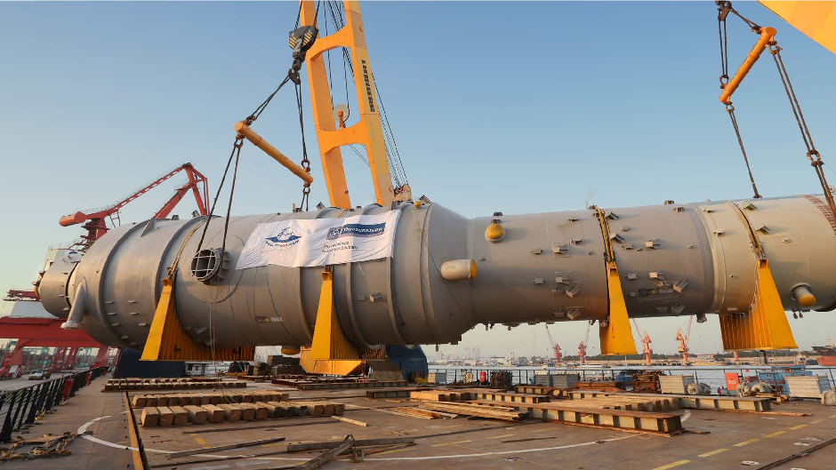
OUR EXPERIENCE

Slide 25
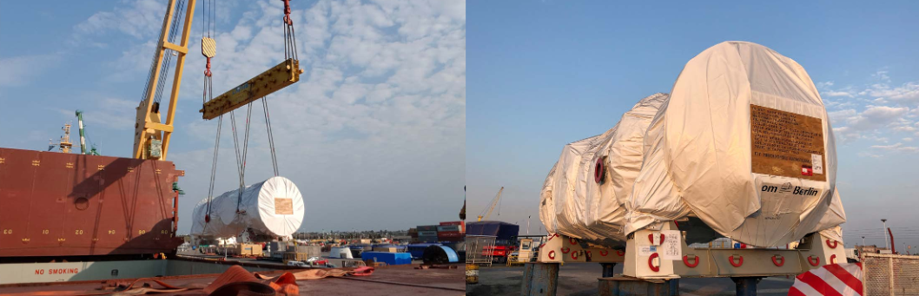
60,000
OUR EXPERIENCE
PROJECT:
Projects in Argentina
Genelba Power Plant
FRT
OUR EXPERIENCE

Slide 26

PROJECT:
15,000
OUR EXPERIENCE
INGA hydroelectric power plant
Projects in DRC
FRT
OUR EXPERIENCE

Slide 27
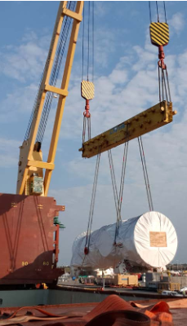
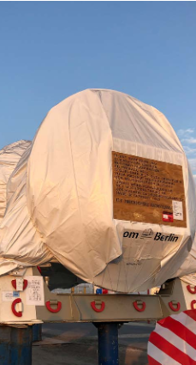
OUR EXPERIENCE
Projects in Argentina
PROJECT:
Genelba Power Plant
60,000
FRT
27
OUR EXPERIENCE

Slide 28
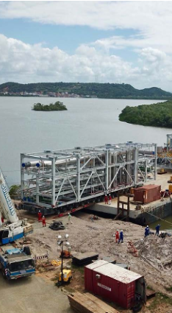
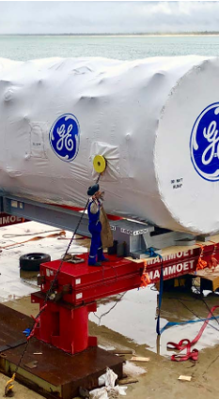
OUR EXPERIENCE
Projects in Brazil
PROJECT:
Thermo Power Plant
20,048
FRT
28
OUR EXPERIENCE

Slide 29
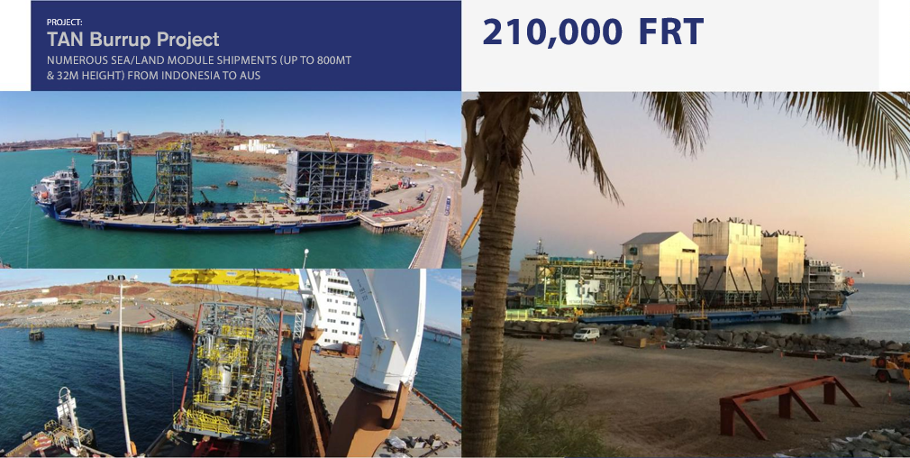
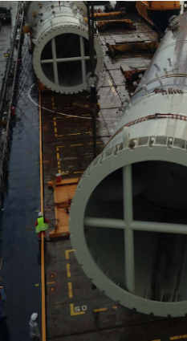
OUR EXPERIENCE
Projects in Australia
PROJECT:
Tan Burrup
Numerous Sea/Land module shipments
210,000
FRT
800MT & 32M
PROJECT CARGO
29
OUR EXPERIENCE
93

Slide 30
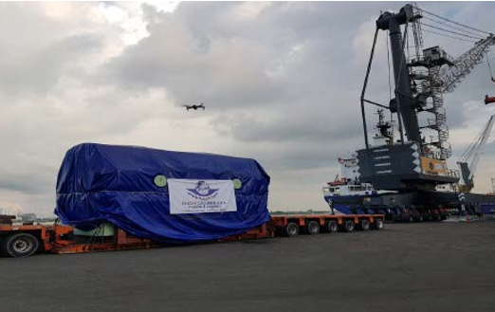
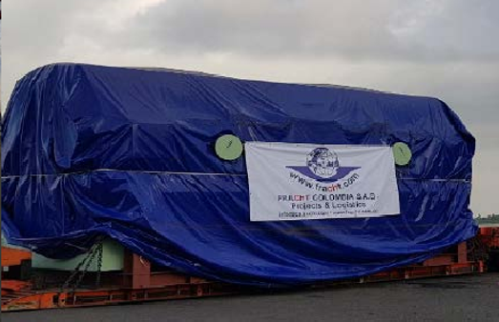
158.65
OUR EXPERIENCE
PROJECT:
Projects in Colombia
Thermoelectric Generator
FRT
OUR EXPERIENCE

Slide 31
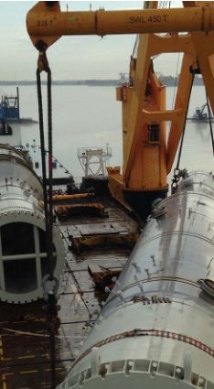
OUR EXPERIENCE
Projects in USA
PROJECT:
Fertilizer Plants
in Louisiana & Iowa
210,000
FRT
120 HEAVY LIFTS UP TO 720 TONS
31
OUR EXPERIENCE

Slide 32
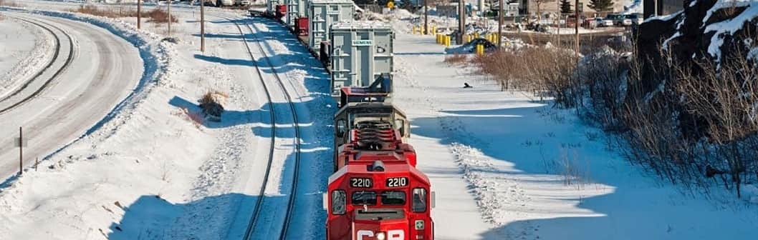
PROJECT:
62,000
OUR EXPERIENCE
FRT
Construction of 4 Substations
Projects in Canada
16 Transformers on Fracht’s 16-axle railcars to Canada.
OUR EXPERIENCE

Slide 33
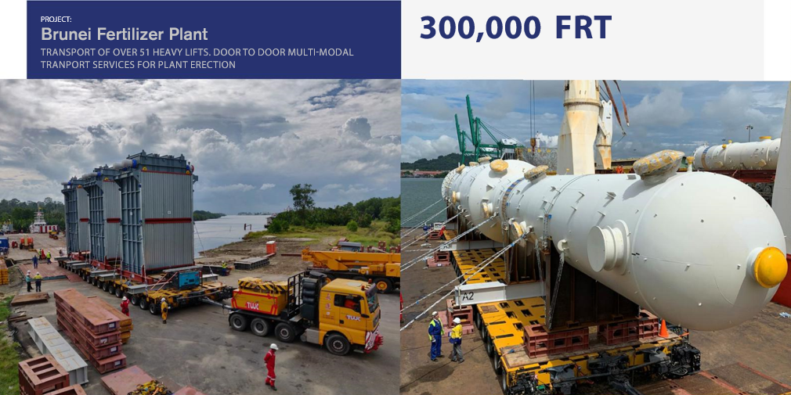
300,000
OUR EXPERIENCE
PROJECT:
Projects in Brunei
BRUNEI FERTILIZER PLANT
FRT
OUR EXPERIENCE

Slide 34
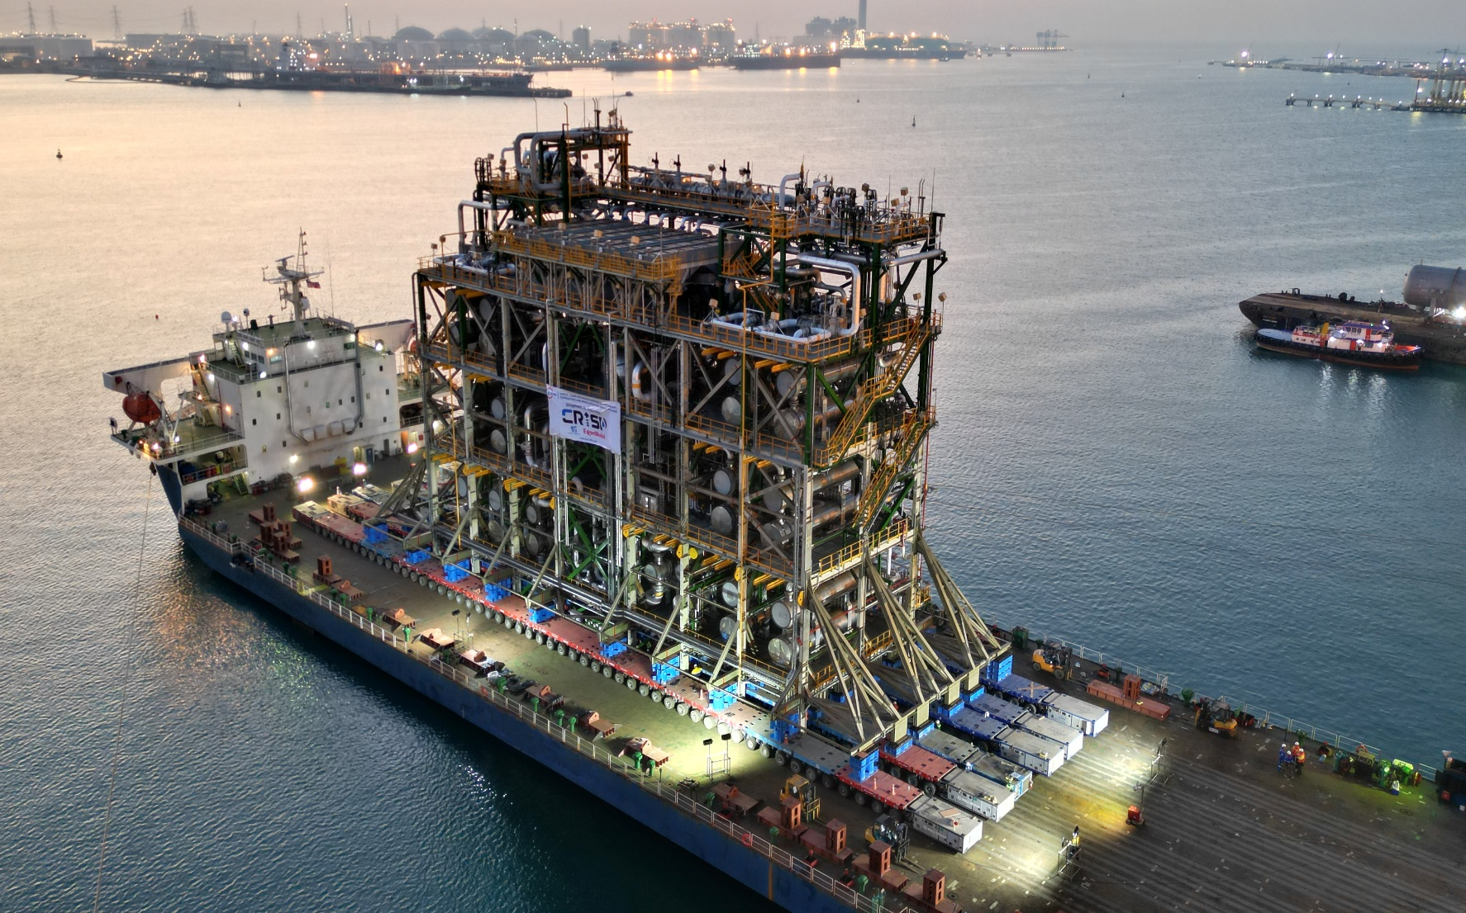
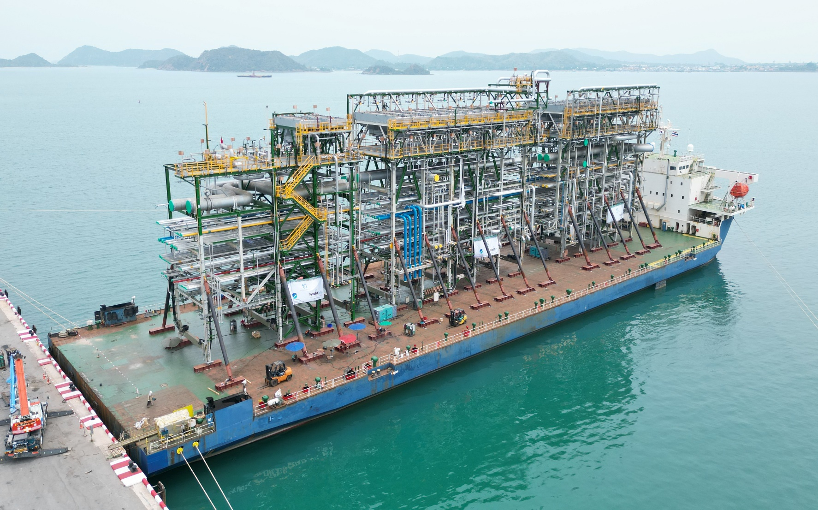
PROJECT:
800,000
OUR EXPERIENCE
CRISP
72 modules, 19 shipments, heaviest module over 4200mt
Projects in Thailand / Singapore
FRT
OUR EXPERIENCE

Slide 35
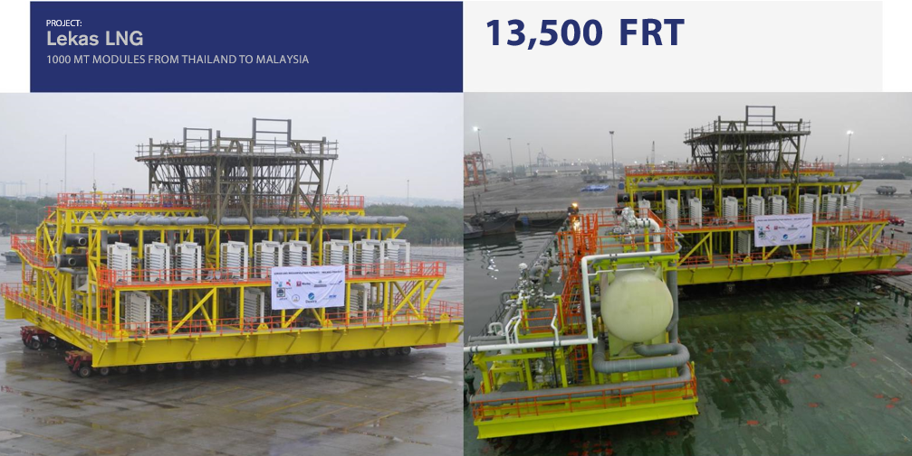
PROJECT:
OUR EXPERIENCE
LEKAS LNG
1000mt modules from Thailand to Malaysia
Projects in Malaysia
OUR EXPERIENCE

Slide 36
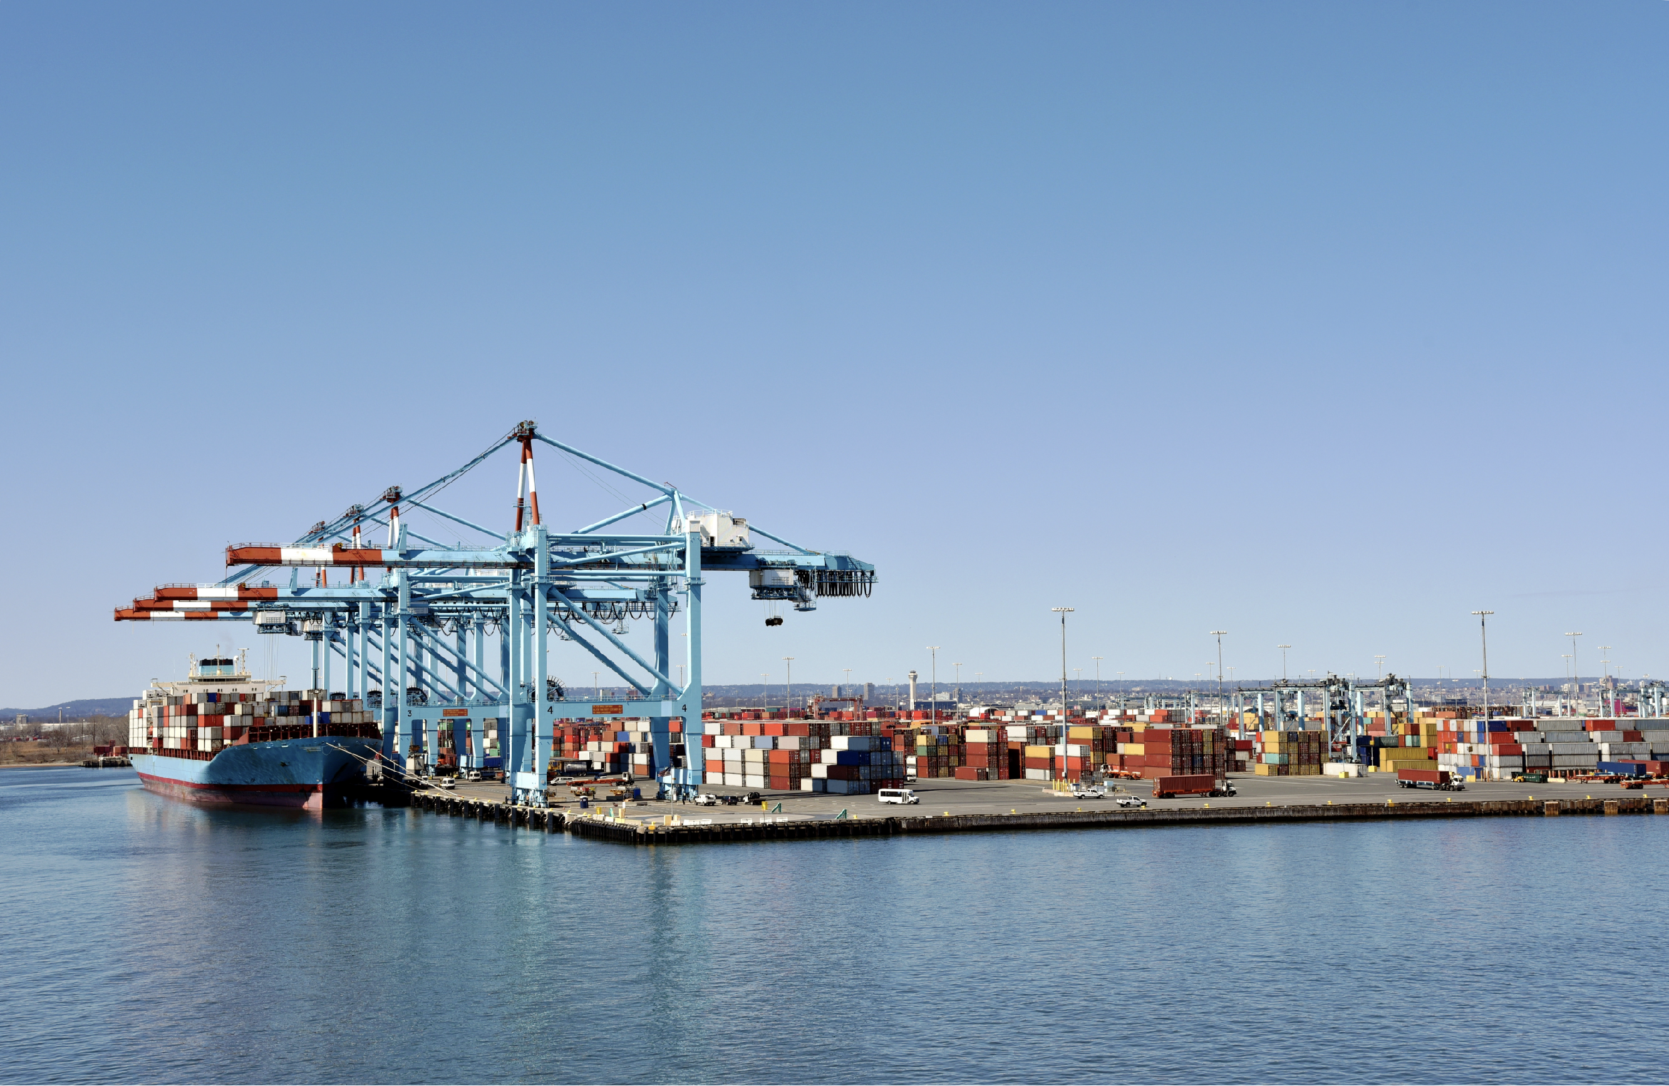

WHAT SOLUTIONS CAN WE PROVIDE FOR YOU?
www.frachtgroup.com

