Slide 1
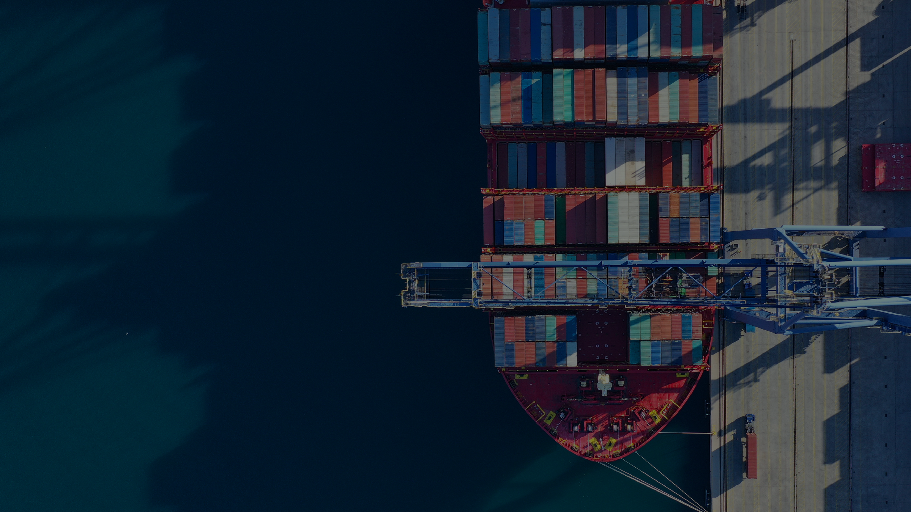

INTRODUCING

Slide 2
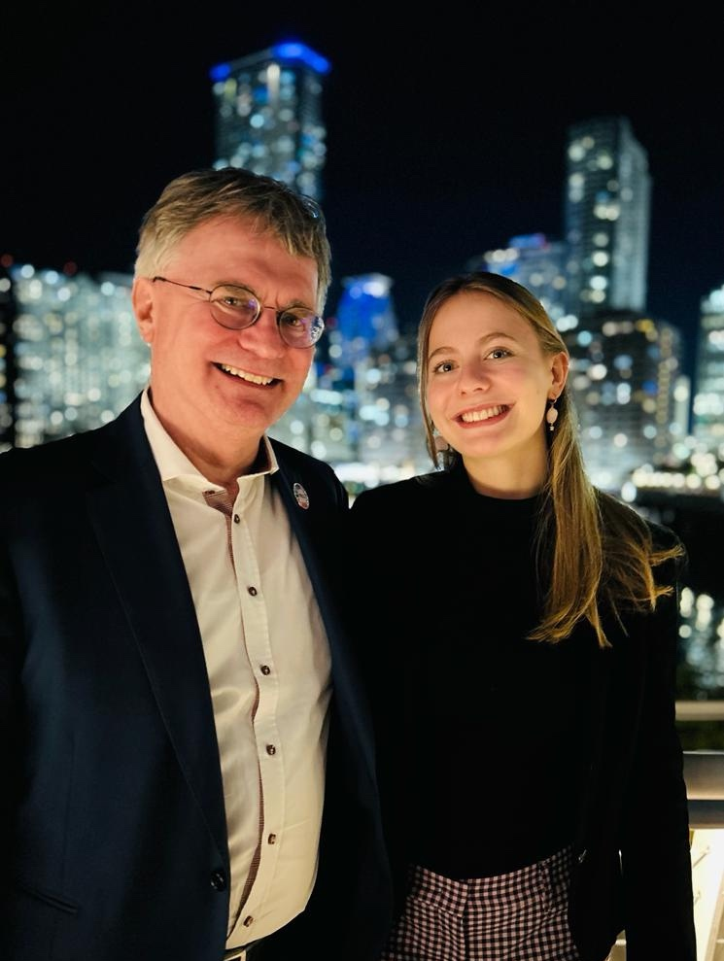


OUR PHILOSOPHY
WE ARE A GLOBAL FAMILY
The heart of our business is upheld by dedicated professionals who focus on our customers’ needs and provide outstanding quality and operational excellence. Our relationships with our clients, subcontractors, and employees are informed by an attitude of partnership, a philosophy that we have consistently practiced since the firm was established back in 1955.
Our goal is to deliver innovative
and sustainable
SOLUTIONS IN EVERY DIRECTION.
INTRODUCING FRACHT GROUP
2

Slide 3
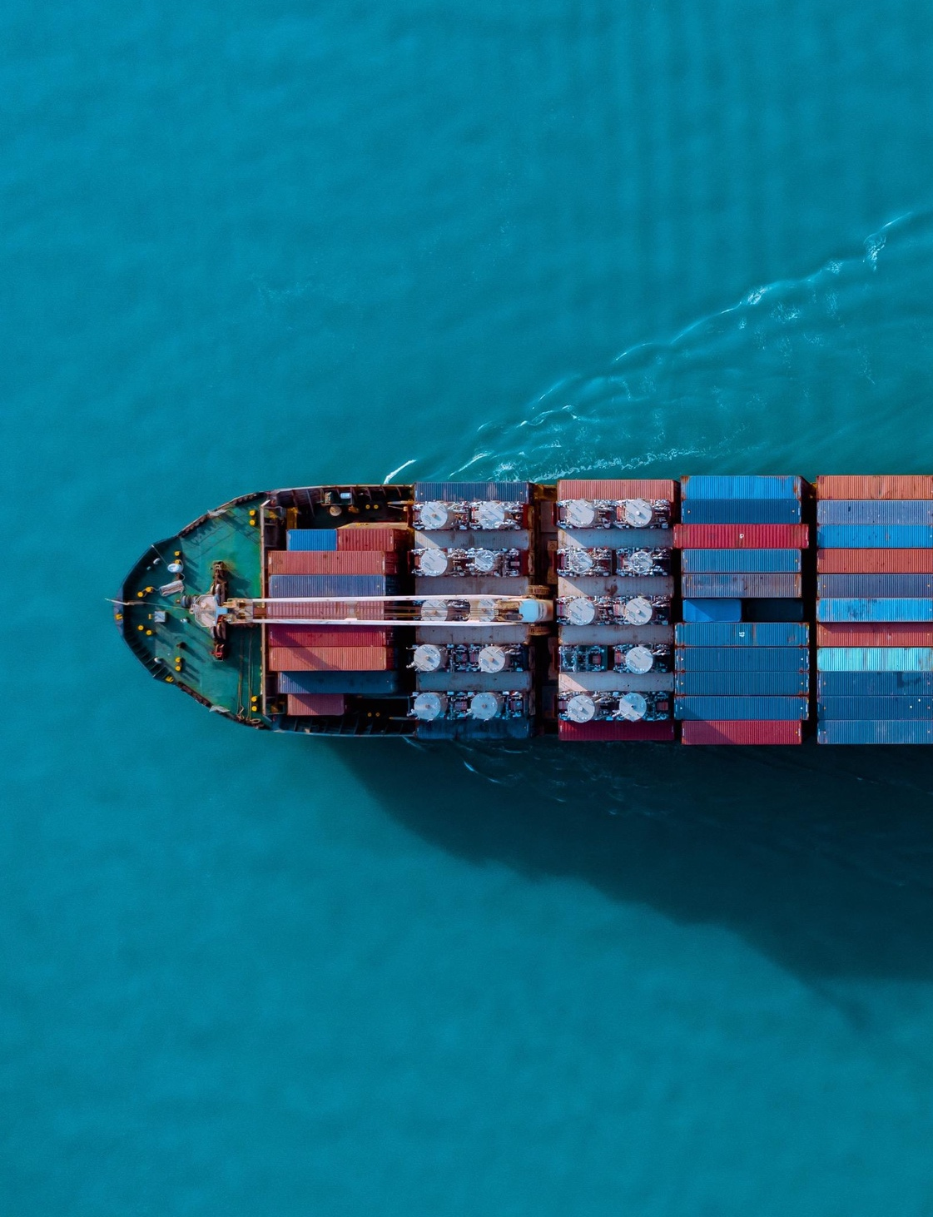

WHO WE ARE
1955
150+
2500+
BASEL,
SWITZERLAND
WORLDWIDE
LOCATIONS
CURRENT
EMPLOYEES
Commitment, Reliability and Punctuality.
COMMITMENT
As an international company, we have a deep understanding of the global markets. Born as project forwarders, we have a rich history dating back to 1955.
RELIABILITY
We offer our clients customized options to best fit their timelines. With full logistics services at origin and destination, tailor-made solutions & over 150 offices worldwide, we pride ourselves on being outstanding strategic providers.
PUNCTUALITY
We are of Swiss origin and we honor the principles of commitment, reliability, and punctuality. We extend these values to our clients every step of the way.
INTRODUCING FRACHT GROUP
3

Slide 4
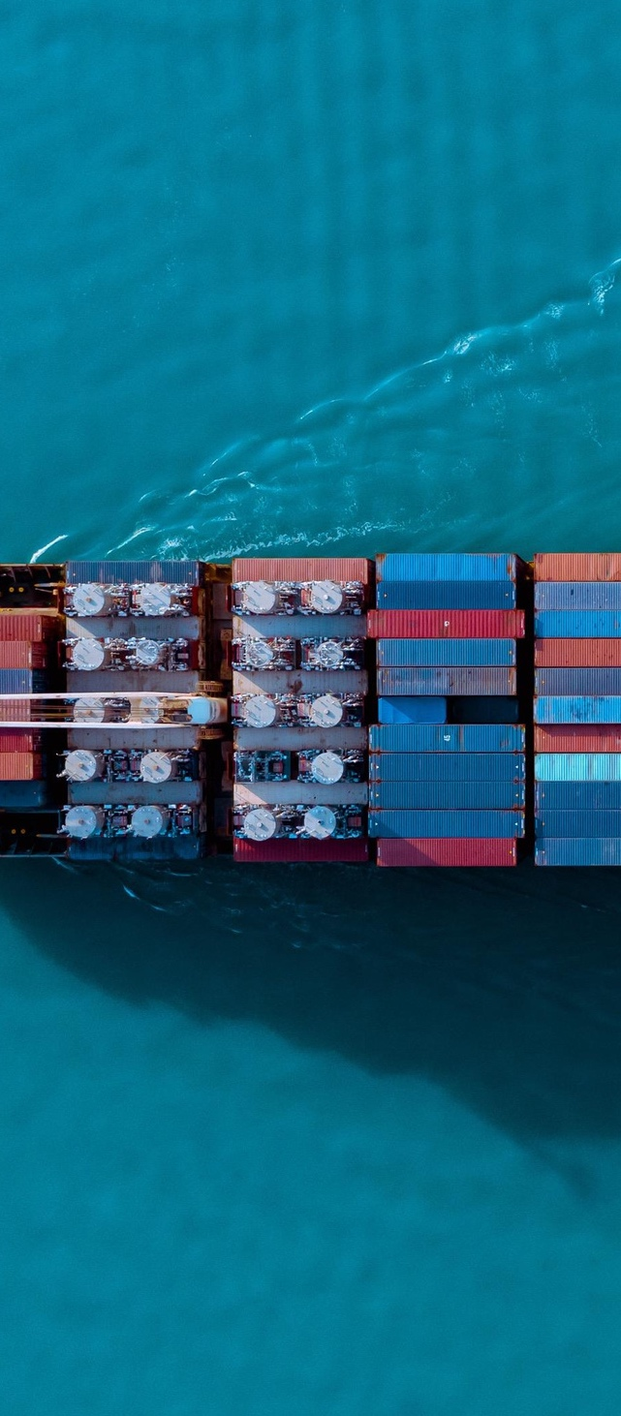

WHO WE ARE
1955
150+
2500+
BASEL,
SWITZERLAND
WORLDWIDE
LOCATIONS
CURRENT
EMPLOYEES
Commitment, Reliability and Punctuality
COMMITMENT
As an international company, we have a deep understanding of the global markets. Born as project forwarders, we have a rich history dating back to 1955.
RELIABILITY
We offer our clients customized options to best fit their timelines. With full logistics services at origin and destination, tailor-made solutions & over 150 offices worldwide, we pride ourselves on being outstanding strategic providers.
PUNCTUALITY
We are of Swiss origin and we honor the principles of commitment, reliability, and punctuality. We extend these values to our clients every step of the way.
INTRODUCING FRACHT GROUP
4

Slide 5
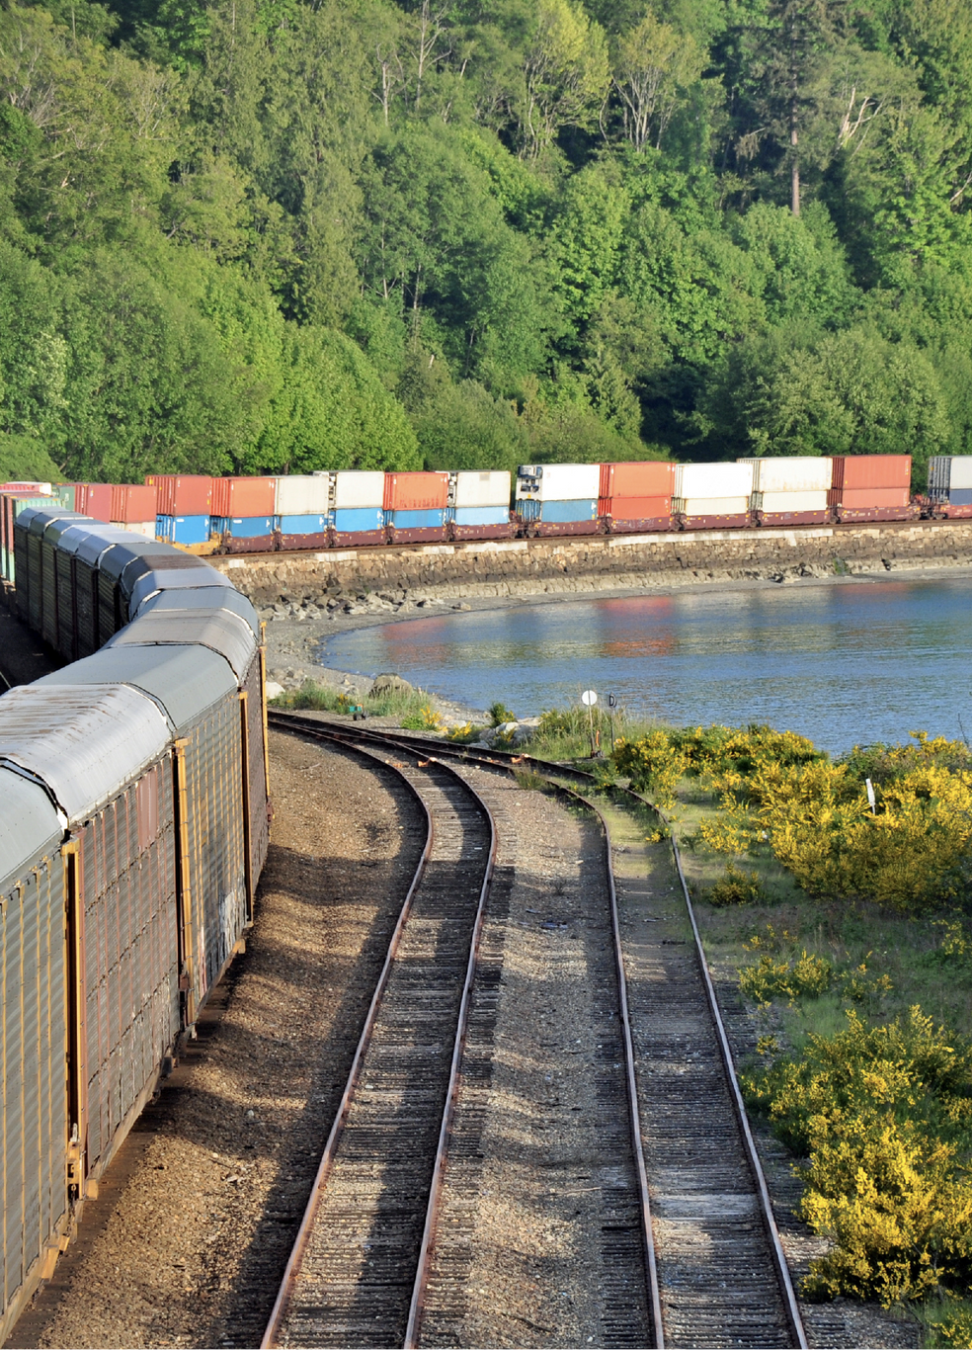

WHO WE ARE
Global Presence & Own Locations
150+
GLOBAL
OFFICES
35+ NORTH & SOUTH AMERICA
ATLANTA, BOSTON, CHICAGO, HOUSTON, LOS ANGELES, MIAMI, NEW YORK, NORFOLK, SAN DIEGO, VANCOUVER, B.C., TORONTO, MONTREAL, CIUDAD DE MEXICO, PORT OF PECEM (CTI), FORTALEZA (CTI), RECIFE (CTI), SALVADOR - BAHIA (CTI), CAMPINAS (NUNO), PERDOES (NUNO), SAO PAULO (FRACHT & NUNO), SANTOS (NUNO), RIO DE JANEIRO (NUNO), NAVEGANTES (CTI), CURIITIBA, PORTE ALEGRE, BOGOTA, BUENOS AIRES, MONTEVIDEO, SANTIAGO DE CHILE, LIMA.
50+ EUROPE & MIDDLE EAST
LILLE, LYON, PARIS, STRASBOURG, TOULOUSE, BIRMINGHAM, LONDON, MILAN, VERONA, GENOA, La Valetta, Bilbao, Madrid, Barcelona, Harderwijk, Schiedam, Amsterdam, Gothenburg, Dusseldorf, Hamburg, Frankfurt, Mannheim, Stuttgart, St. Wendel, Nuremburg, Basel, Agno, Embrach, Geneva, Zurich, Wettingen, Rapperswil, Helsinki, Copenhagen, Vienna, Warszawa, Poznan, Krakow, Katowice, Wroclaw, Olsztyn, Ostrava, Valaska Praha/Ricany, Papa, Brussels, Antwerp, Abu Dhabi, Dubai, Porto, Bucharest, Cluj Napoca.
28+ AFRICA
NETWORK EXPANSION
KINSHASA, MATADI, LUBUMBASHI, KOLWEZI, LIKASI, KASUMBALESA, DAR ES SALAAM, KIGOMA, NDOLA, DURBAN, JOHANNESBURG, KIGALI, BUJUMBURA, PORT LOUIS, DAKAR, ABIDJAN, OUGADOUGOU, DOUALA, CAIRO, NIAMEY, MOMBASA, KAMPALA, BAMAKO.
28+ ASIA & OCEANIA
Network expansion includes, on average, the addition of 7 new offices each year.
BEIJING, DALIAN, HONG KONG, SHANGHAI, SHENZHEN, NINGBO, XI’AN, GUANGZHOU, QINGDAO, XIAMEN, TAIPEI, MANILA, TOKYO, KUALA LUMPUR, KARACHI, JAKARTA, ADELAIDE, BRISBANE, PERTH, SYDNEY, MELBOURNE, MUMBAI, HO CHI MINH, BANGKOK, SINGAPORE, MAKATI CITY.
INTRODUCING FRACHT GROUP
5

Slide 6
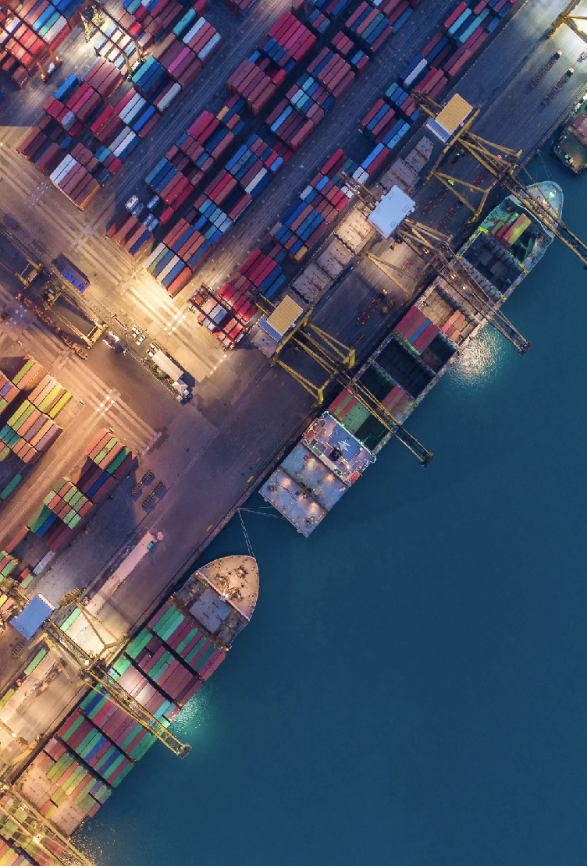
GLOBAL NUMBERS
The Fracht Group handles a wide variety of general cargo from all corners of the world!
250,000 TEUS
MOVED IN 2024.
18 Million Kilos
OF AIR SHIPMENTS IN 2024.
123 Air Charters
MOVED SINCE 2023.
INTRODUCING FRACHT GROUP
6

Slide 7
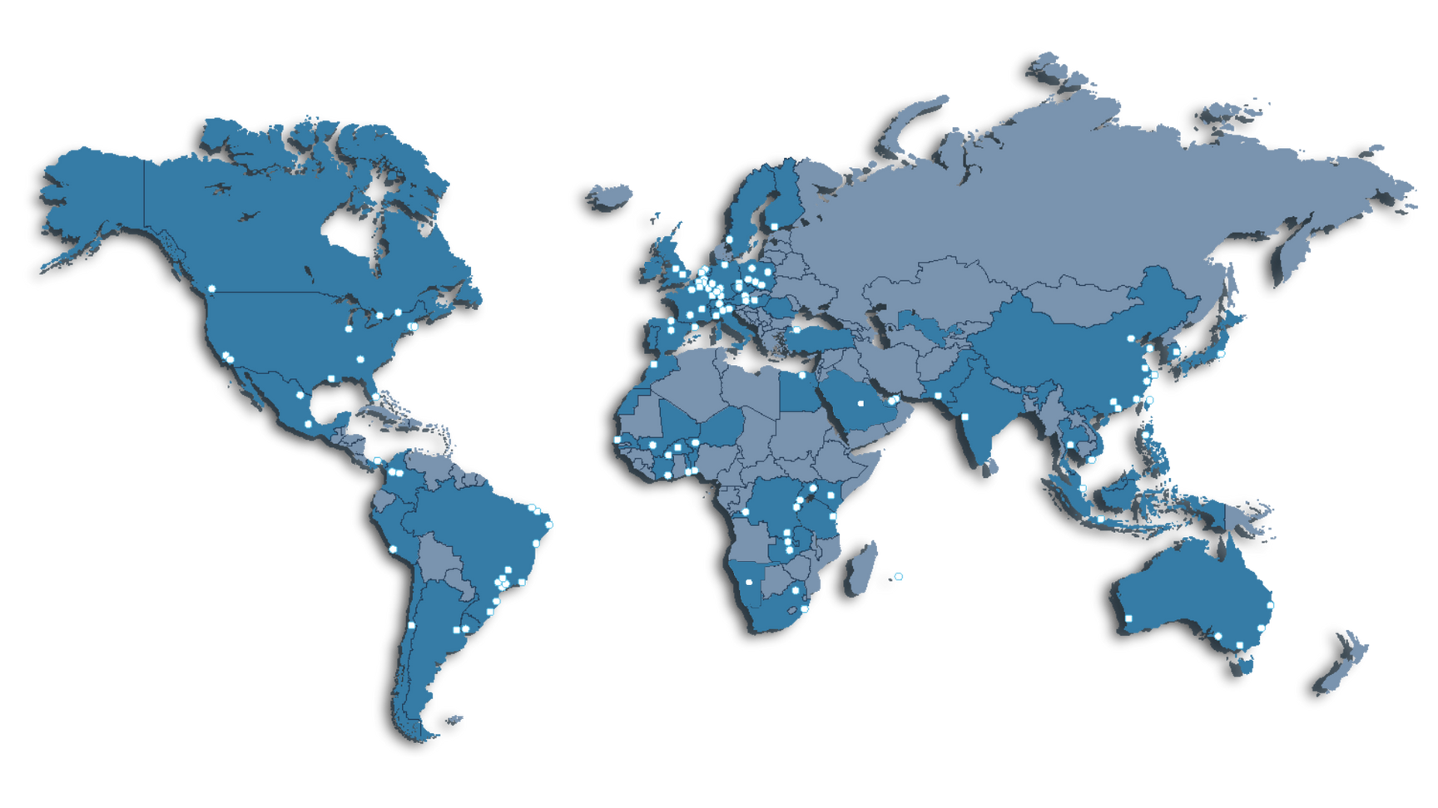
GLOBAL OFFICES
35+
NORTH &
SOUTH AMERICA
UNITED STATES, MEXICO, CANADA, COLOMBIA, ARGENTINA, EL SALVADOR, BRAZIL, PERU, URUGUAY, CHILE.
28+
AFRICA
IVORY COAST, MALI, BURKINA FASO, BURUNDI, MOROCCO, SENEGAL, TANZANIA, SOUTH AFRICA, UGANDA, RWANDA, CONGO- KINSHASA, ZIMBABWE, TOGO, ZAMBIA, KENYA, NIGER, MAURITIUS, NAMIBIA.
50+
EUROPE & MIDDLE EAST
ITALY, BELGIUM, SWITZERLAND, SPAIN, GERMANY, UNITED KINGDOM, FRANCE, ROMANIA, AUSTRIA, SWEDEN, POLAND, CZECHIA, HUNGARY, PORTUGAL, NETHERLANDS, FINLAND, UNITED ARAB EMIRATES, TURKEY, EGYPT, IRELAND.
28+
ASIA & OCEANIA
NETWORK
EXPANSION
Network expansion includes, on average, the addition of 7 new offices each year.
CW implementation of operating systems in Germany, Switzerland and other countries.
THAILAND, CHINA, VIETNAM, HONG KONG SAR CHINA, INDONESIA, PAKISTAN, PHILIPPINES, JAPAN, INDIA, SINGAPORE, TAIWAN, AUSTRALIA.
INTRODUCING FRACHT GROUP
7

Slide 8
GLOBAL OFFICES
INTRODUCING FRACHT GROUP
8

Slide 9

DOOR-TO-DOOR GLOBAL LOGISTICS
Tailored, End-to-End Solutions
SERVICE HIGHLIGHTS
We assess and optimize your supply chain using custom strategies backed by a global network and deep carrier relationships.
Core Services:
Seafreight
Airfreight
Project Cargo
Rail
Trucking
Warehousing
Specialized Solutions:
White Glove Delivery
Supervised Offloading
Barge Services & Final Mile
Custom Services (Export/Import)
3PL/4PL
Charters (Air/Ocean)
KEY CAPABILITIES
Priority space allocations with top ocean & air carriers.
Custom logistics solutions across all commodities.
Visibility tools with real-time tracking & reporting.
Strong presence through global offices & exclusive agents.
INTRODUCING FRACHT GROUP
9

Slide 10
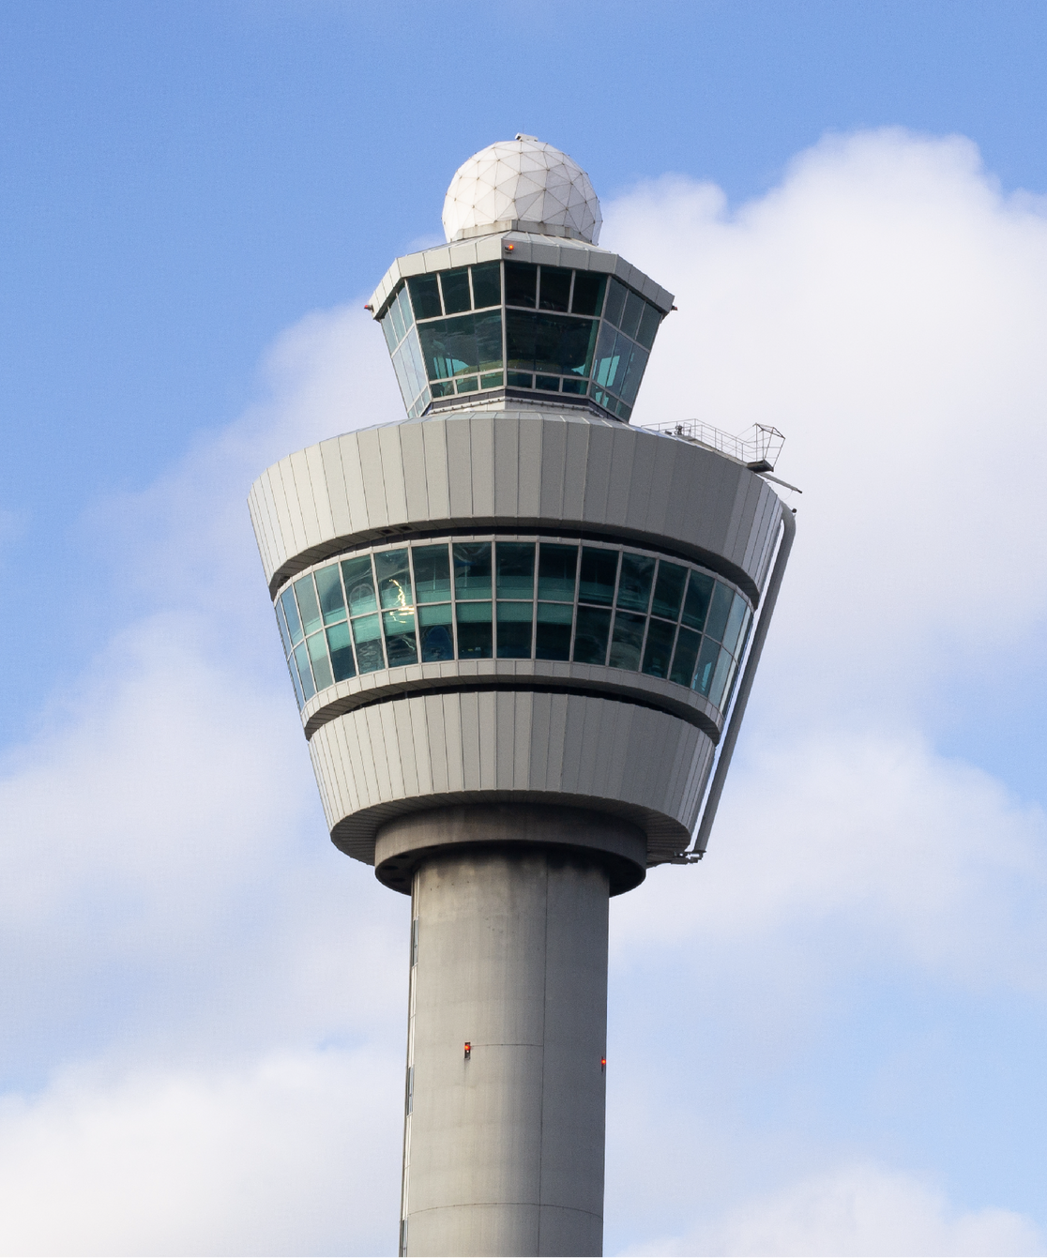
ACCOUNT MANAGEMENT
Control Tower Methodology
Fracht’s global control tower methodology allows for a hub and centralized solution for visibility, decision-making processes, and execution of transportation/logistics services.
BENEFITS
Single point of contact.
Global Network.
Custom Solutions.
End-to-end visibility & control.
Global Reach & Local Support.
Finance & Reporting.
INTRODUCING FRACHT GROUP
10

Slide 11
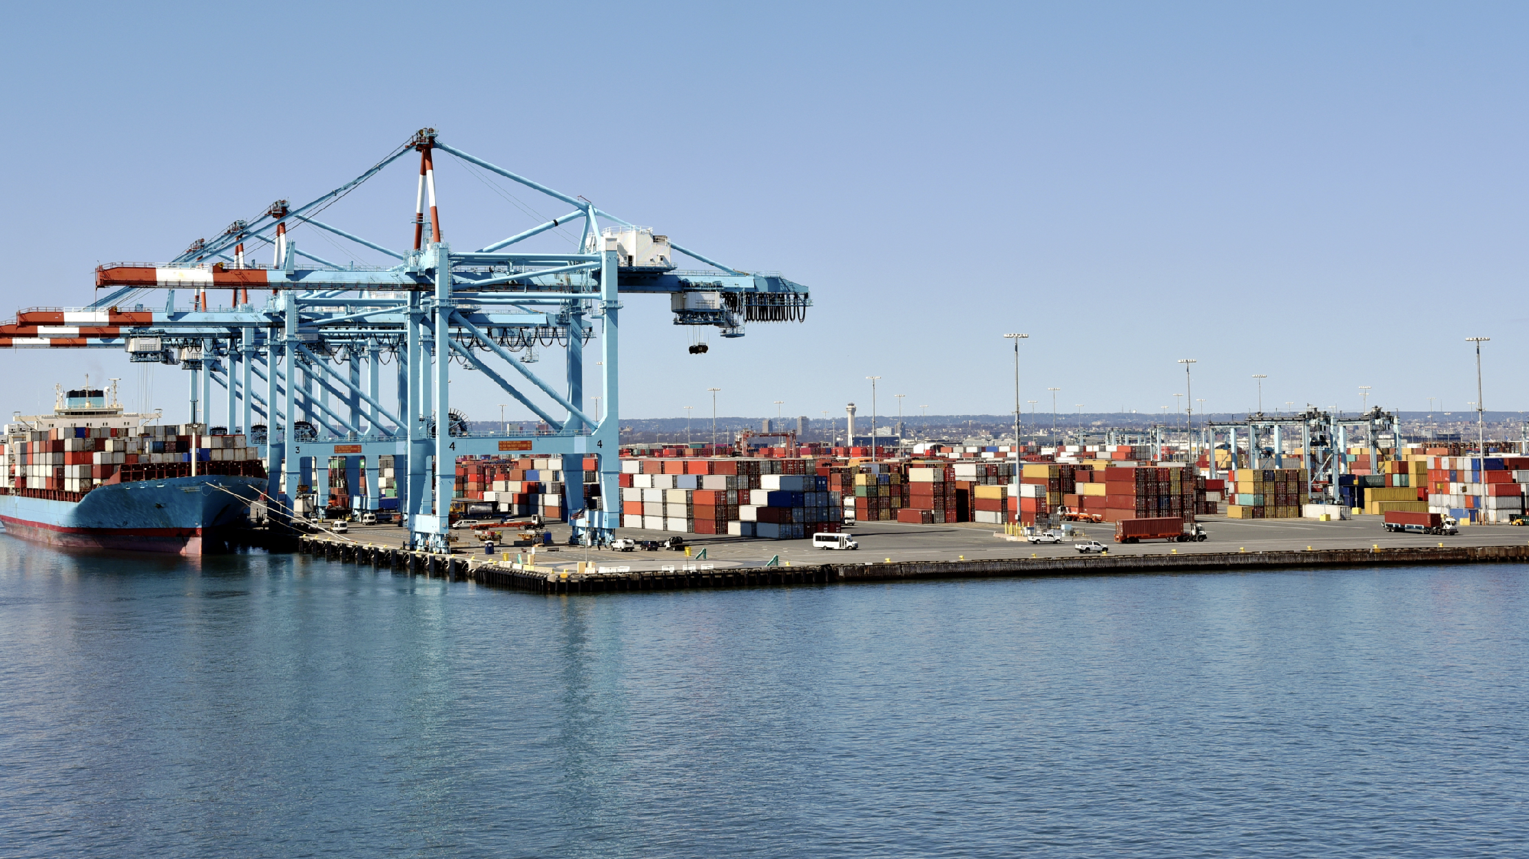

WHAT SOLUTIONS CAN WE PROVIDE FOR YOU?
www.frachtgroup.com

Slide 12
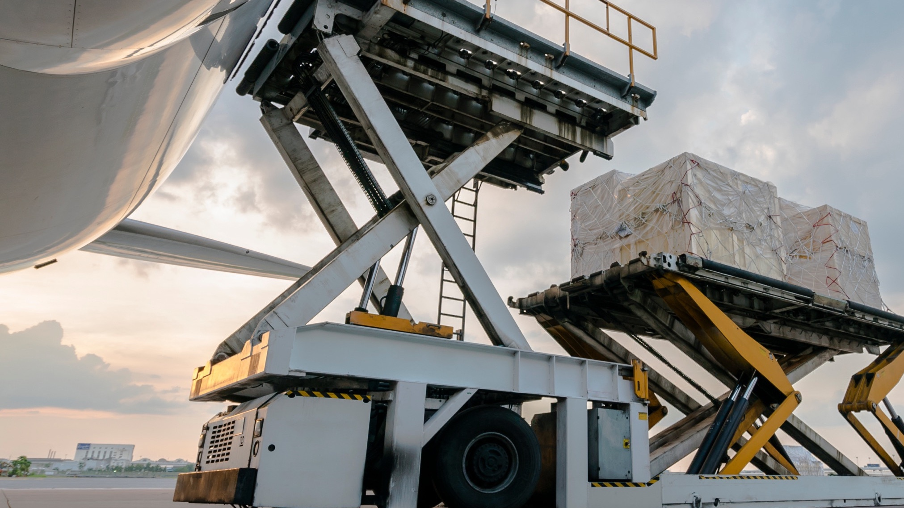
WHAT SOLUTIONS CAN WE PROVIDE FOR YOU?
www.frachtgroup.com

Slide 13

WHAT SOLUTIONS CAN WE PROVIDE FOR YOU?
www.frachtgroup.com

