Slide 1
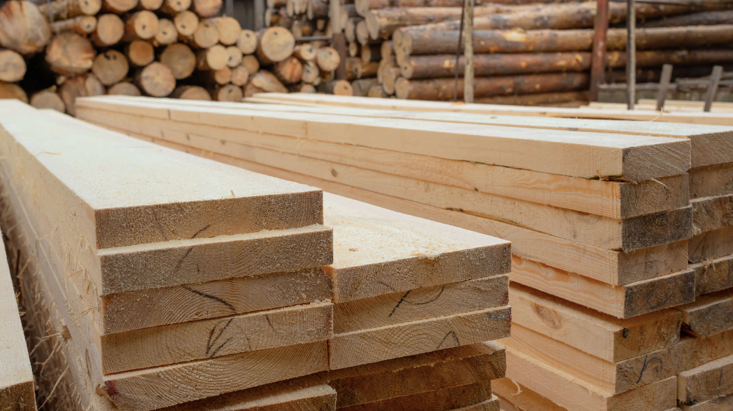

WOOD, PULP & PAPER

Slide 2

WOOD, PULP & PAPER

Slide 3


COMPREHENSIVE LOGISTICS FOR THE WOOD INDUSTRY
Fracht provides tailored logistics solutions for the global wood industry, handling everything from raw materials to finished wood products. With deep industry expertise and strong market presence, we deliver value through competitive sea freight rates, door-to-door logistics, and dependable carrier management.
Our services include container loading, warehousing at major ports, and end-to-end customs clearance. With named account agreements based on regular volumes and fixed-rate periods, we ensure predictable, cost-effective logistics operations. Every solution is backed by our extensive market knowledge and operational excellence, ensuring the best possible routing to every destination.
WOOD, PULP AND PAPER
137

Slide 4
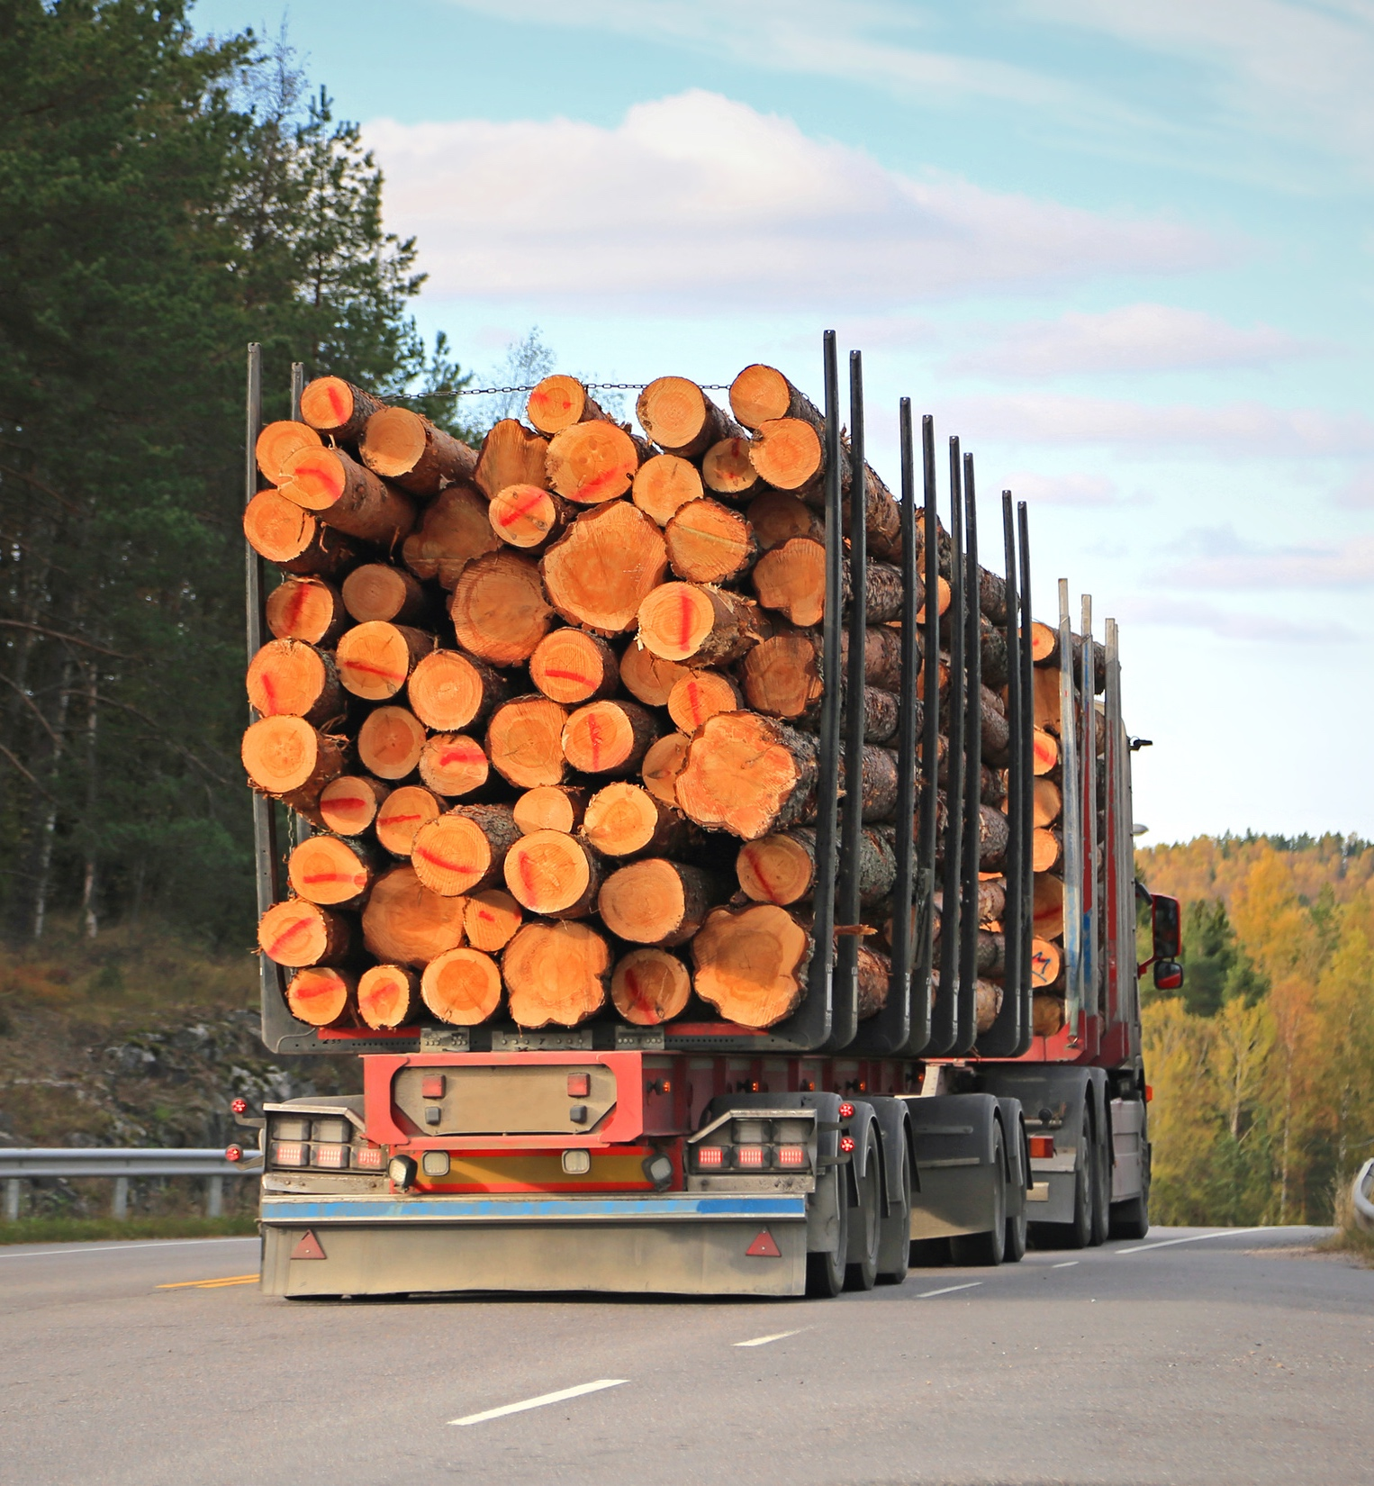
GLOBAL REACH IN WOOD AND FURNITURE TRANSPORT
The Fracht Group is highly specialized in transporting wood and furniture products, offering complete logistics services across key global markets. With strategically located offices in major exporting countries, we ensure seamless coordination, visibility, and reliability throughout the supply chain.
In Finland alone, our team handles 200 to 300 containers of wood products every month, shipping to destinations across the world. Our local expertise combined with global reach makes Fracht a trusted logistics partner for manufacturers, exporters, and importers in the wood and furniture sectors.
WOOD, PULP AND PAPER
138

Slide 5
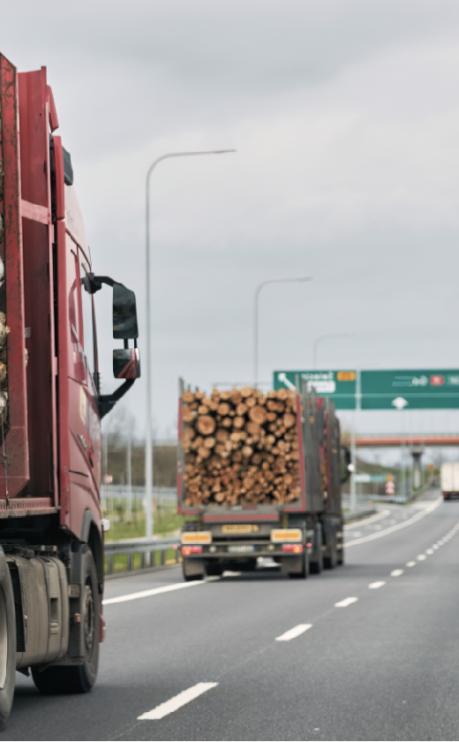

MACHINERY TRANSPORT FOR PULP & PAPER
For years, the Fracht Group has supported the pulp and paper industry with specialized logistics for both general cargo and large-scale equipment. We manage the transport of machinery and components used in production — including oversized and heavy-lift cargo — through multimodal solutions across sea, air, rail, road, and barge.
PROVIDED SERVICES
ADDED VALUE
  Door / door logistics seafreight.
  Feasibility studies.
  Airfreight.
  Route surveys for oversized and heavylift cargo in-house transport engineering solutions.
  Overland transportation project cargo logistics.
  Project consulting and logistics management services.
  Laydown yards and interim to long term storage export & import customs clearance.
WOOD, PULP AND PAPER
139

