Slide 1


WAREHOUSING

Slide 2

WAREHOUSING

Slide 3
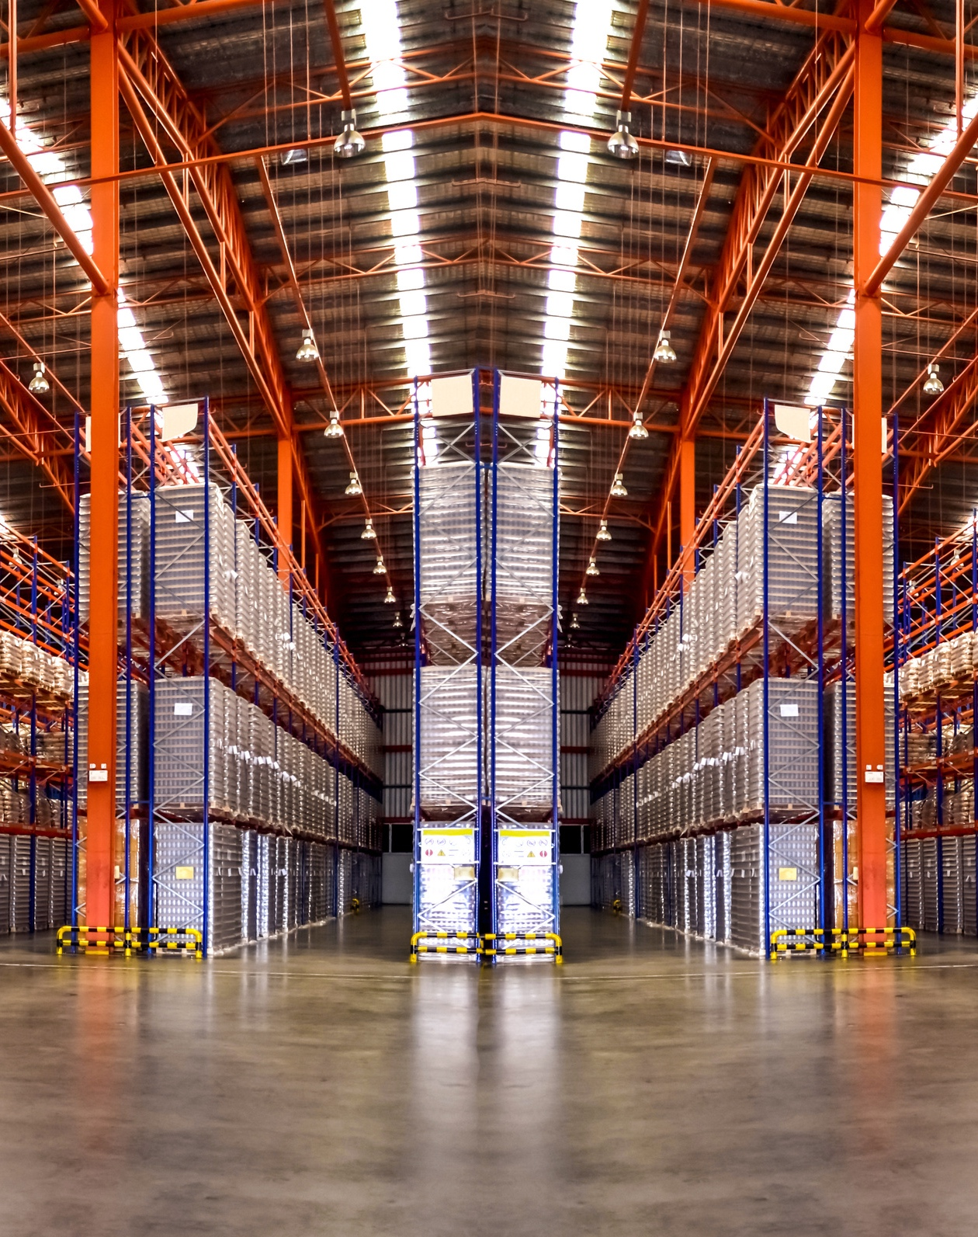


GLOBAL WAREHOUSING
At Fracht, our global warehousing capabilities are built to support agile, responsive, and scalable supply chains. With facilities strategically located across key trade lanes, our network provides proximity to ports, manufacturing centers, and major consumer markets; reducing transit time, optimizing costs, and enabling faster fulfillment.
Our warehousing solutions are tailored to meet the needs of industries ranging from energy and industrials to retail and technology. Whether you need temporary overflow space, bonded storage, or a long-term fulfillment partner, we deliver flexibility without compromising visibility or control. Each facility integrates seamlessly with our transportation and customs services, providing a true end-to-end logistics experience.
KEY CAPABILITIES INCLUDE:
Climate-controlled and secure storage environments.
Bonded and non-bonded zones for customs efficiency.
Multi-client and dedicated warehouse models.
API/EDI-enabled Warehouse Management Systems (WMS) for real-time inventory tracking.
GLOBAL WAREHOUSING

Slide 4


END-TO-END SUPPORT THAT GOES BEYOND STORAGE
Our approach to warehousing goes far beyond four walls. We deliver strategic value through services that help clients reduce overhead, speed up distribution, and respond faster to market demands. From initial inbound receipt to final mile delivery, we act as an extension of your team, ensuring operational continuity, supply chain resilience, and customer satisfaction.
Our teams manage everything from cargo deconsolidation to pick-and-pack operations, reverse logistics, and inventory optimization. Fracht is experienced in designing customized workflows for complex projects and providing value-added services like kitting, quality control checks, and labeling.
OUR WAREHOUSING SOLUTIONS SUPPORT:
Inbound logistics: deconsolidation, cross-docking, bonded storage.
Inventory management: batch control, FIFO/FEFO, reporting.
Fulfillment & Distribution: B2B and e-comm fulfillment, last-mile enablement.
Custom projects: kitting, repackaging, QA inspections, returns management.
GLOBAL WAREHOUSING
134

