Slide 1


TEXTILE

Slide 2

TEXTILE

Slide 3
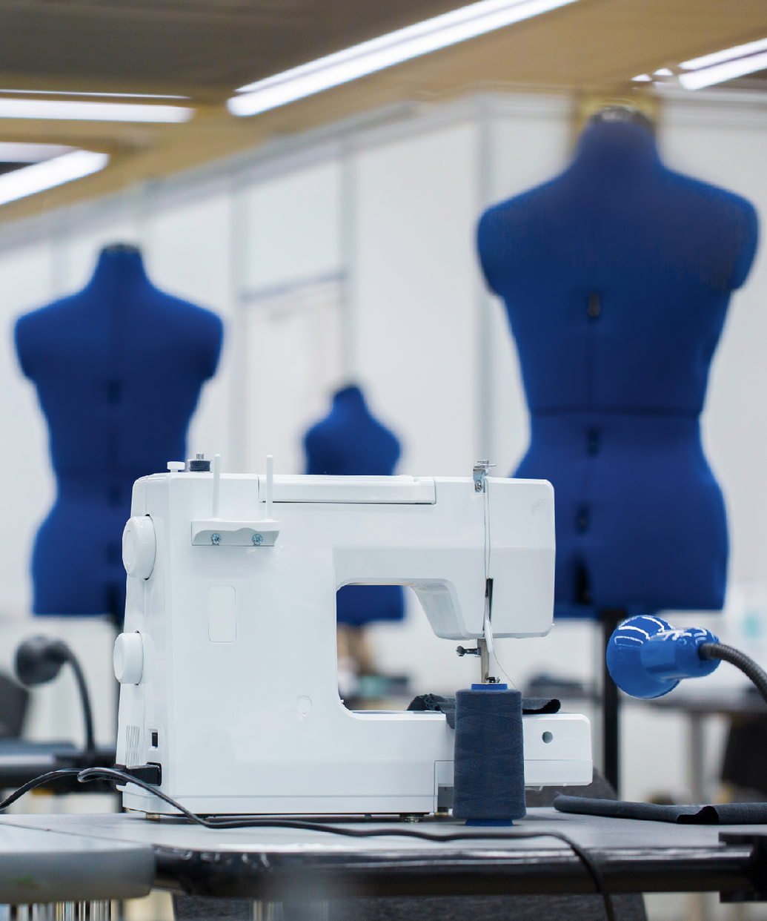


END-TO-END SERVICE FROM PRODUCTION TO DELIVERY
Our main objective is to provide comprehensive, specialized logistics services for the textile industry — from production at origin to final delivery at the consignee.
With a deep understanding of textile processes and supply chain dynamics, we ensure efficient planning, personalized management, and smart coordination.
We also focus on minimizing total transit time, optimizing costs, and meeting delivery expectations in a fast-paced, high-demand sector.
TEXTILE
129

Slide 4
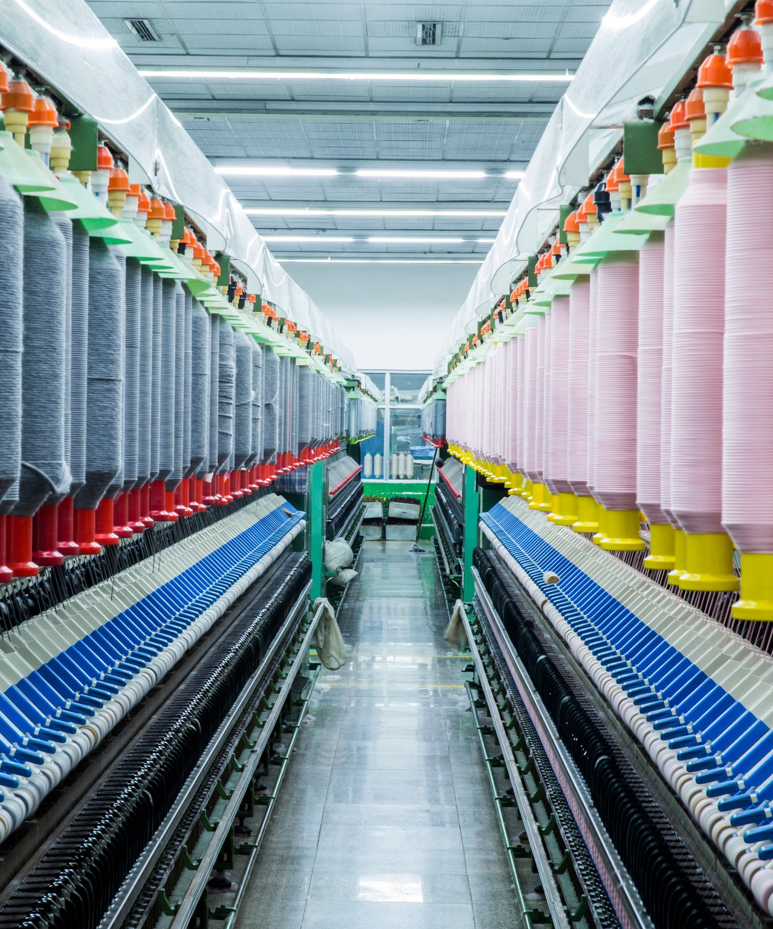
TAILORED SOLUTIONS FOR THE TEXTILE SUPPLY CHAIN
FRACHT’S TEXTILE LOGISTICS EXPERTISE INCLUDES:
  Consolidation services for high-volume SKUs.
  Time-sensitive air and sea freight coordination.
  Secure handling of finished garments, raw fabrics,
  and accessories.
  Flexible warehousing for seasonal demand and
  pre-retail services.
  Import/export customs clearance for
  multi-destination deliveries.
  Support for fast fashion and omni-channel distribution.
TEXTILE
130

