Slide 1
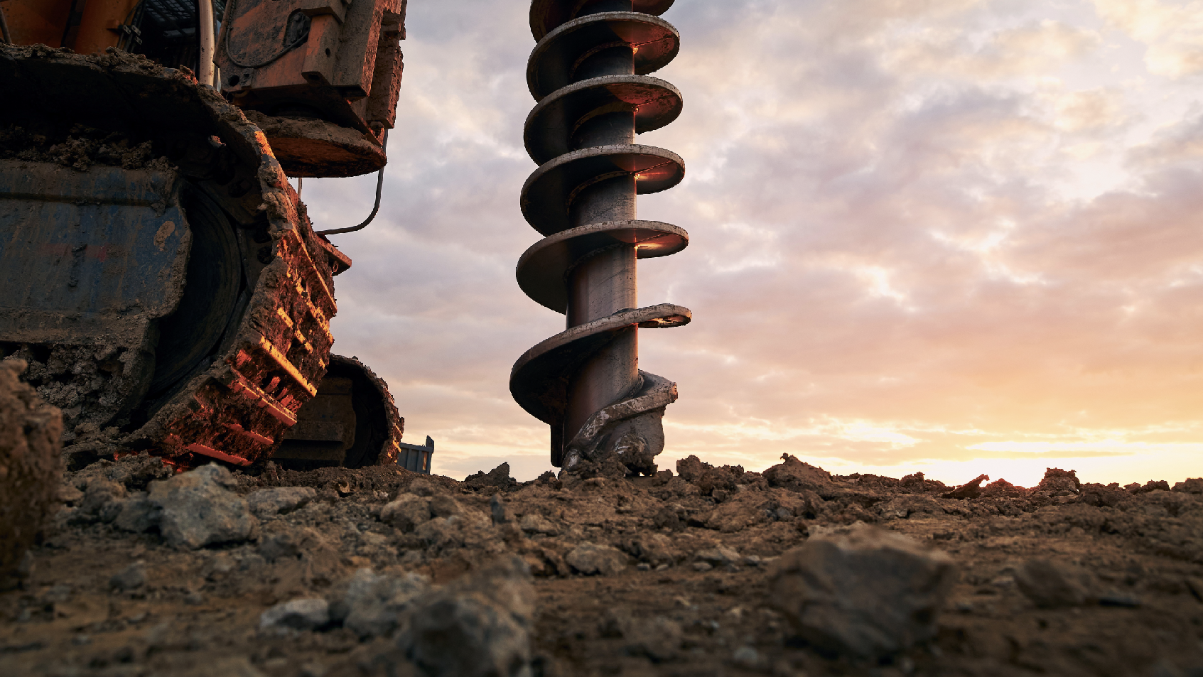

ROAD MACHINERY

Slide 2

ROAD MACHINERY

Slide 3
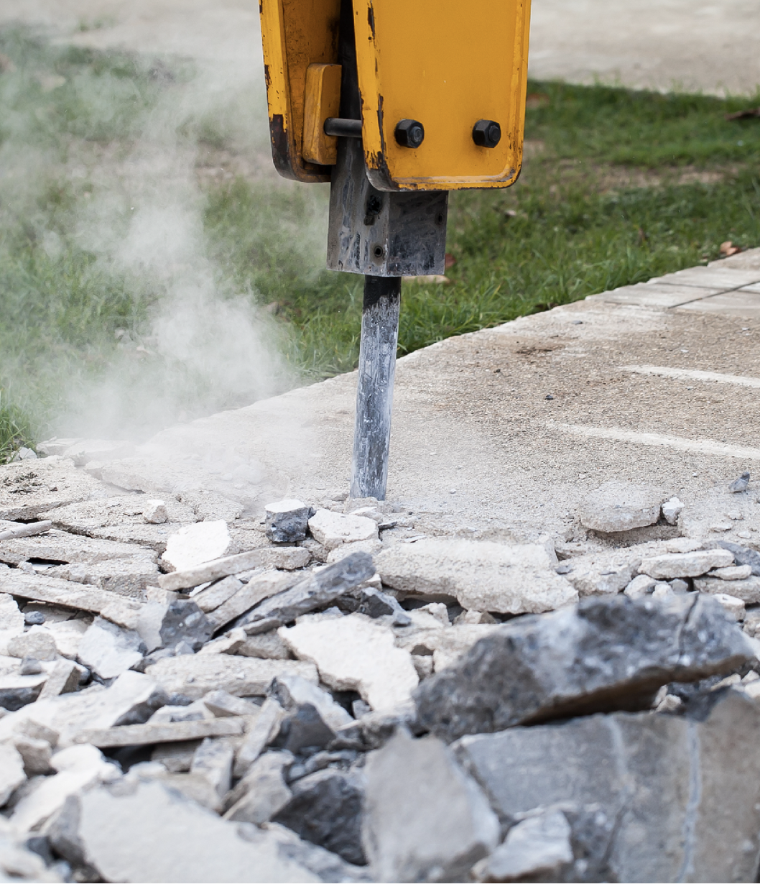

COMPREHENSIVE SERVICE FROM ORIGIN PRODUCTION TO FINAL DELIVERY
Engineering and construction projects rely on the timely delivery of specialized equipment and heavy machinery.
Fracht acts as a trusted logistics partner, ensuring your critical assets are transported with precision, care, and efficiency — from production site to final delivery.
With end-to-end project coordination, we help you meet tight timelines and operational requirements, no matter how complex the job or remote the destination.
ROAD MACHINERY
124

Slide 4

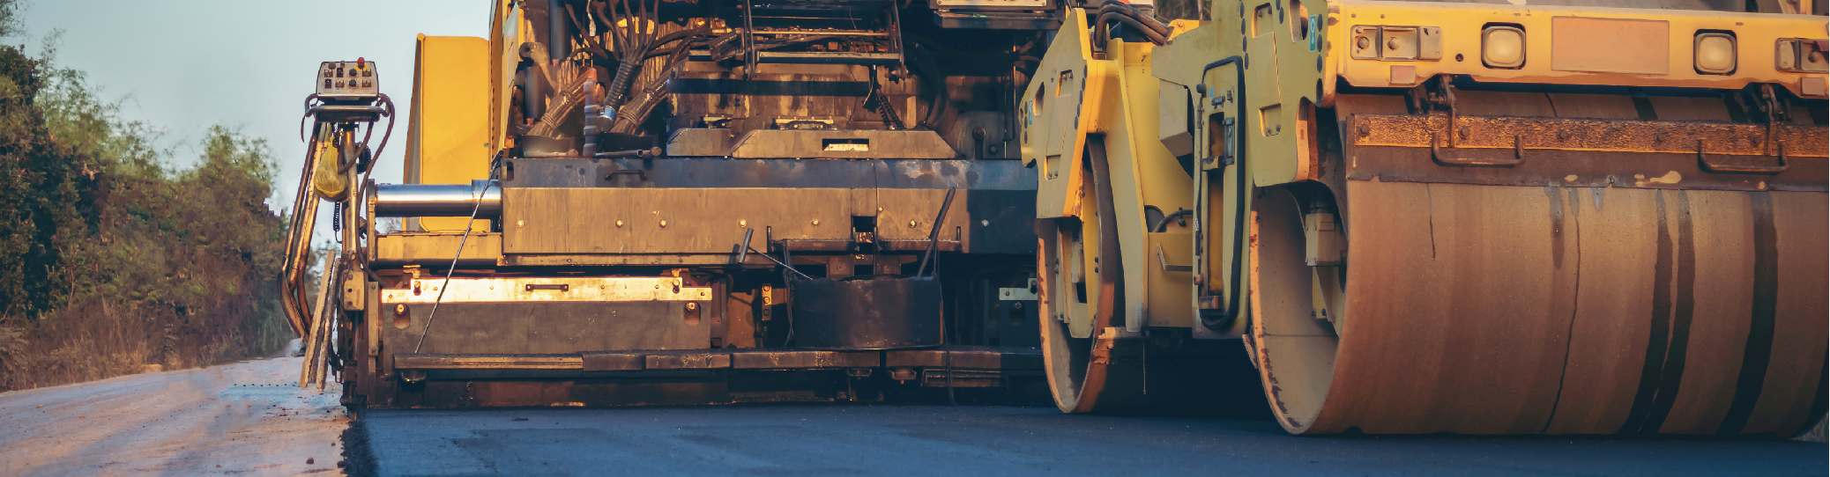
OUR EXPERIENCE COVERS
A WIDE RANGE OF PRODUCTS
Equipment for earthmoving, paving, hydraulics, railway engineering, concrete, and architecture.
Logistics solutions for infrastructure repair projects, including transportation networks, streets, highways, expressways, roads, bridges, tunnels, railways, and runways.
ROAD MACHINERY
125

Slide 5
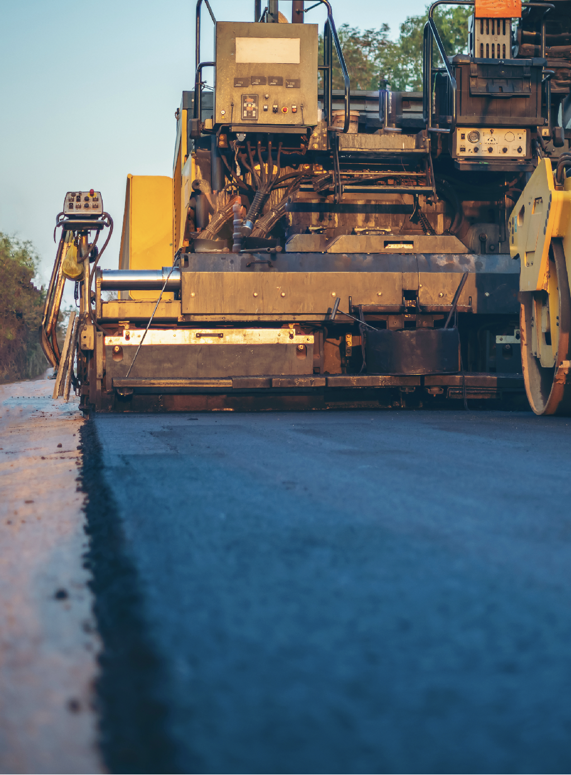
OUR EXPERIENCE COVERS A WIDE RANGE OF PRODUCTS
Fracht’s experience spans the full spectrum of road construction and infrastructure equipment. We manage the transport of machinery and components required for both new developments and critical
repair projects.
We handle equipment for:
  Earthmoving.
  Paving.
  Hydraulics.
  Concrete and architectural construction.
  Railway and track engineering.
We provide logistics solutions for infrastructure projects involving:
  Roads, expressways, and highways.
  Bridges and tunnels.
  Railways and runways.
  Urban transportation networks.
ROAD MACHINERY
126

