Slide 1


RENEWABLE ENERGY

Slide 2

RENEWABLE ENERGY

Slide 3
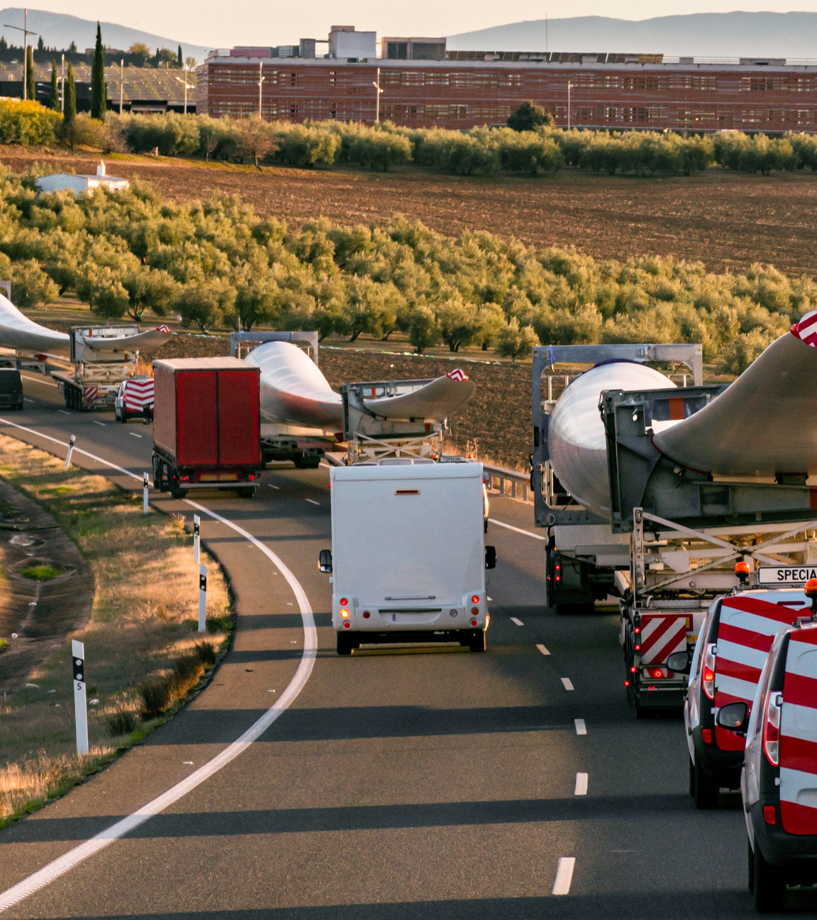

EXPLORE SOLAR ENERGY
We understand the importance of safety and efficiency when it comes to the transportation of Solar energy equipment (panels, trackers etc.). Fracht’s global team of Solar Energy experts have the knowledge and experience to keep your supply chain moving smoothly and efficiently. From Seafreight (FCL/LCL, Out of Gage) or Airfreight, Trucking and Railway.
Fracht covers all your needs from start to finish.
RENEWABLE ENERGY
116

Slide 4

GLOBAL SHORT OR LONG-TERM WAREHOUSE SOLUTIONS
SOLAR SPECIFIC JOBSITE SERVICES, SUCH AS:
Fracht own supervision & discharge crew
Equipment rental
Reliable installation services for ground mount solar systems.
We are not just building solar farms. We are sunstalling the future.
Pile driving with own equipment.
Panel mounting.
Racking assembly.
Pile surveying & marking.
RENEWABLE ENERGY
117

