Slide 1
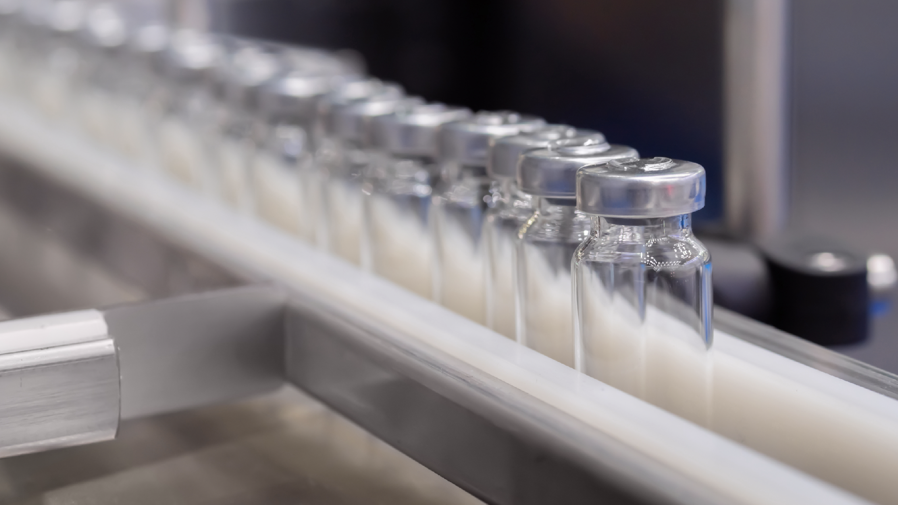

PHARMA

Slide 2

PHARMA

Slide 3


FRACHT IS COMMITTED TO THE QUALITY AND WELL-BEING OF PEOPLE
Our logistics expertise starts from the management of raw materials and extends to the finished products. We understand the strict transportation requirements that this industry needs and guarantees the shipping of all healthcare and life science products to be transported to the manufacturer’s specification.
Pharmaceutical logistics involves managing numerous processes and variables, all with high levels of complexity. It also requires handling thousands of different units while ensuring strict control over environmental conditions such as temperature and sterility for many of them. This makes logistics a crucial tool for efficiently managing stock levels and reducing costs in both storage processes and the transportation and distribution stages.
PHARMA
73

Slide 4
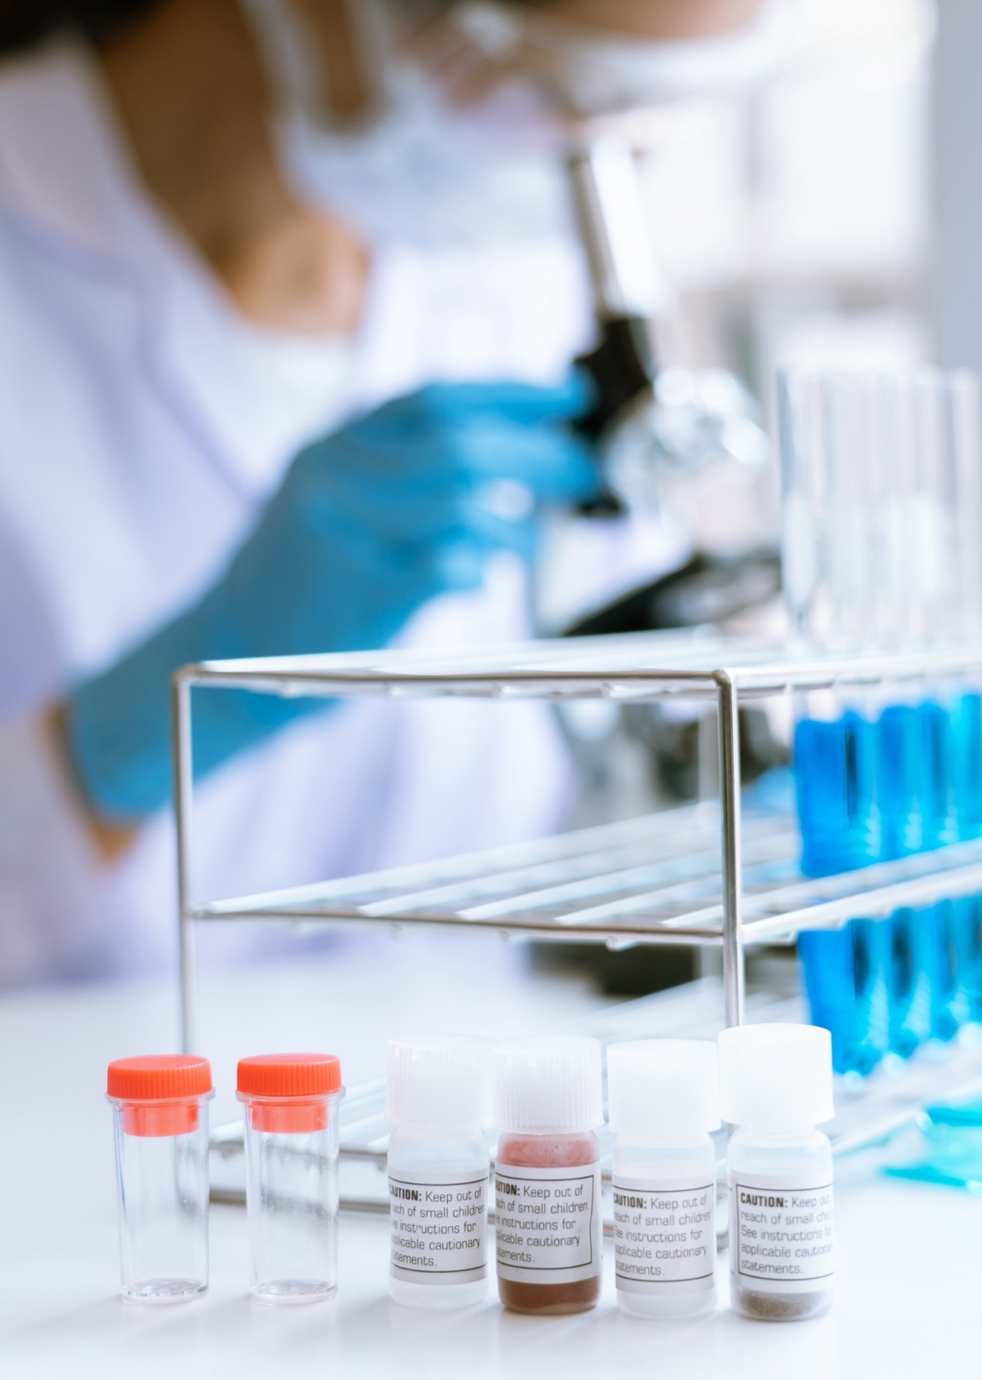

FRACHT’S END-TO-END COLD CHAIN MANAGEMENT LOGISTICS SOLUTIONS
Worldwide temperature-controlled transportation by air-, sea- and trucking modality.
Global GDP compliant, temperature-controlled facilities.
Specific temperature controlled cool rooms providing cross-docking services.
A network of transportation partnerships that allow for continuous temperature monitoring.
Time sensitive product launches.
Control tower visibility and management.
Expertise in the pharma segment.
PHARMA
74

Slide 5
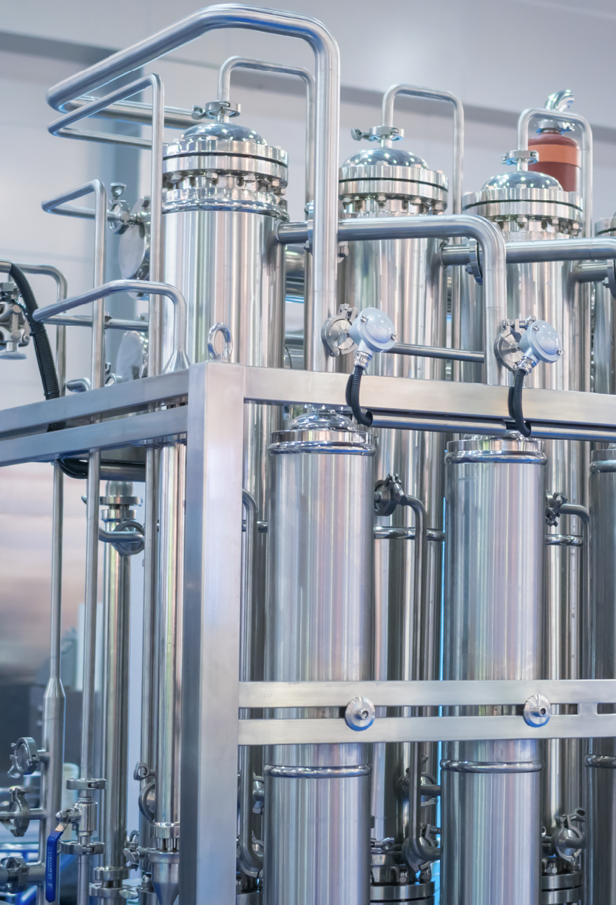
FRACHT’S EXPERIENCE
Expertise in the Pharma Segment: ISO 9001, AEO
The Fracht Group offers an extensive expertise in the cold chain transportation sector.
With an experienced team, Fracht is always looking for the ideal transport method (air, sea and road) with the most suitable packaging solution for the transport of temperature-sensitive products (active, passive and hybrid system).
Our globally standardised systems and specific service offerings ensure that we always meet your exact requirements.
Ensuring excellence, we promote a strict process of homologation and qualification of all service providers of the Logistics Chain. In addition, our Logistics Integration network offers reliability to handle with specific quality prerequisites, end-to-end operational visibility and regulatory compliance required by the Pharma industry.
WRITE HERE ABOUT YOUR OWN CERTIFICATES
PHARMA
75

Slide 6
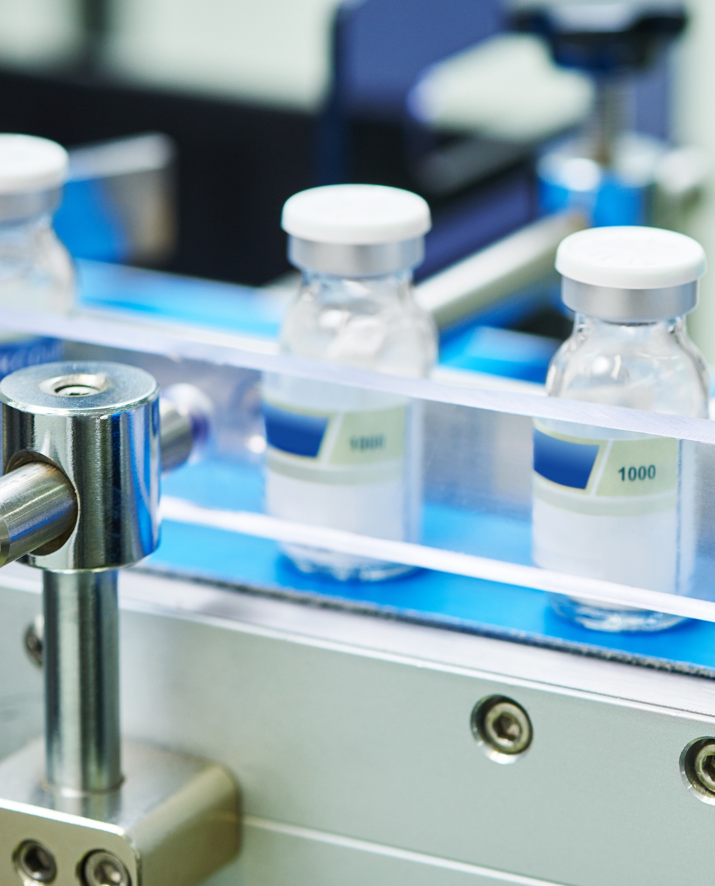
REAL-TIME MONITORING
Fracht’s pharma cold chain monitoring is designed with health and well-being at its core. If a reading falls outside the predefined range, our team is immediately alerted and ready to activate escalation and contingency measures.
This commitment includes:
Management of the entire process.
4PL Solutions.
International Logistics (International Shipping and Collection).
Traceability and temperature monitoring.
Integration with the best temperature-controlled warehouses.
PHARMA
76
76

