Slide 1
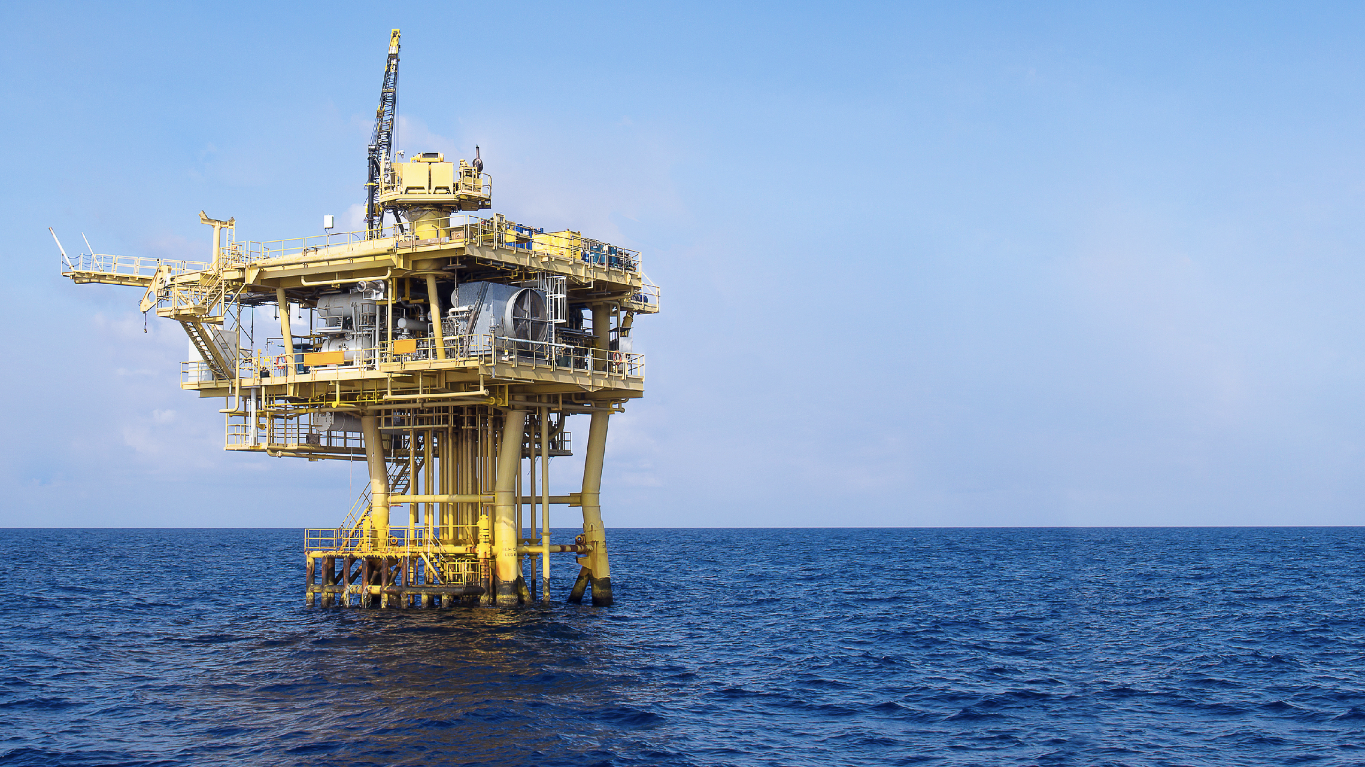

OIL & GAS

Slide 2

OIL & GAS

Slide 3


CUSTOM SOLUTIONS WITH RISK ASSESSMENT AND OPERATIONAL GUIDANCE
We understand the importance of safety and efficiency when it comes to the transportation for Oil and Gas equipment. Whether your focus is upstream, downstream or integrated from end to end, Fracht’s global team of oil & gas experts have the knowledge and experience to keep your supply chain moving smoothly and efficiently. From Airfreight, Sea freight, FCL or LCL, Break Bulk, Heavy Lift, Part and Full charters, Fracht Group covers all your needs from start to finish.
SPECIALIZED SERVICES INCLUDE
1.
2.
CAPITAL PROJECT LOGISTICS & FREIGHT FORWARDING
SUPPLY CHAIN CONSULTANCY & SOLUTION DESIGN
3.
4.
RIG MOVE MANAGEMENT TO MAXIMIZE DRILLING TIME
LEAD LOGISTICS PROVIDER & CONTROL TOWER SERVICES
OIL & GAS
69

Slide 4

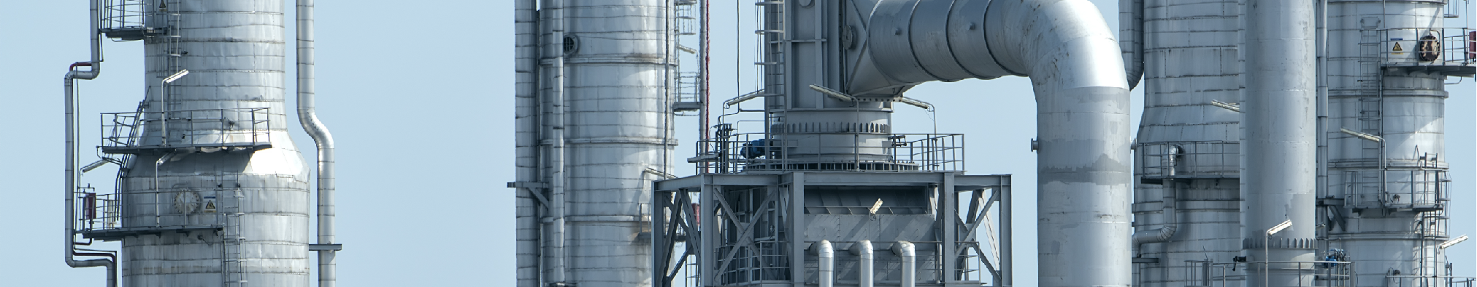
EXAMPLE OF TRANSPORTATION FLOW
We transport a variety of oilfield and well control equipment including:
Flanges
Goatheads
Tees & Crosses
Frack Valves
Towers
Drilling equipment
Compressors
Pumps
Complete modules
Tank vessels
Heat exchangers
Air coolers
Evaporators
Large integrated modules
Fracht has the expertise to perform transport tailored solutions to the Oil & Gas industry. The excellent relationship we maintain with reliable vendors and partners combined with our global network in the most important Oil & Gas hubs around the globe allow us to choose between carriers and transport vehicles most suitable for your organization.
OIL & GAS
70

