Slide 1
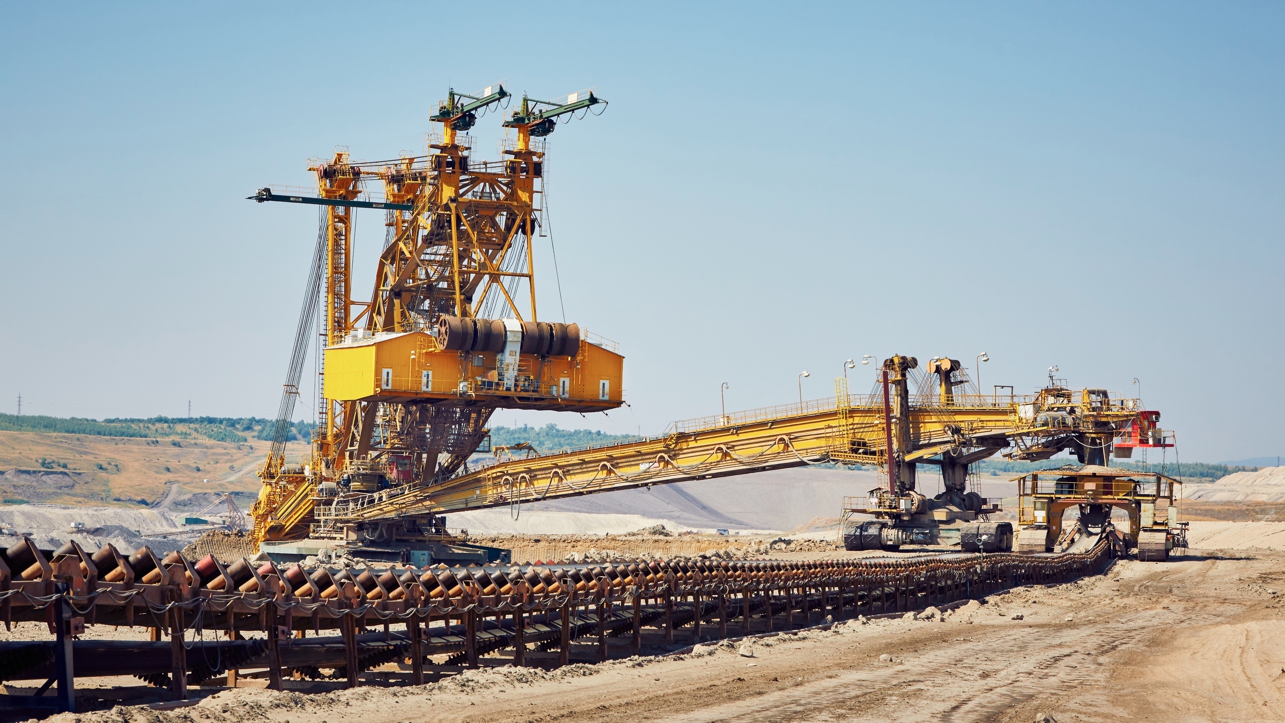

MINING

Slide 2

MINING

Slide 3
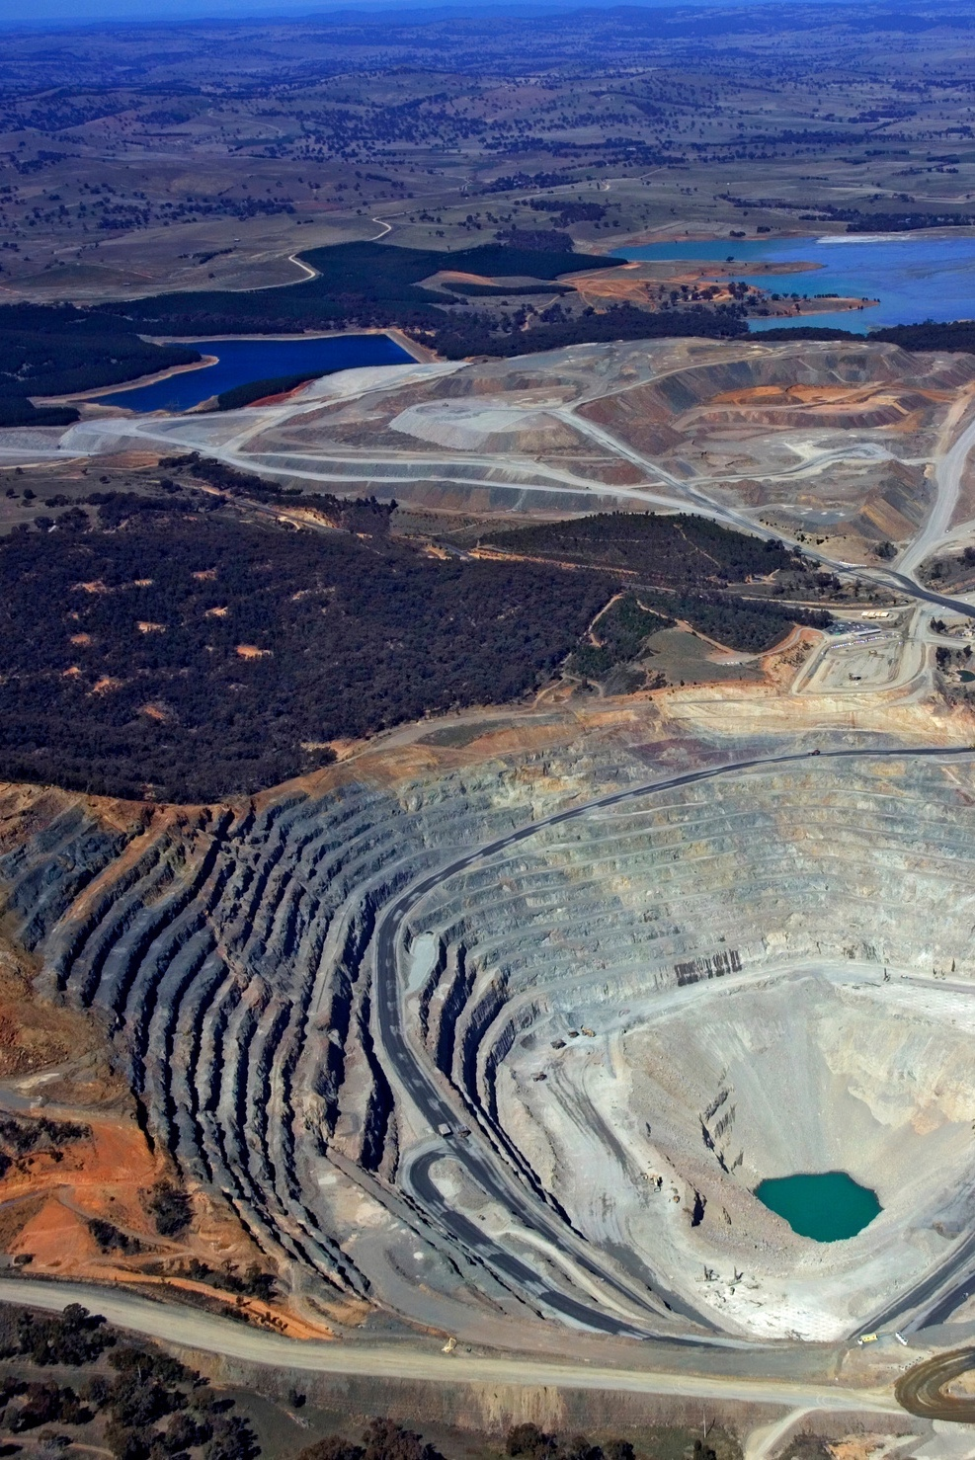

EXPERT LOGISTICS FOR THE MINING SECTOR
Mining logistics has been a core strength of the Fracht Group for decades. We understand the unique challenges of transporting equipment and materials to remote, hard-to-reach sites with minimal infrastructure — whether in the Andes, the Gobi Desert, the Australian outback, or the Democratic Republic of Congo.
From coal, uranium, and oil sands to copper, iron ore, and rare minerals, we support every stage of your operation with dependable, cost-effective logistics solutions. Our services include full risk assessments, tailored operational manuals, and a sharp focus on safety, timing, and precision.
Fracht’s experienced teams manage the delivery of complex mining equipment such as excavators, dump trucks, crushers, ship unloaders, conveyor belt systems, tires, and drilling machines — ensuring flawless execution under the toughest conditions.
MINING
61
61

Slide 4
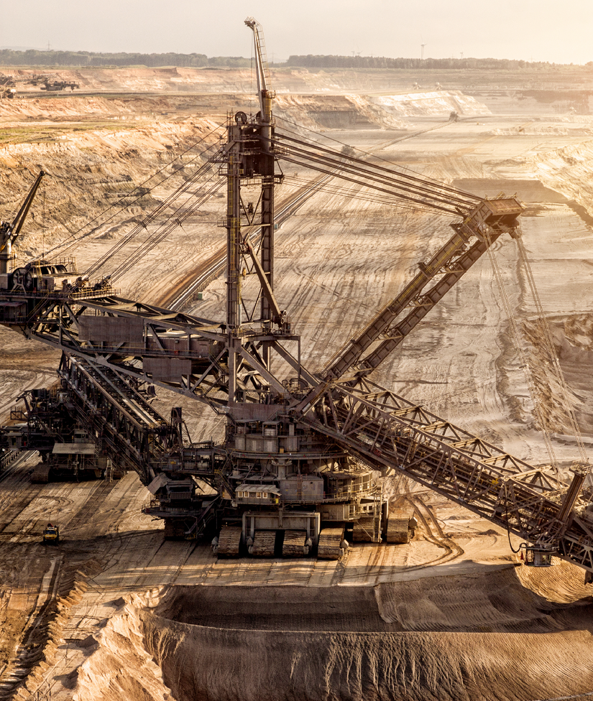

FRACHT COVERS ALL YOUR NEEDS FROM START TO FINISH
Fracht’s global team of mining logistics experts ensures your supply chain remains efficient and resilient, even in the harshest environments.
We provide seamless transport via sea freight (FCL, LCL, Out of Gauge, Breakbulk, Charter/Part Charter), airfreight, trucking, and rail — managing every step from origin to remote site delivery.
SERVICES FOR THE MINING INDUSTRY
  Tower services.
  Capital project logistics & freight forwarding.
  Supply chain consultancy & solution design.
  Lead logistics provider & control tower service.
MINING
62

