Slide 1
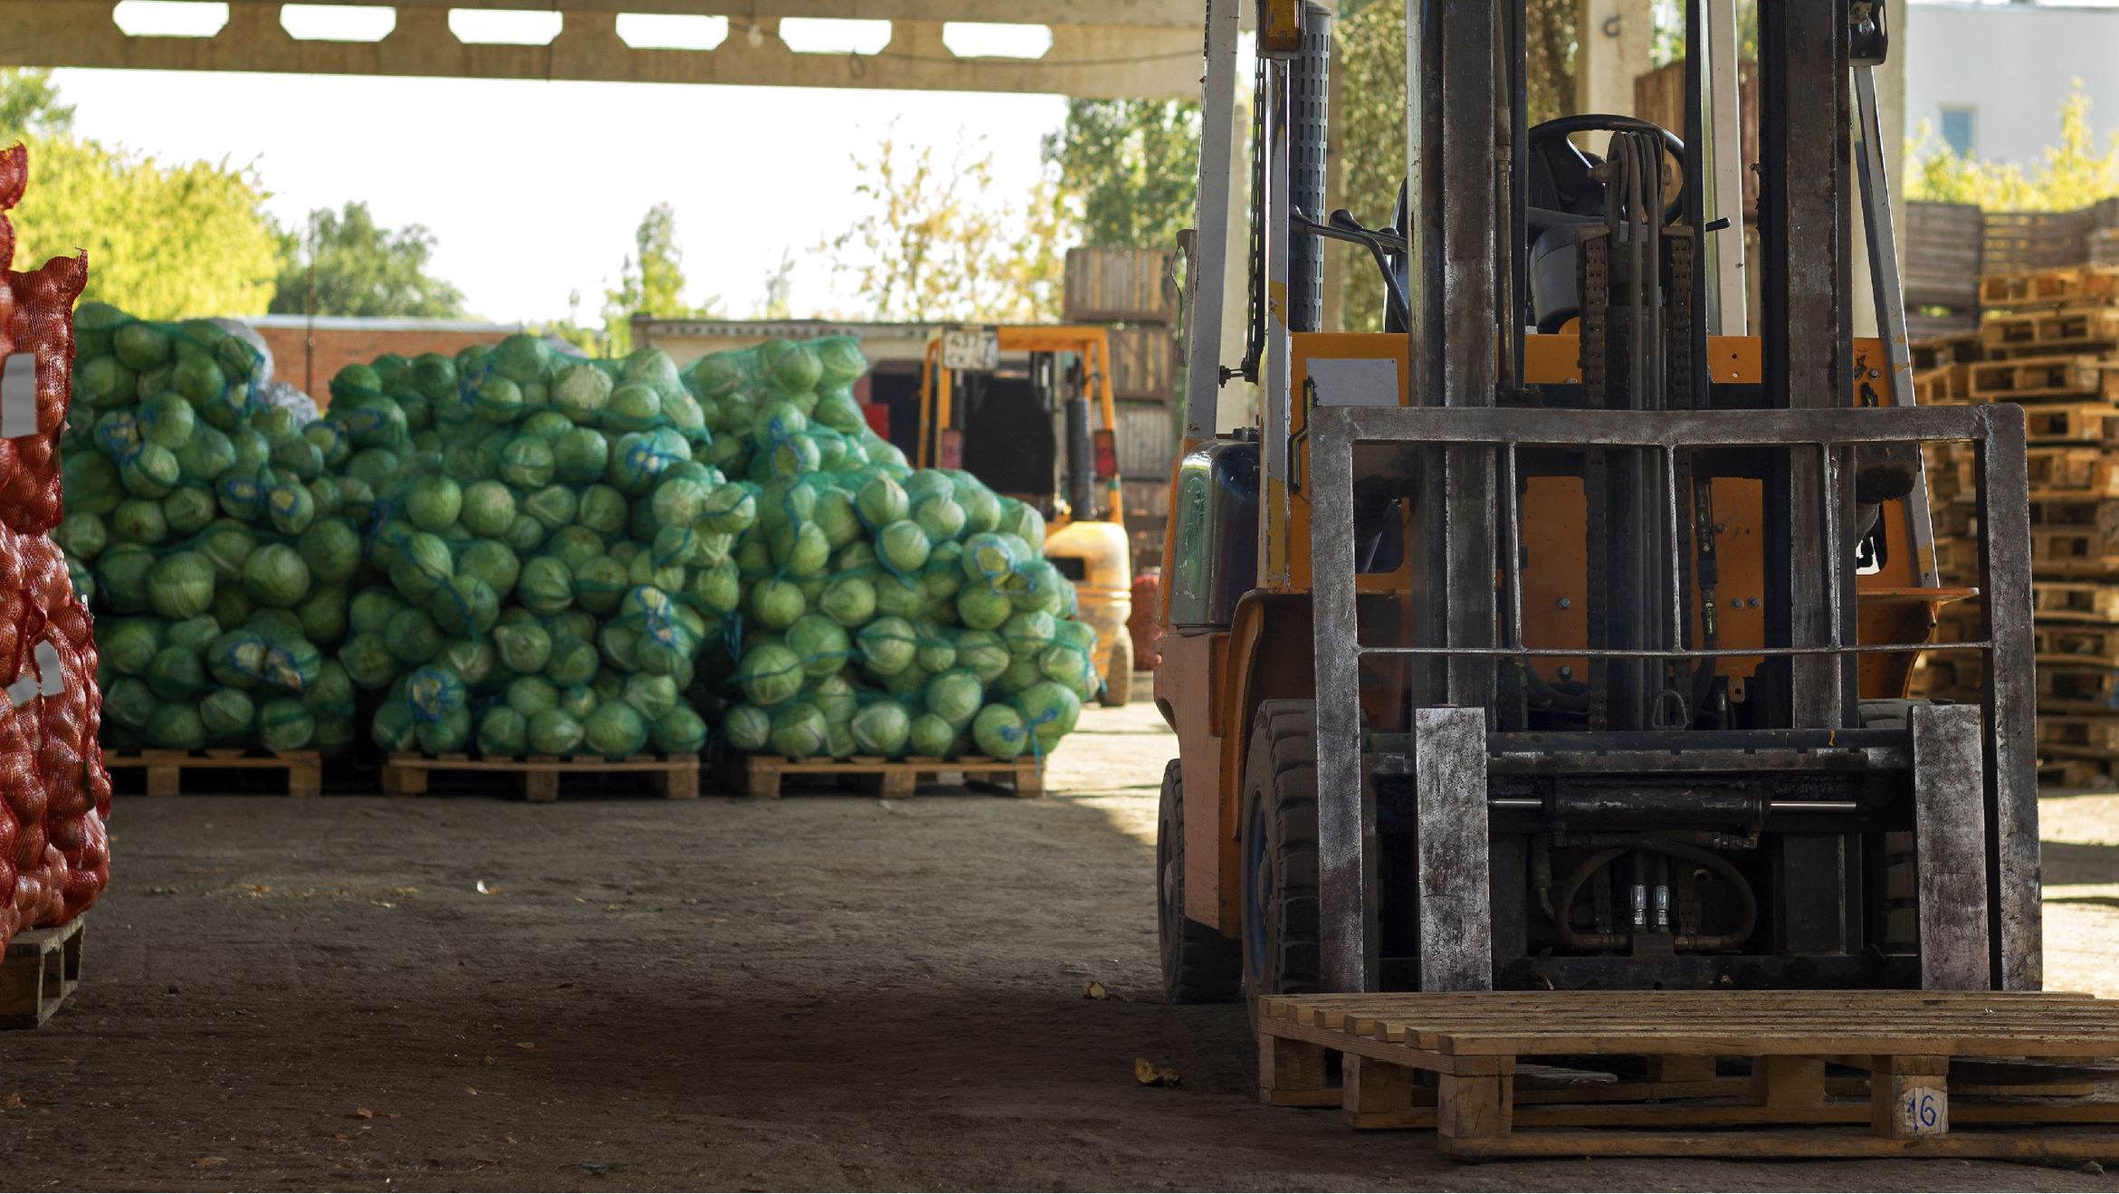

FOOD & BEVERAGES

Slide 2

FOOD & BEVERAGES

Slide 3


EXPERTISE ACROSS FOOD
& BEVERAGE COMMODITIES
Fracht brings deep expertise across a wide range of food and beverage commodities — from frozen goods and perishables to dry bulk, beverages, and specialty products.
Whether you're shipping soybeans, peanuts, or beer, we ensure your cargo arrives safely, fresh, and on time.
Our dedicated teams monitor each shipment closely to guarantee temperature control, regulatory compliance, and reliable delivery from origin to destination.
FOOD & BEVERAGES
53

Slide 4
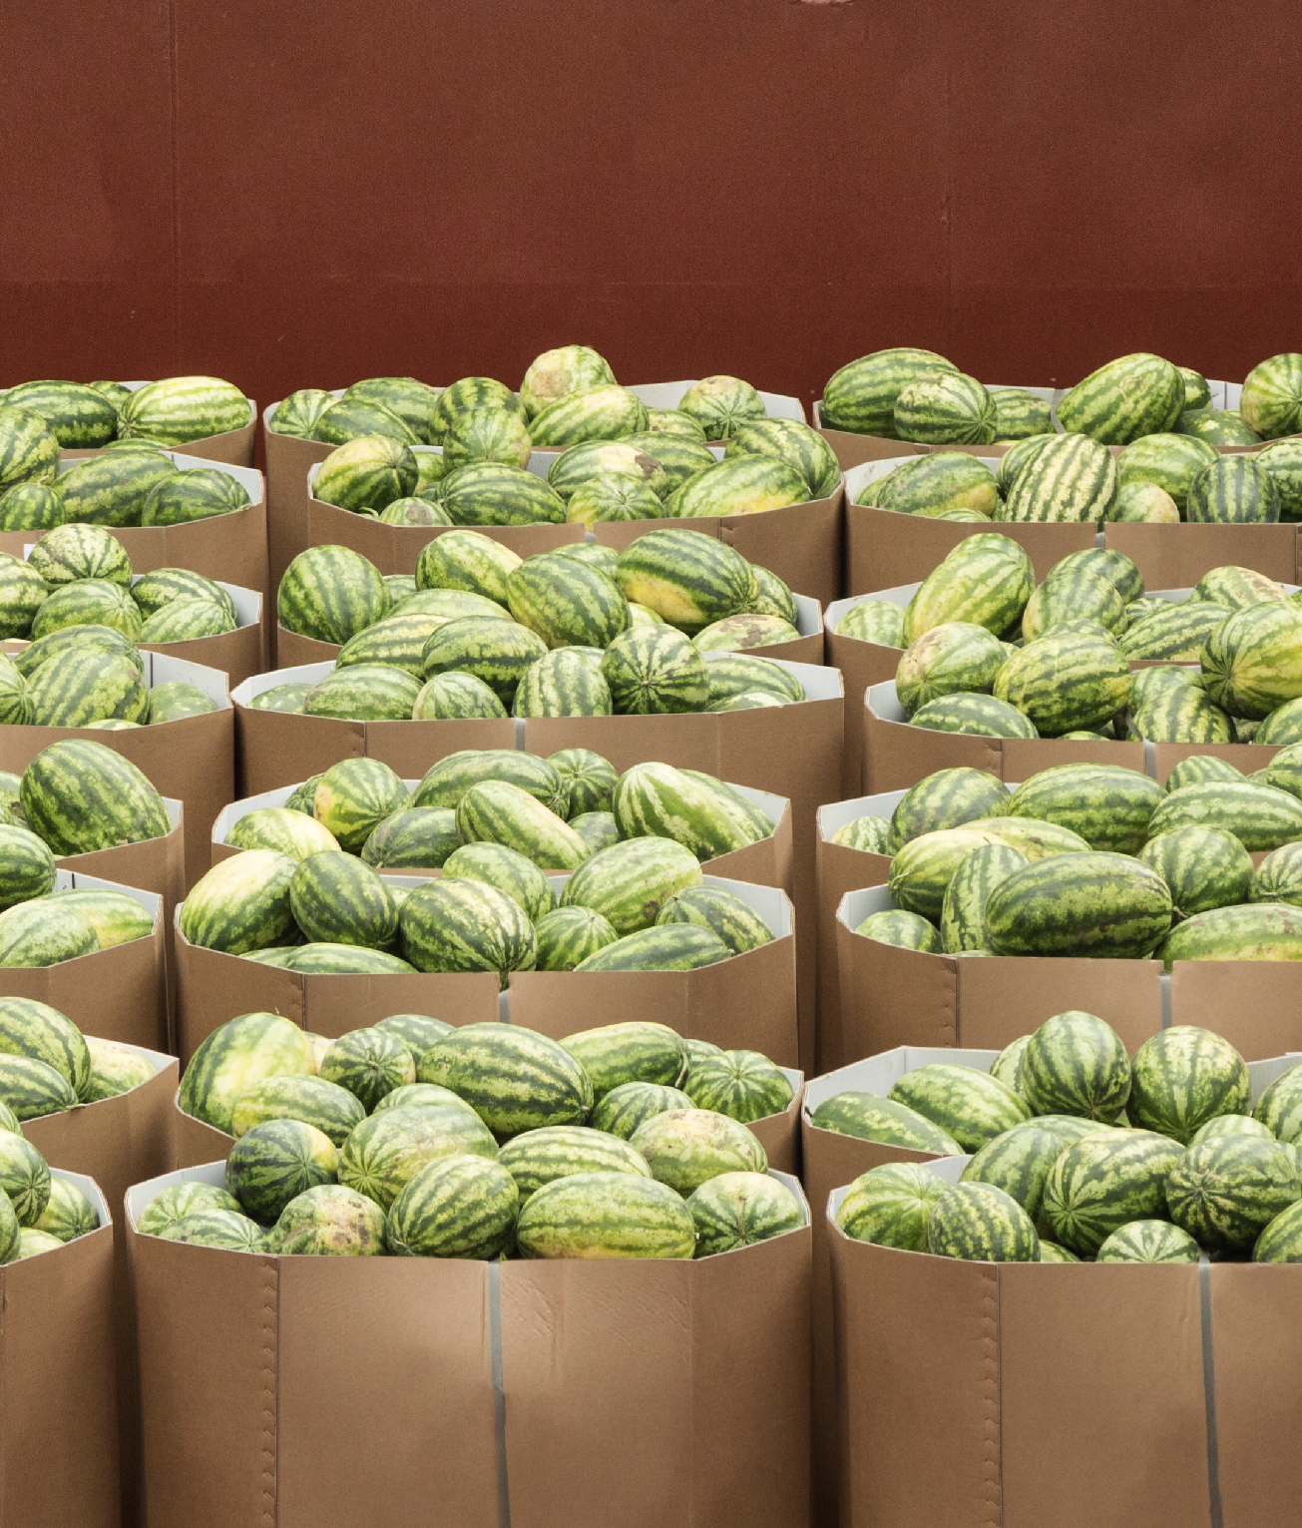

OUR TAILOR-MADE
SOLUTIONS INCLUDE
1.
2.
TEMP-CONTROLLED
CONTAINERS
CONTROL TOWER SERVICES
3.
4.
FAST TRANSIT OPTIONS
DIRECT SAILINGS
FOOD & BEVERAGES
54

