Slide 1


EPC

Slide 2

EPC

Slide 3
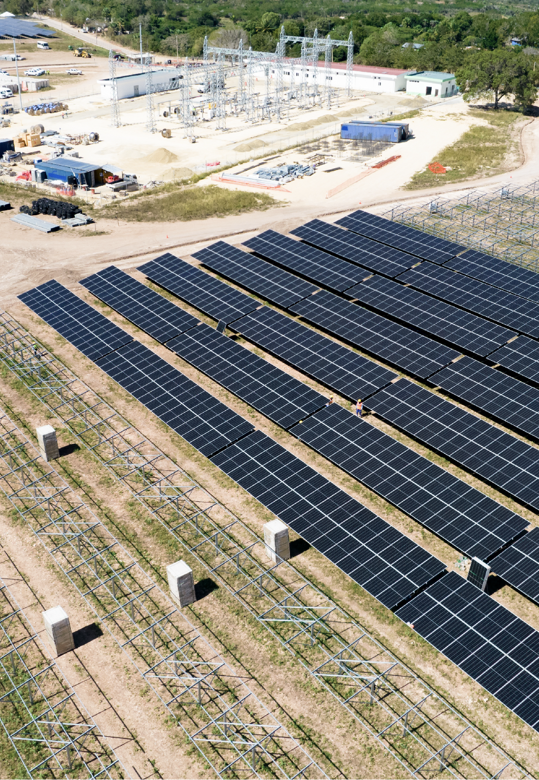

CUSTOMIZED SOLUTIONS FOR COMPLEX PROJECTS
Fracht delivers end-to-end logistics for the EPC (Engineering, Procurement, and Construction) sector — with a focus on safety, precision, and operational control. Our global team of experts ensures that heavy, oversized, and high-value project cargo reaches even the most remote or complex job sites.
From Breakbulk and OOG cargo to FCL, LCL, full and part charters (sea or air), trucking, barging, and railway — we provide multimodal transport and engineering services tailored to your project's lifecycle.
EPC
49

Slide 4
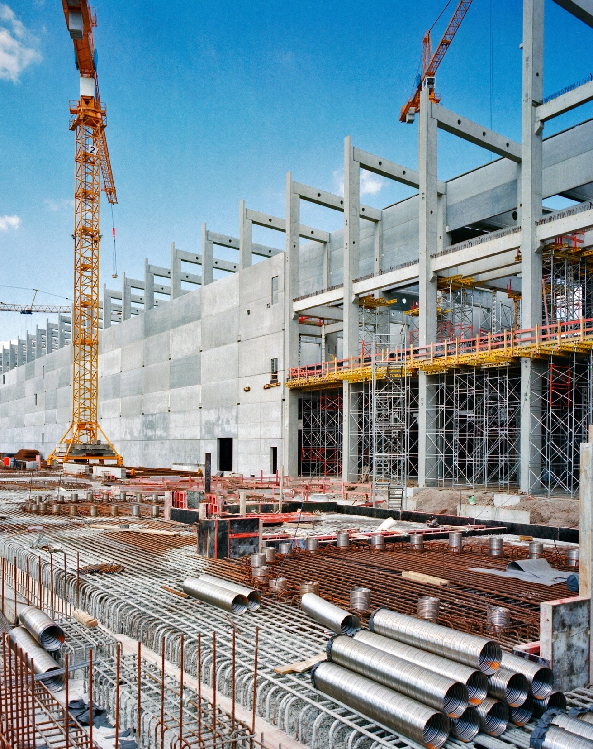

OUR EPC LOGISTICS EXPERTISE SPANS INDUSTRIES SUCH AS:
  Capital project logistics & freight forwarding.
  Oil & gas.
  Mining.
  Power generation.
  Pulp & paper.
  Renewable energy (hydro, wind, solar, biomass).
  Supply chain consultancy & control tower solutions.
  Lead logistics provider (LLP) models.
Fracht provides reliable solutions including risk assessment and operational manuals tailored to your requirements and specific operation.
EPC
50

