Slide 1


CUSTOMS BROKERAGE

Slide 2

CUSTOMS BROKERAGE

Slide 3
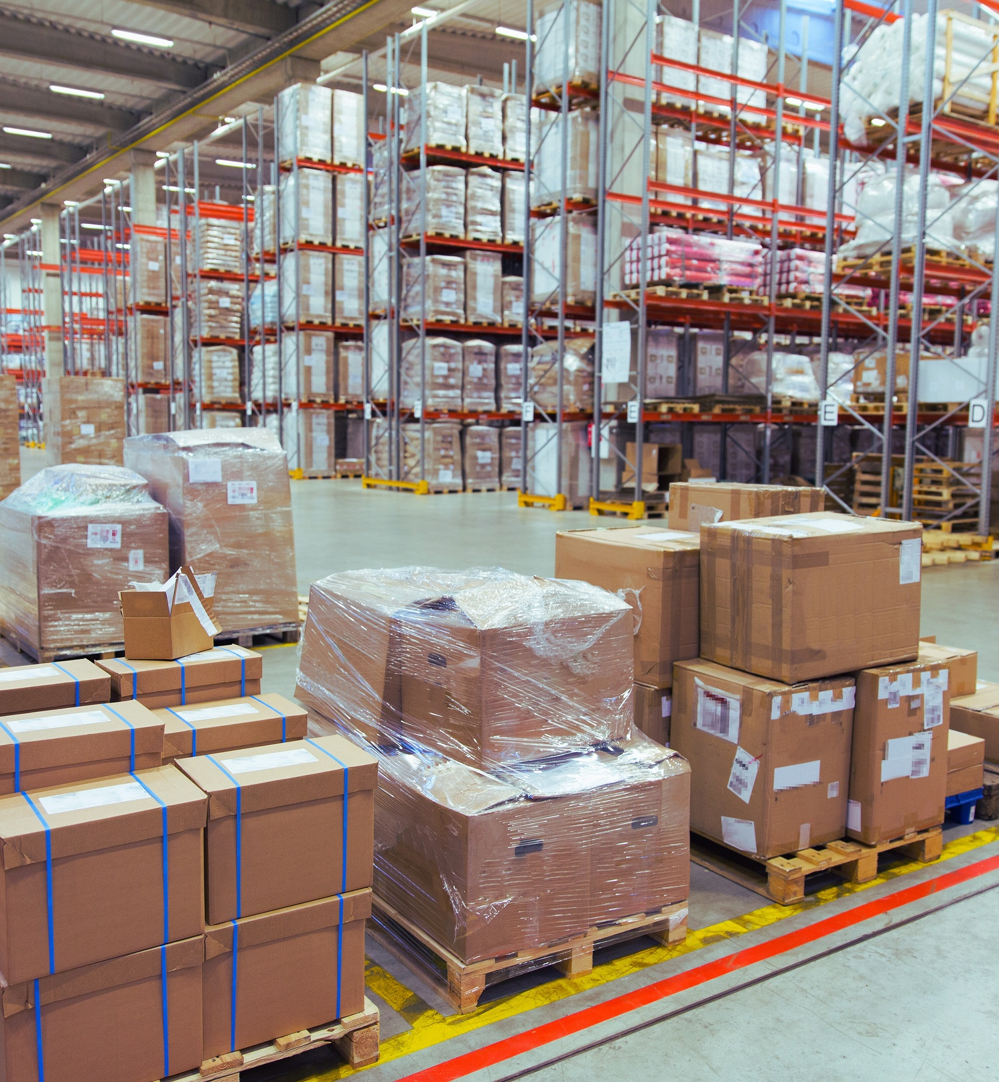

CHOOSE A SEAMLESS
CUSTOMS COMPLIANCE
We understand that customs regulations are complex and numerous, and compliance is essential to maintaining smooth international trade.
With our extensive knowledge, attention to detail, and commitment to compliance, we streamline your customs clearance process.
Our expert customs teams ensure your goods cross international borders without any problem and that your customs clearance operations run as smoothly as possible.
CUSTOMS BROKERAGE
44

Slide 4

OUR SERVICES, FOR BOTH
IMPORT AND EXPORT
From documentation to customs duty payment, we handle every step, allowing you to focus on your core business.
  Analysis and optimization of duties and taxes.
  Customs duty management.
  VAT and excise duty management.
  Assistance with customs classification of goods.
  Duty refund assistance.
  Audit.
CUSTOMS BROKERAGE
45

Slide 5



AN EFFICIENT COMPLIANCE JOURNEY
Our teams draw on in-depth knowledge and specific expertise in your sector.
  Working with you, we develop a comprehensive classification database for your products line, maintaining the consistency and accuracy of your customs processes.
  We stay abreast of regulatory changes and promptly communicate any impactful updates to you, ensuring you are always informed and prepared.
PARTNERSHIP AT THE HEART OF SUCCESS
Fracht goes beyond simply providing a service. We strive to build strategic and consultative relationships with our clients. Our team becomes an extension of your business, providing a single point of contact for superior service.
CUSTOMS BROKERAGE
46

