Slide 1
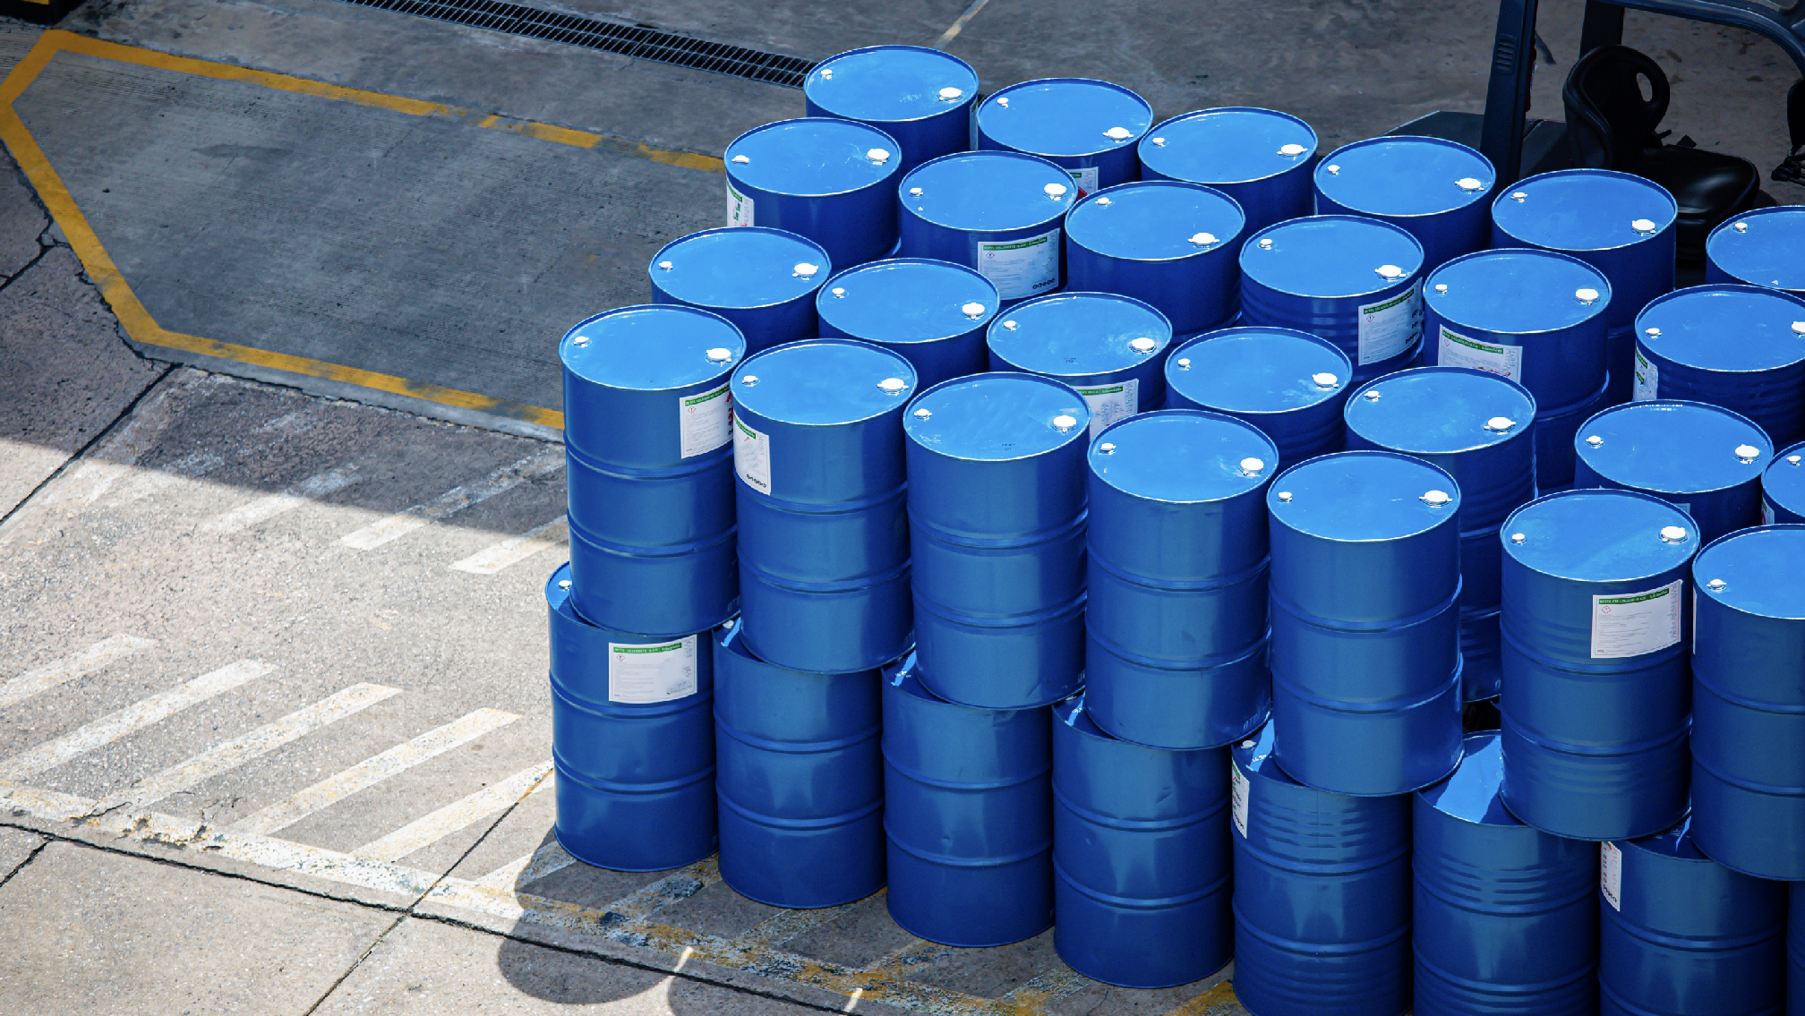

CHEMICALS

Slide 2

CHEMICALS

Slide 3
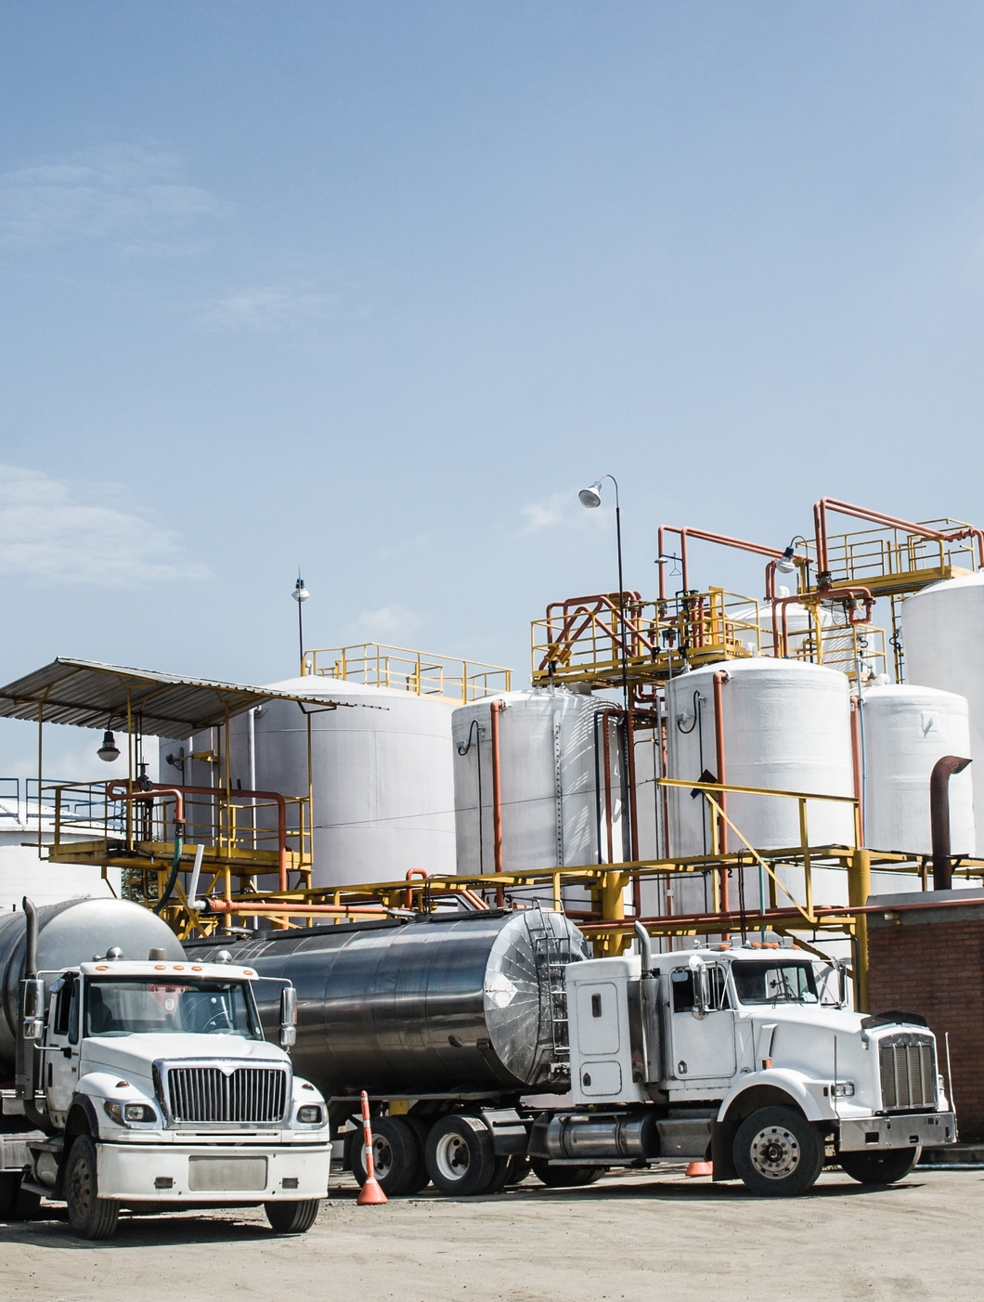


UNLOCKING THE POTENTIAL OF YOUR CHEMICAL SUPPLY CHAIN
Fracht’s dedicated chemical team designs, implements, and operates a wide array of complex and innovative chemical supply chain solutions around the world. These experienced supply chain professionals understand how to meet the strict safety and environmental requirements of the chemical industry, while at the same time delivering high-value solutions that accommodate our customers’ transportation needs.
We improve the overall effectiveness of the chemical supply chain by taking the necessary steps to maximize visibility while streamlining the flow of goods from origin to destination.
CHEMICALS
40

Slide 4
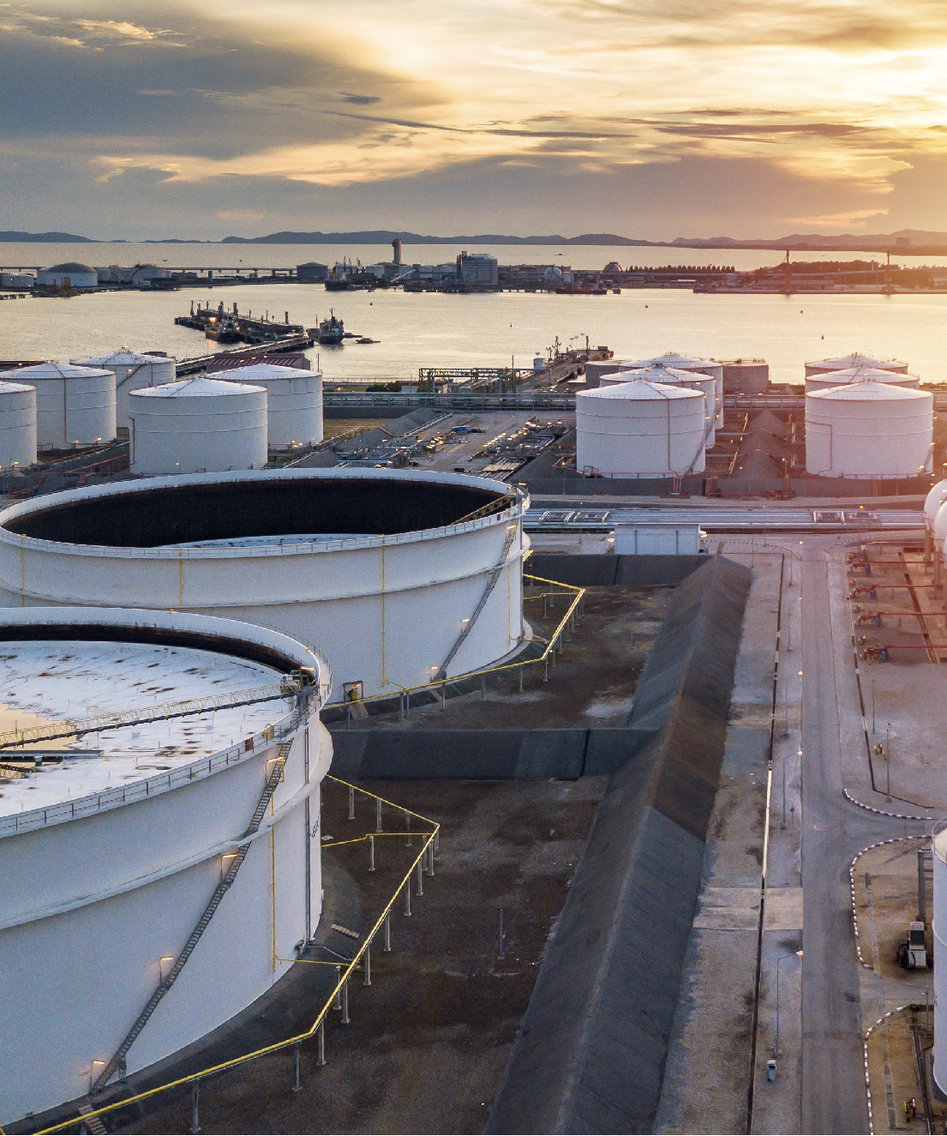
SPECIALIZED
SERVICES INCLUDE
  Repackaging.
  DG handling & Warehousing.
  Hazmat & DG airfreight.
  Air Charters.
  Drumming.
  Temperature controlled units.
  ISO tanks.
  Transport - totes, drums, pails and more in-house.
  LCL consolidations.
  4PL solutions – reporting, track & trace and other visibility tools.
CHEMICALS
41

