Slide 1


AUTOMOTIVE

Slide 2

AUTOMOTIVE

Slide 3
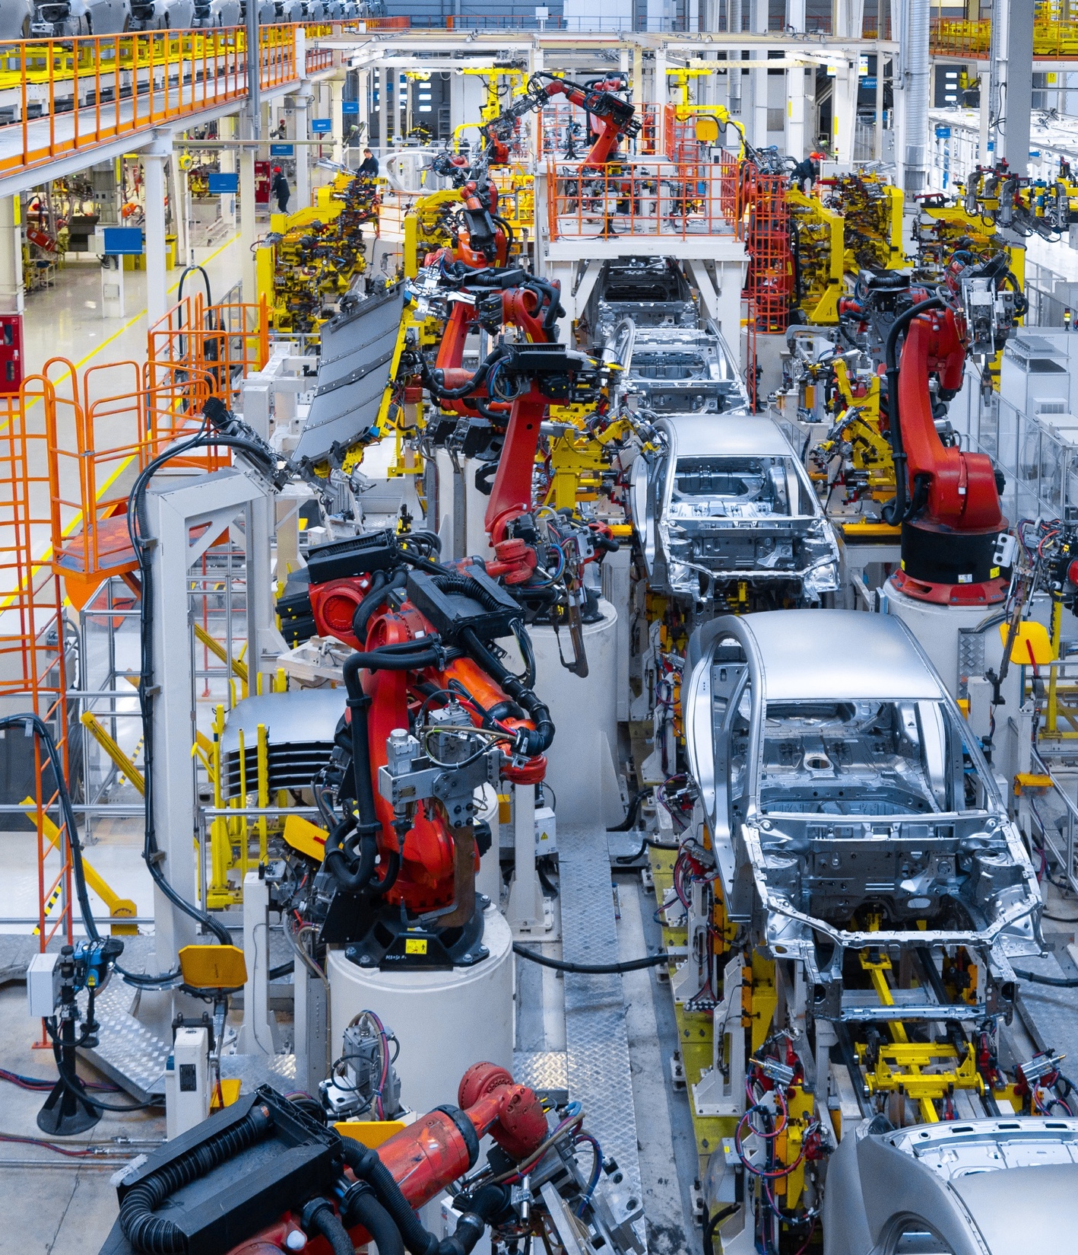

TAILORED LOGISTICS FOR THE AUTOMOTIVE INDUSTRY
The automotive industry’s complex supply systems present a particular challenge and require expertise in information design, process planning and operations efficiency.
AUTOMOTIVE
36

Slide 4


UNLEASHING
THE POWER
OF EFFICIENCY
Our services deliver quality solutions with the best practice-value mix and with the flexibility demanded by the world’s leading automobile manufacturers. Our dedicated automotive specialists combine deep industry knowledge with hands-on experience in supply chain management, implementation, and execution.
Fracht works closely with your teams to design flexible, customized solutions that align with your production schedules and performance goals.
AUTOMOTIVE
37

